Slide 1
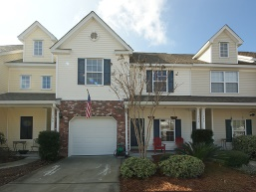
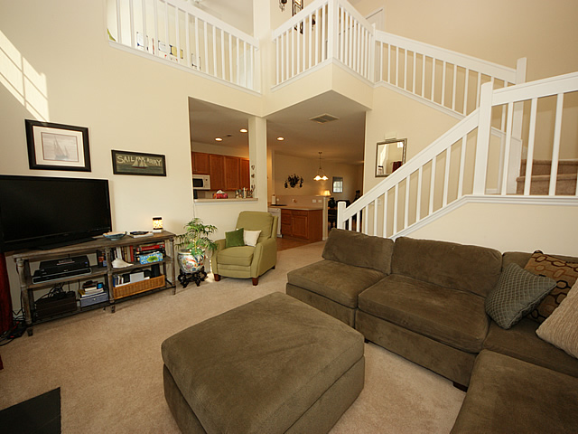
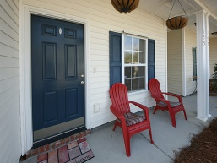
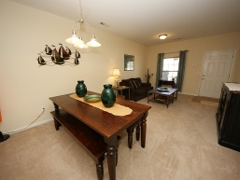
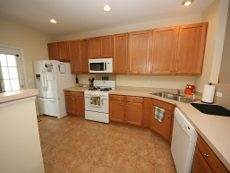
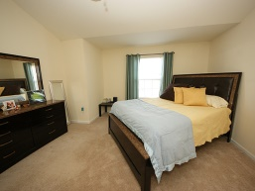
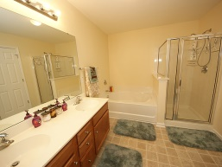
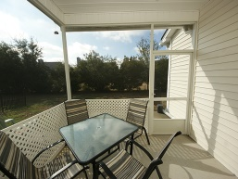
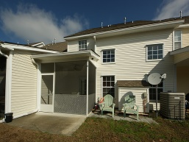

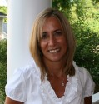
$500 Agent bonus & $500 Closing Costs
155 Dorothy Drive
Grand Oaks Plantation | Charleston, SC 29414 | MLS# 15001626 | $187,900
This delightful, well-cared for 2 bedrooms with loft town-home, located in the desirable Grand Oaks Plantation, is ready to welcome you home! **** MOVE-IN READY ***** LOW MAINTENANCE **** SPACIOUS, OPEN CONCEPT FLOOR PLAN **** Welcoming living/dining room combination with 9ft smooth ceilings greets you in to the home and then leads you towards the large kitchen which offers plenty of cabinet and counter space and is equipped with a gas stove and ceramic tiled floors. The kitchen then leads you out back to a nicely sized screened in porch with ceiling fan where there is plenty of outside space to entertain, grill out and relax. Adjacent to the kitchen you will find a separate great room; perfect for entertaining, features a gas fireplace with logs and 2-story cathedral ceiling offering an abundance of light. Follow the stairs up to the second floor where you will find a nicely sized owner's suite with dual sink vanity, separate shower and garden tub and large walk-in closet. You will also find an additional bedroom, full hall bathroom, laundry area and a Loft with closet which is multi functional (home office/gym/nursery/playroom) and can easily be converted to a 3rd bedroom if desired. Home offers plenty of additional storage space in the garage, attic and under stairway closet space. Enjoy the neighborhood pool right around the corner along with neighborhood access to the Bees Ferry Recreational Center, Dog Park and numerous walking paths throughout this wonderful community. Grand Oaks Plantation is conveniently located within close proximity to historic Charleston, the Charleston International Airport, I-526, shopping, restaurants and much more. MOTIVATED SELLER! $500 closing cost assistance with acceptable offer. Come and take a look at everything this home has to offer before it goes! And, on this house get 0.5% of your loan amount off closing fees with preferred lender!. Call me to find out how!
Desiree Maurer
Office - (843) 416-2000
Mobile - (843) 327-9010
desiree.maurer1@gmail.com
www.yourcharlestonhousesearch.com
Keller Williams Realty
496 Bramson Ct Ste 200
Mt. Pleasant, SC 29464

