Slide 1
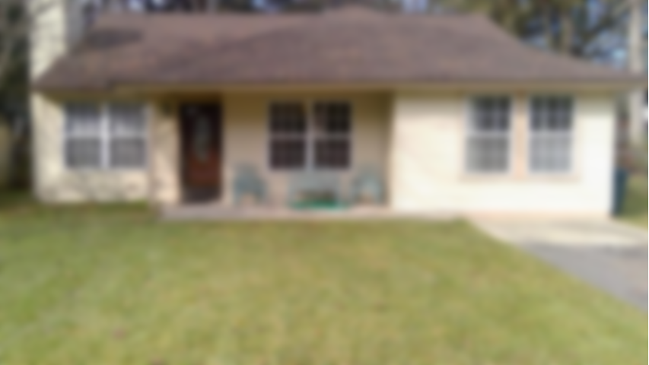
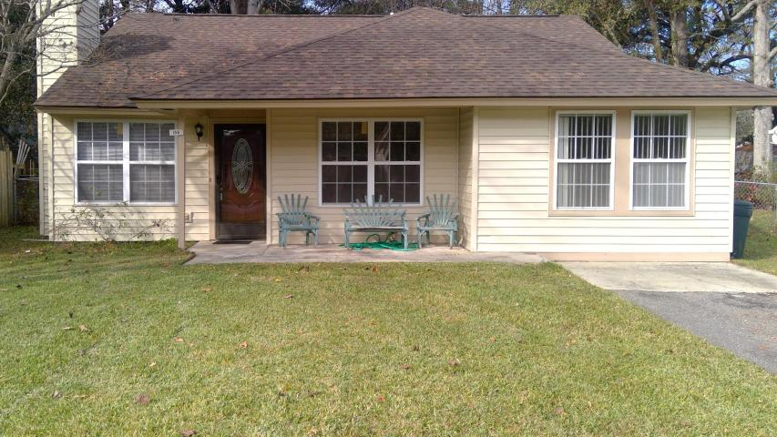
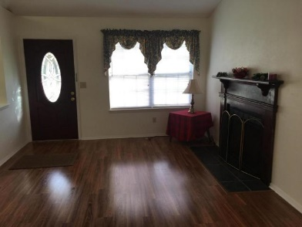
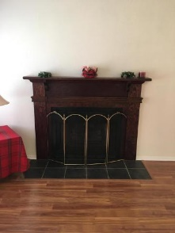
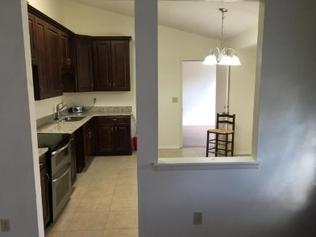
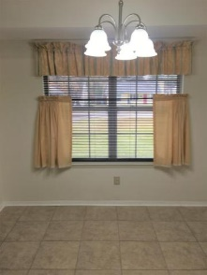
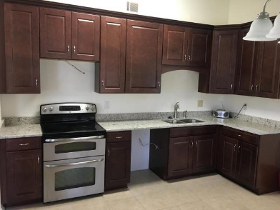
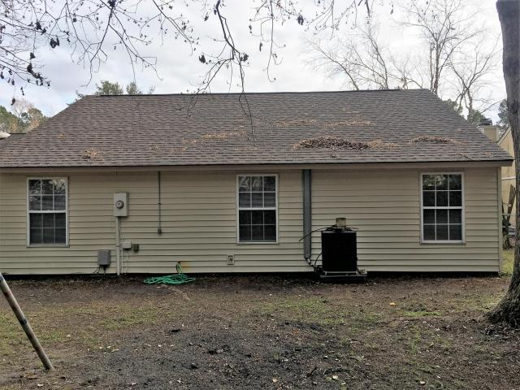


155 Mickler Drive Moss Point · Ladson · MLS# 17032958 · $146,400
Gorgeous Cozy Home. Ready Now! NO HOA!
Come see this Lovely 3 Bedroom one bath home. This home has been updated very nicely. You will love the Gorgeous Kitchen Cabinetry and New Granite Counter-Tops. Updates include a New Roof & (1yr Old)HVAC. New Flooring(Tile in the Kitchen, Beautiful Laminate in Living room, Den and hallways, Carpet in the bedrooms).Spacious Updated Bath with new tile floors and fixtures. Nice size backyard. The home is conveniently located, and in the Dorchester 2 School District. Nearby are many restaurants, Lowes food store, Publix, Walmart Market, ALDI foods, a Movie Theater, and Summerville Hospital Med Center. You are minutes away from Palmetto Commerce Park companies and employers; Boeing, Joint Base Charleston, Charleston International Airport. Seller to pay up to $3,000 in buyer closing costs.
James Hopkins
(843) 708-5930
James.Hopkins@AgentOwnedRealty.com
AgentOwned Premiere Group | 1800 Trolley Rd | Summerville, SC 29485

