Slide 1
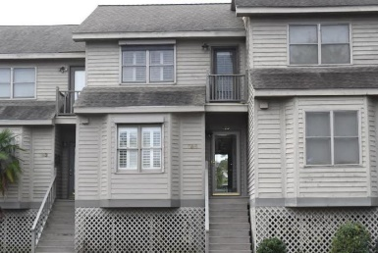
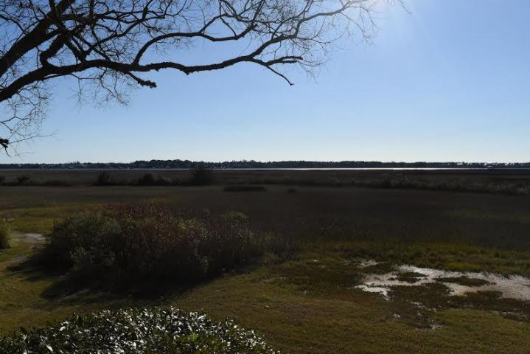
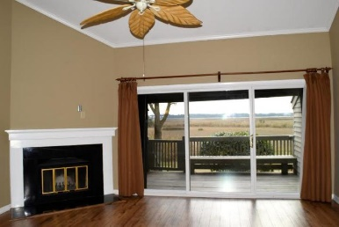
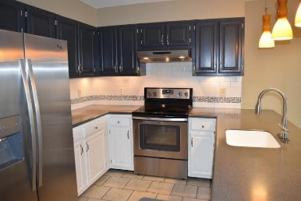
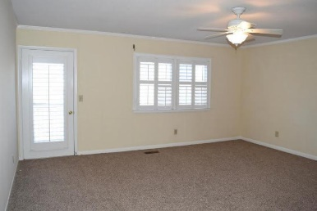
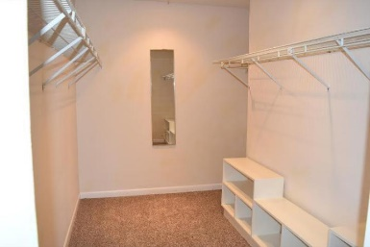
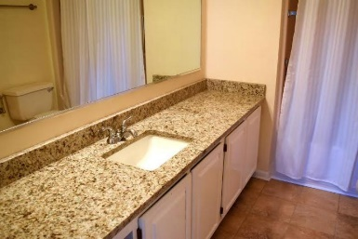
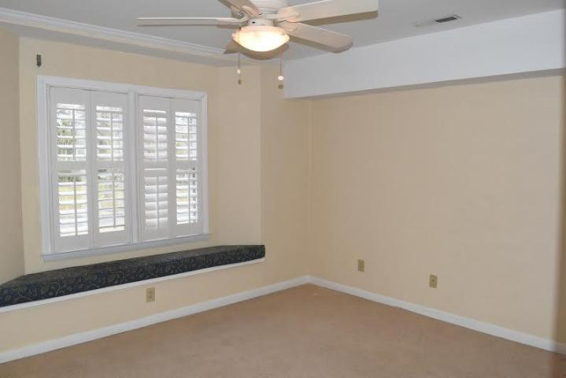
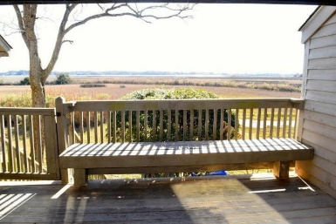
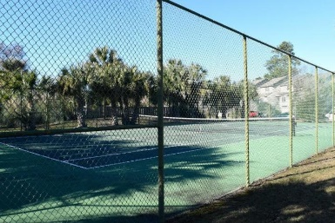



155 River Breeze Drive Waterway South ~ Charleston, SC 29407 MLS# 16001820 ~ $221,900
The living is easy in this impressive, generously appointed home with an open floorplan that provides for amazing views and breathtaking sunsets over the Intracoastal Waterway from your private deck and great room. The main floor has beautiful new laminate flooring, a cozy fireplace, a new sliding glass door to the deck, and elevated ceilings that have been freshly smoothed. The recently renovated kitchen flows into the great room and has Corian countertops, new stainless appliances, and a beautiful glass tile backsplash. The floorplan includes two spacious bedrooms…both with Plantation Shutters and plenty of room for sleep and storage. The Master Bedroom Suite has new carpet, a large walk-in closet and new granite in the bath. While the home is located close to dining, shopping and beaches, this home it is tucked away in Waterway South, a very quiet private community. The neighborhood includes a pool, tennis courts, and club house. Monthly regime fees include exterior maintenance, lawn care, trash removal and flood insurance. The regime is well into the project of installing new Cement Siding on all of the buildings.
$500 Agent Bonus with ratified contract by 5/31/16
Cheryll Woods-Flowers
ABR, e-Certified, SHS
(843) 442-2219
www.woodsflowers.com

