Slide 1

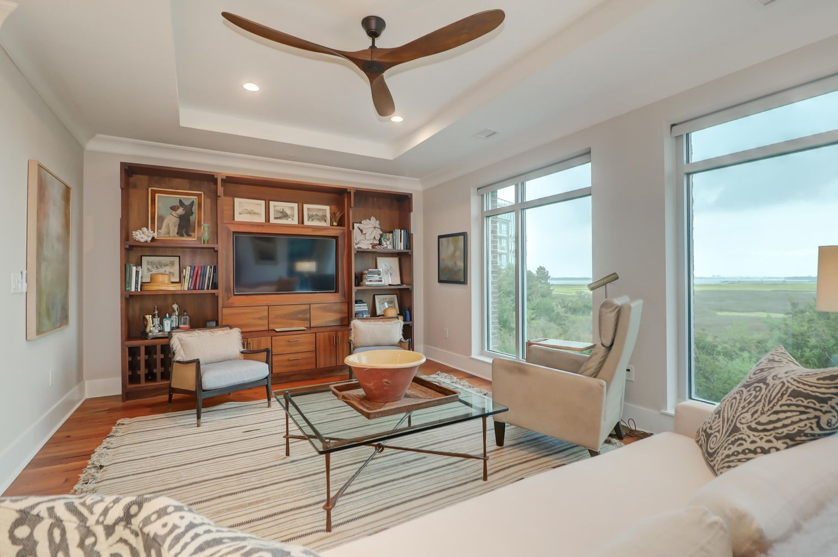
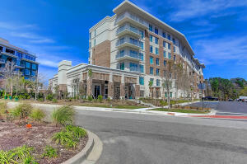
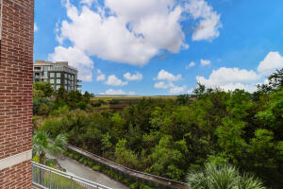



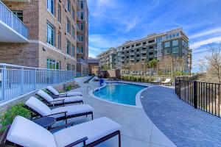


155 Wingo Way #427
Tides IV Condominiums | Mount Pleasant, SC 29464
MLS# 21027276 | $1,375,000
Beautiful Views
of the Wando River!
Fantastic Rental Property
White Glove Living in the heart of Mt. Pleasant--it doesn't get any better than this! Developed by EastWest Developers, Tides IV is unique to the area and offers Consierge Level Service, Owner 's Retreat, Gym, Pool, and Fire Pit, ALL within five minutes of downtown Charleston, WholeFoods, and major shopping areas. This two bedroom condo has spectacular views of the marsh and Wando River and immediate access to bike and walking paths leading to Waterfront Park. In perfect move-in condition, owners have added quartz countertops, repainted with Farrow and Ball, and upgraded most of the hardware, fixtures, lighting, toilets, and closets. Quarterly regime fee includes insurance, water, internet, cable, and gas (cooktop and Rinnai water heater). With only 53 units in the building, Tides IV is a tight knit, friendly community. Covered parking for one car is available in the garage with plenty of overflow parking immediately outside the building. There is also additional storage for owners in the garage. Pampered, secure living at its best--come take a peek; you will not be disappointed!
Ann Cortes
Office - (843) 886-8110
Mobile - (843) 324-6808
ann.cortes@carolinaone.com
Carolina One Real Estate | 1503 Palm Blvd | Isle of Palms, SC 29451-2280

