Slide 1
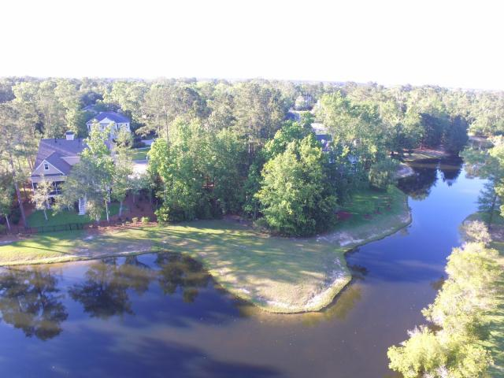
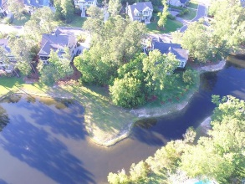
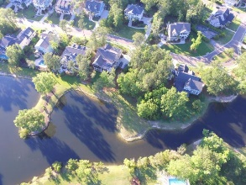
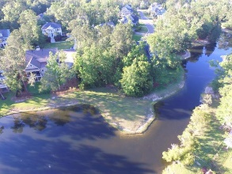
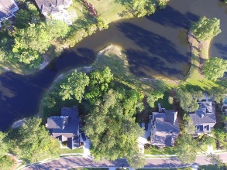
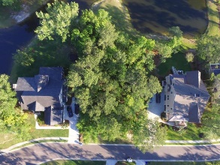


1560 Capel Street
Park West ~ Mount Pleasant, SC 29466
MLS# 17017709 ~ $239,900
Custom Build Your Dream Home with a Pond View!
Brand New
Construction
Beautiful pond homesite located in popular Masonborough!
This is one of the largest homesites in the neighborhood…perfect for building your dream home! Enjoy the quiet evenings and the lowcountry wildlife overlooking the pond. Take advantage of Park West amenities including swim/tennis, jogging trails, play park and clubhouse. Enjoy the convenience of shopping and dining in your neighborhood!
Maria Woodul, ABR, CRS, SFR
Broker Associate
843.297.1836
MWoodul@carolinaone.com
www.MariaWoodul.com
Carolina One Real Estate
2713 Highway 17 North
Mt. Pleasant, SC 29466

