Slide 1
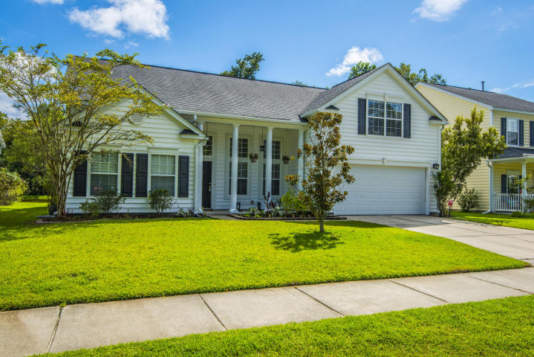
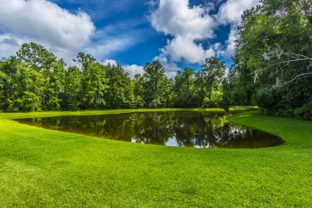
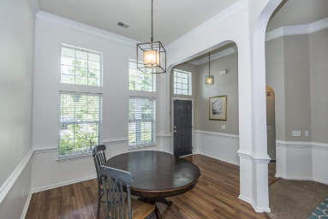
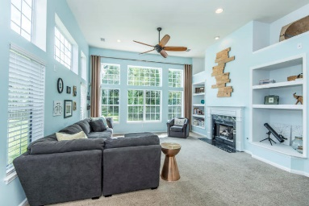
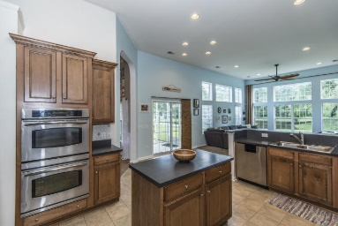
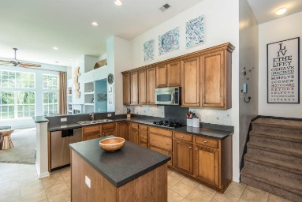
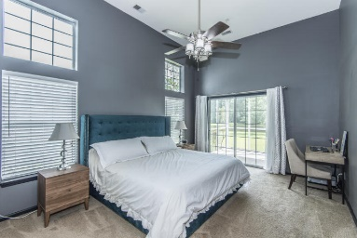
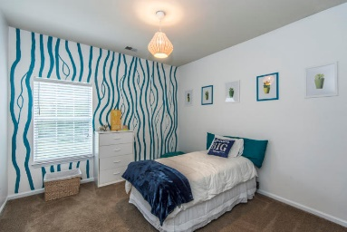
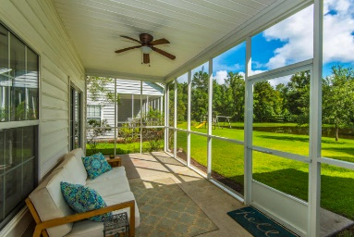
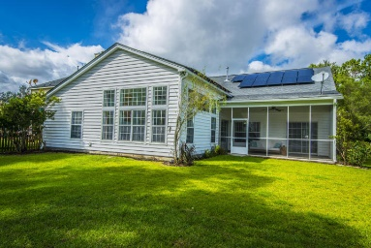


Open House Saturday & Sunday 2-4
1561 Ashley Gardens Boulevard
Grand Oaks Plantation ~ Charleston
MLS# 17022658 ~ $322,900
Gorgeous August floor plan in West Ashley's Grand Oaks. This 3 bedroom 2 bath home sits on a premier pond lot. With soaring 12' ceilings this home is full of natural light. Wood floors in foyer and dining room. Gas fireplace. Chef's kitchen boasts 42'' upgraded cabinets, gas cooktop, double ovens, stainless appliances and refrigerator conveys. Master suite is spacious with 12' ceilings, sliding glass door and ceiling fan. Master bath has water closet, dual vanity, separate tub and shower and large walk in closet. 2 additional bedrooms on the other side of house both with walk in closets. Bonus room upstairs with built ins. Pre-wired for speakers in great room, master and porch. PLUS... Solar panels produce 60% of electricity used in home. Installed by Homestar Solar Solutions in 12/2016. The panels are owned, not leased AND installed on the rear of home so not seen from front of house.
Jennifer Frampton Pait
843-568-9509
jenniferfp@carolinaone.com

