Slide 1
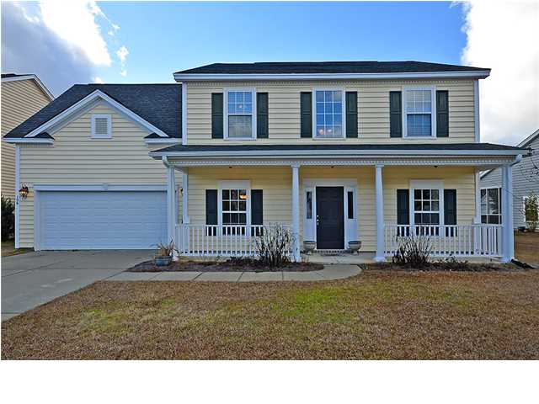
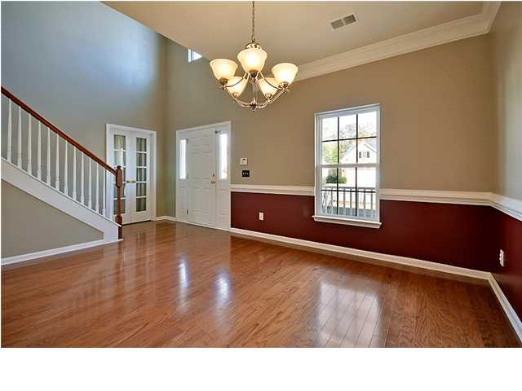
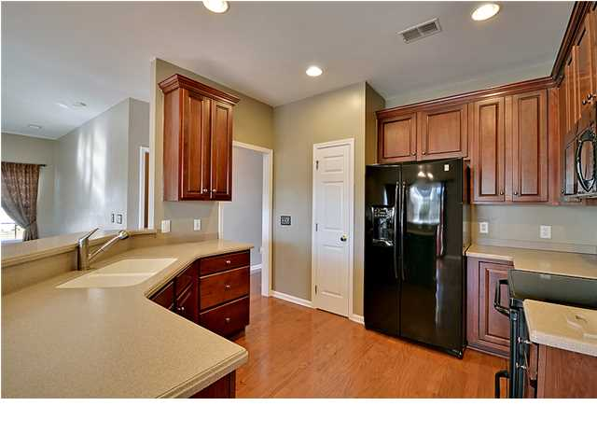
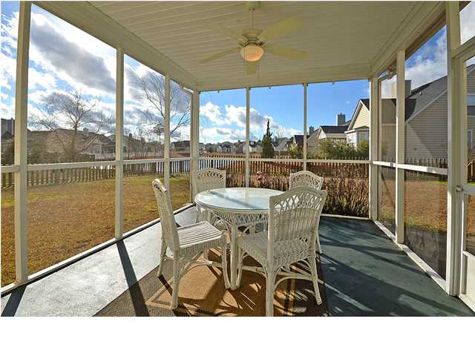
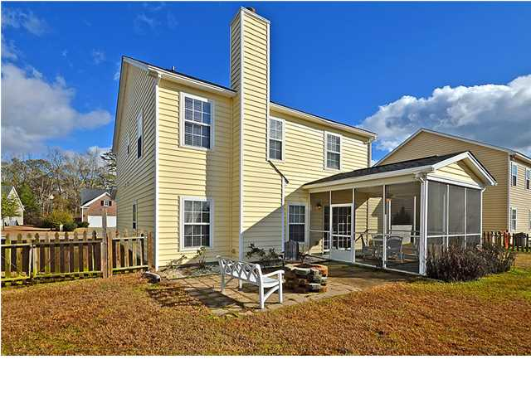


MAGNIFICENT AND STYLISH!!
156 Back Tee Cir
Legend Oaks Plantation
Summerville
MLS# 1401805
$232,500
This Traditional two story home is situated on a quiet golf course community street and is surrounded by a large, private fenced yard and offers gorgeous pond views.
This Remarkable home has 3 large bedrooms upstairs including the spacious master bedroom and the priceless master bathroom with a large garden tub and a separate shower. The large upstairs Bonus room can be a 4th bedroom or large office/playroom. The Stunning first floor with beautiful wood floors, 9+ foot smooth ceilings offers an authentic formal dining with distinctive crown and chair rail molding, a stylish family room with a cozy fireplace, a modern kitchen with crafted wood cabinets, upgraded built-in appliances, a sunny and bright breakfast area and private door to the valuable screened-in porch and the oversized patio for outside enjoyment.
This magnificent home is priced for a quick sale. Owners have agreed to $650.00 painting allowance with acceptable offer. See attachment. Opportunity knocks! Age, sqft, taxes, acreage, HOA dues/fees and schools are approx. buyer to verify.
Bill Everett, Jr
Broker
Office 843-767-7777
Direct 843-693-8539
Fax 843-576-5352
RE/MAX Pro Realty, 9209 University Blvd, Charleston, SC 29406

