Slide 1
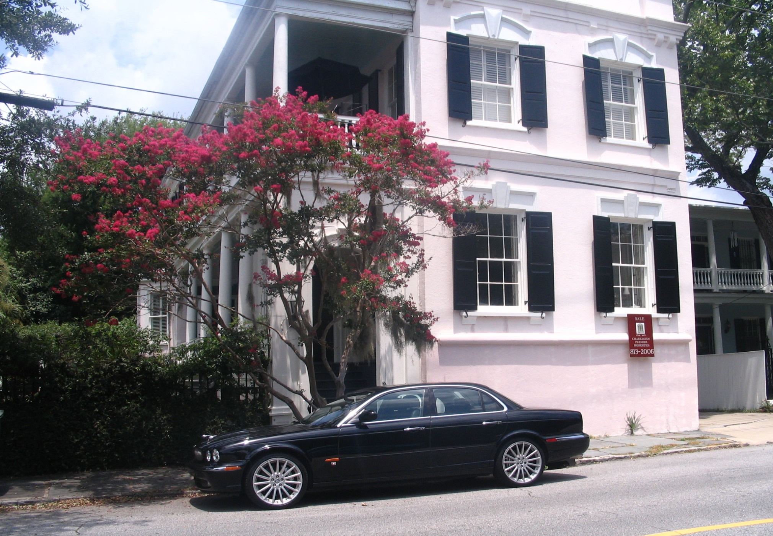
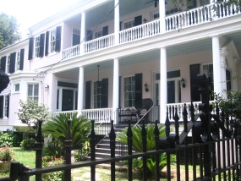
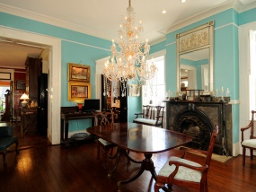
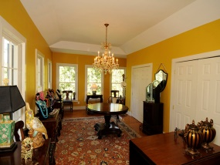
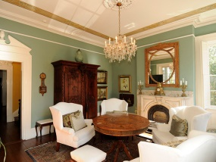
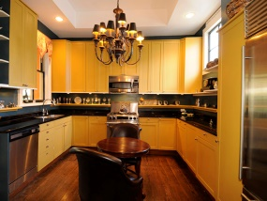
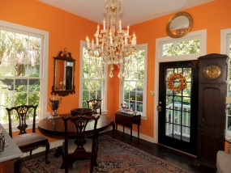
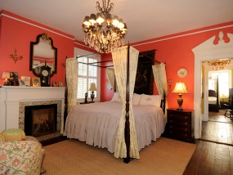
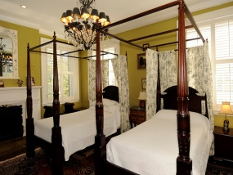
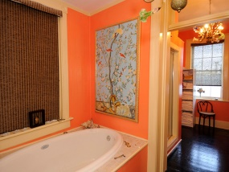
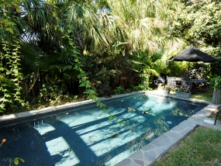
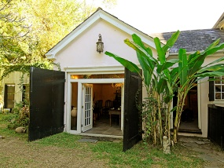


Historic Grand Mansion nearColonial Lake
156 Wentworth St ~ MLS# 1419789
Welcome to the James Sanders House, built in 1845.
This elegant home has been restored with all the modern day conveniences and is situated on a deep wide lot containing a rose-covered pergola with slate flooring around a new saltwater endless swimming pool. In grand Charleston style, the masonry house retains many original features such as plaster moldings, heartpine floors, lead glass windows and marble fireplaces and is a great family home with 4 ample bedrooms or a palace for a collector of art and antiquities. The original carriage house has been updated and serves as a poolside dining room. This home is pure joy with light filled rooms. Work at home in the spacious 2nd floor office and sitting room with its own outside entrance! The James Sanders Home has hosted several grand parties for Spoleto USA and chamber music events.
Handsome Properties, Inc 53 Broad St Charleston, SC 29401
Ellen Murray
843 813-2006
chaspremierprop@bellsouth.net

