Slide 1
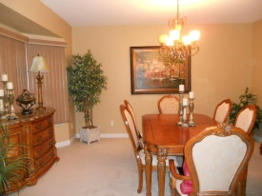
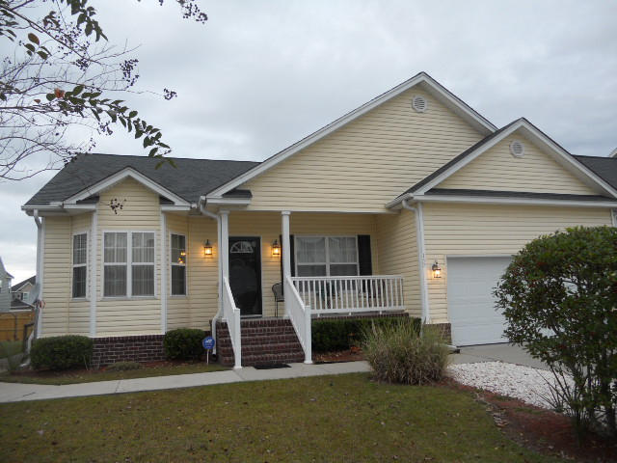
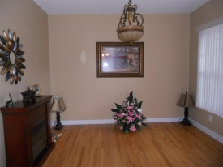
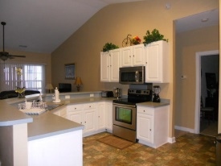
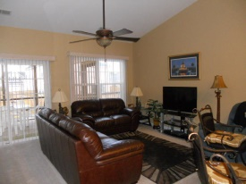
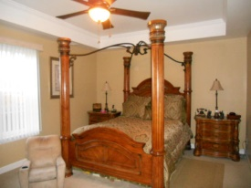
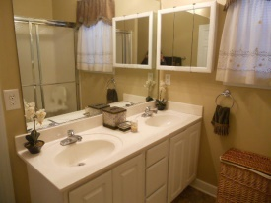

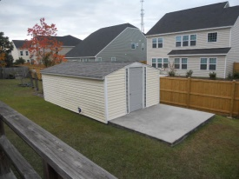

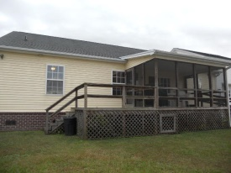
New on the market!
157 Antebellum Way
Southern Magnolia
Summerville, SC 29483
MLS# 14029267 | $180,000
4 Bed / 2 Bath
Beautiful, well maintained one story, 4 bedroom home.
This home features a formal living room, dining room and open kitchen over looking the family room.
Screened porch and deck open to a spacious, partially fenced in back yard.
12x24 work shop with 220 power built to match the house will convey with sell.
Connie White, Broker
C: 843-532-3356
conniesyouragent@gmail.com
Charleston Homes
111 Spring Hall Dr
Goose Creek, SC 29445

