Slide 1
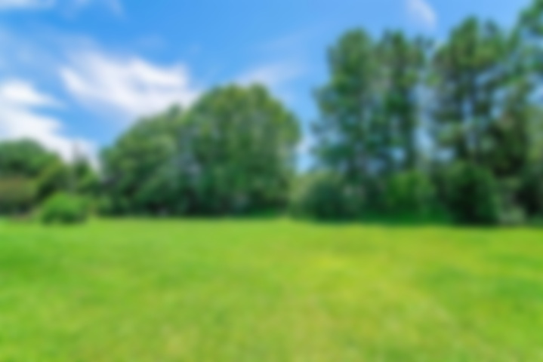
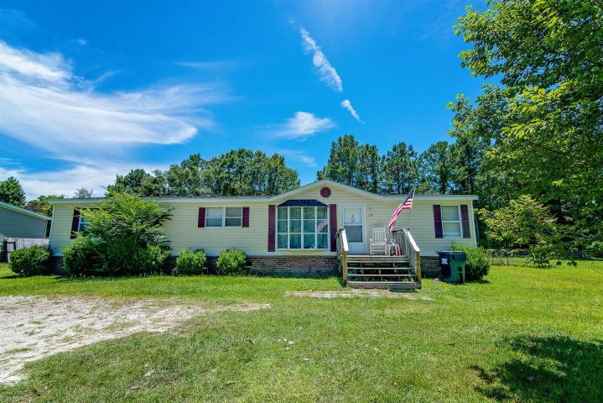
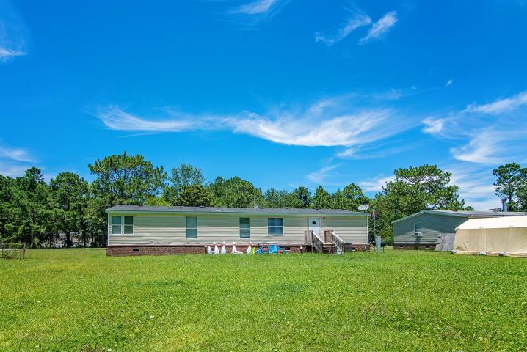
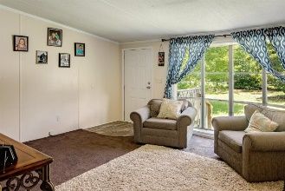
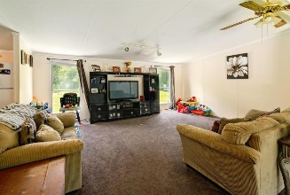
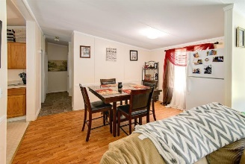
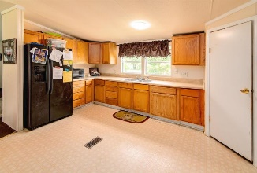
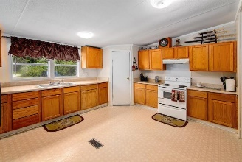
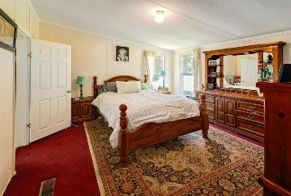
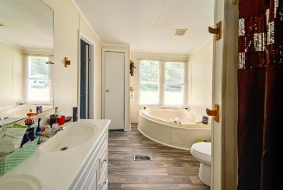
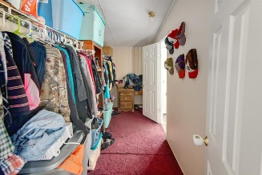
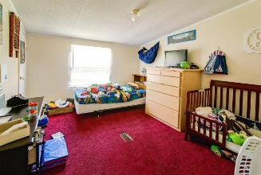
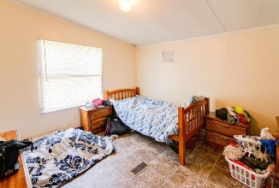


157 Hammock Street
Clemson Terrace ~ Summerville ~ MLS# 18019454 ~ $142,500
Just Listed In Clemson Terrace!
1680sq.Ft. 3 Bed 2 Bath On 1/2 Acre
This single-story home is nestled on a large, .50 lot with mature landscaping in Clemson Terrace. Inside, the inviting floor plan is complimented by vaulted ceilings, decorative crown moldings, and a large picture window. The eat-in kitchen boasts a large pantry, ample cabinet and counter space, and two refrigerators to convey with an acceptable offer and as part of the sales contract. The master suite features a large walk-in closet and en-suite with a garden tub. Roof replaced about 3 years ago, water heater barely a year old, flooring replaced a year ago. It is located in the DD2 school district. Clemson Terrace is conveniently located near shopping, dining, and Historic Downtown Summerville. Come see your new home today!
Asking $1,200,000
MLS# 17023051
3,692 SqFt
4 Bed/3½ Baths
Short Drive to Historic Downtown Charleston & Beaches
Jacqui Swain
(843) 295-9484
jacquiswainc21@gmail.com
www.JacquiSwain.c21.com
Century 21 Expert Advisors • 100 Seven Oaks Lane • Summerville, SC 29485

