Slide 1
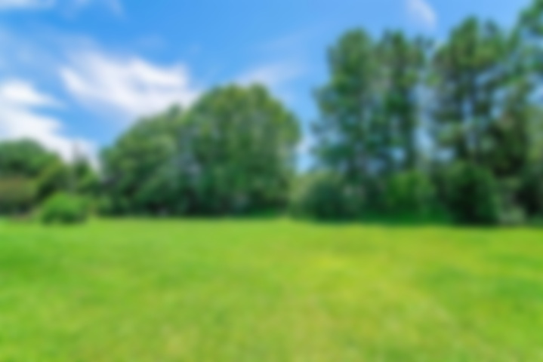
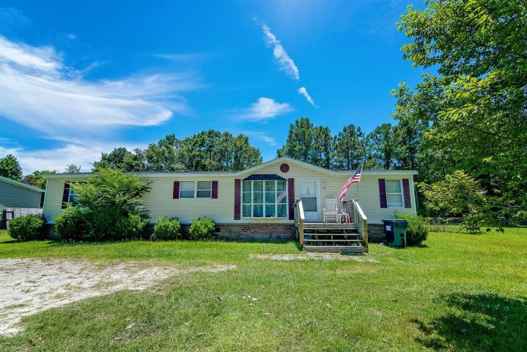
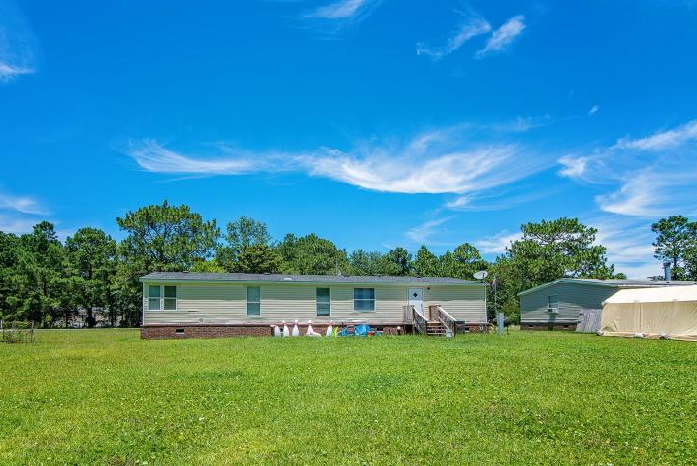
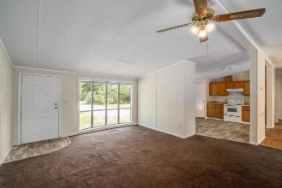
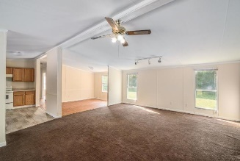
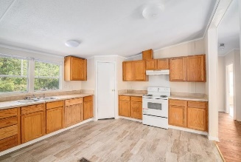
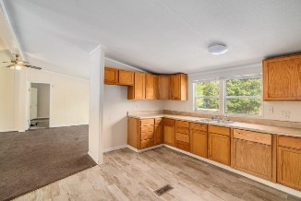
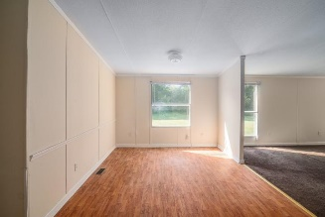
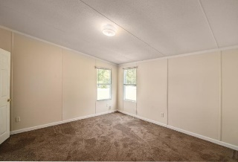
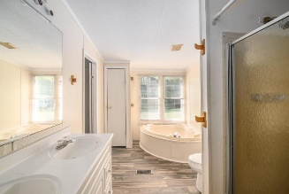
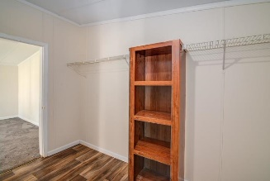
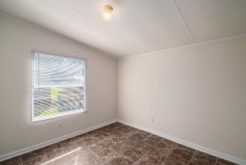
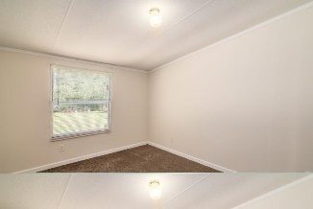


157 Hammock Street
Clemson Terrace ~ Summerville ~ MLS# 18019454 ~ $139,900
New Price + New Carpet and Paint!
1680sq.ft on 1/2 acre lot!
This freshly painted single-story home is nestled on a large, .50 lot with mature landscaping in Clemson Terrace. Inside, the inviting floor plan is complimented by vaulted ceilings, decorative crown moldings, and a large picture window. The eat-in kitchen boasts a large pantry, ample cabinet and counter space. The master suite features a large walk-in closet and en-suite with a garden tub. Roof replaced about 3 years ago, water heater barely a year old, much of the flooring replaced September 2018. It is located in the DD2 school district. Clemson Terrace is conveniently located near shopping, dining, and Historic Downtown Summerville.
Come see your new home today!
Asking $1,200,000
MLS# 17023051
3,692 SqFt
4 Bed/3½ Baths
Short Drive to Historic Downtown Charleston & Beaches
Jacqui Swain
(843) 295-9484
jacquiswainc21@gmail.com
www.JacquiSwain.c21.com
Century 21 Expert Advisors • 100 Seven Oaks Lane • Summerville, SC 29485

