Slide 1
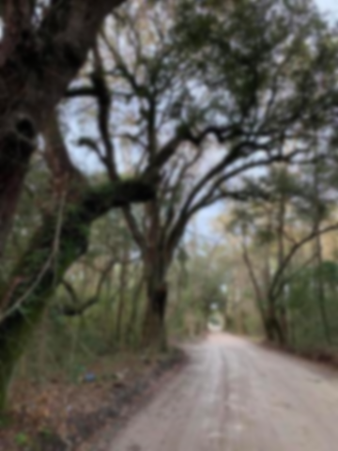
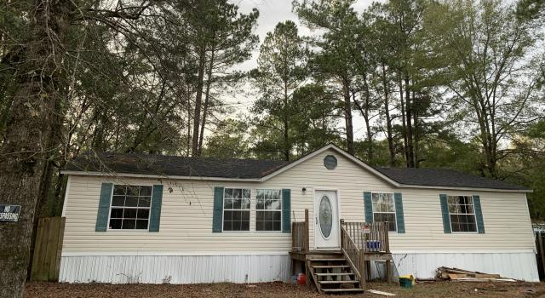
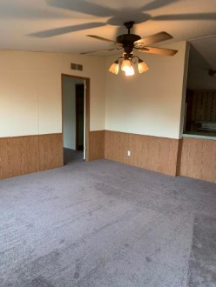
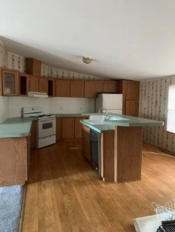
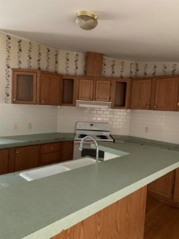
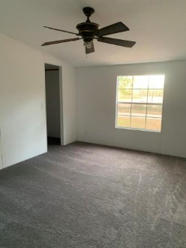
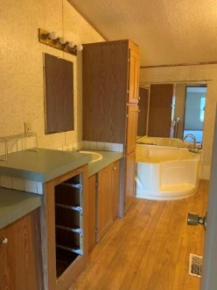
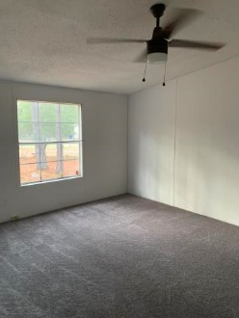



Huge Yard & No HOA!
157 Shady Lane
Summerville, SC 29485 | MLS# 20001013 | $125,000
This home is being sold in "as is" condition. Owner has done quite a bit of work. New carpet, new sheetrock, new windows across the front & new paint. A/C is not working. The inside looks nice & rooms are spacious.
BJ Rodgers
843-697-1409 | bjrodgerscharleston@gmail.com
www.bjrodgersrealtor.com
EXP Realty LLC | 170 Meeting Street Ste 304 | Charleston, SC 29401

