Slide 1
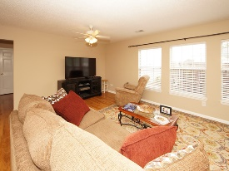
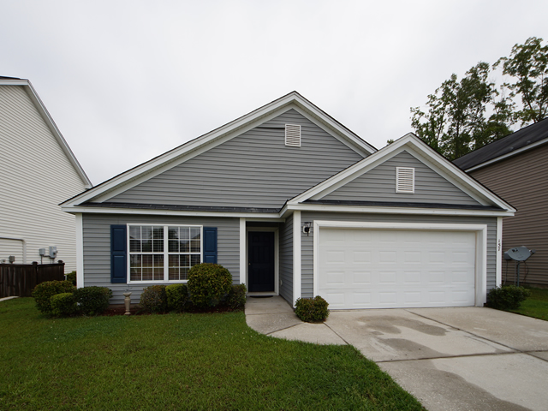
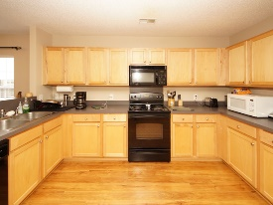
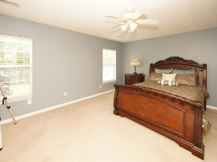
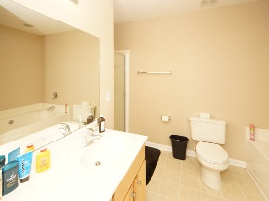
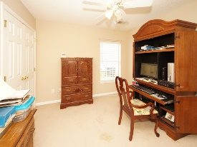
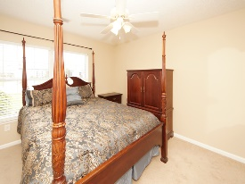
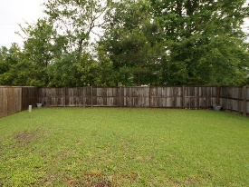


Wonderful New Home!
157 Thistle Road
Longleaf
Goose Creek, SC 29445
Open House Canceled!
Under Contract In 3 Days!
MLS# 17011739 | $175,000
3 Bed / 2 Bath
Neat and Clean!
This cute 3 bedroom 2 bath home has been well maintained and is ready for a new owner. Open floor plan, large kitchen, wood flooring, professional painting, fenced back yard and convenient location make this home desirable for any home owner. AC was replaced in 2013.
We are priced to sell!
Connie White, Broker
C: 843-532-3356
conniesyouragent@gmail.com
Charleston Homes
597 Old Mt. Holly Road
Suite 301
Goose Creek, SC 29445

