Slide 1
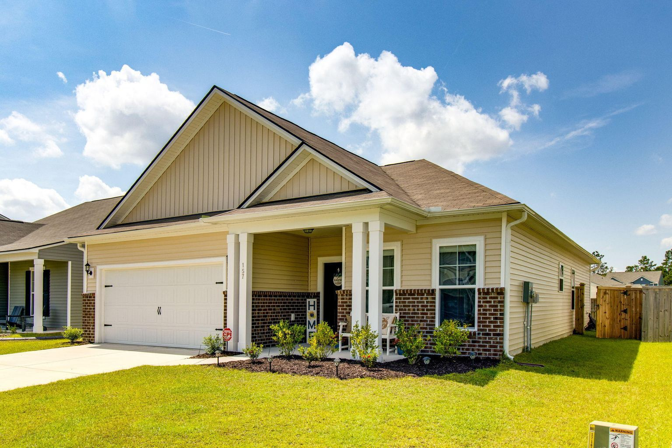
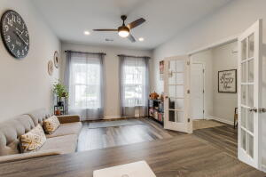
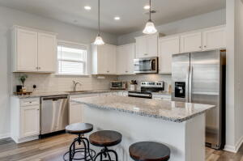
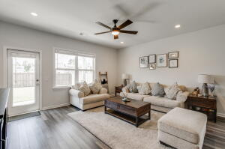
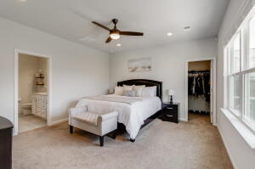
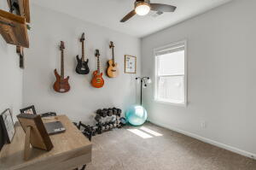
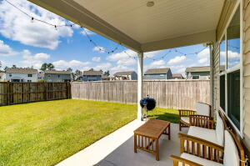
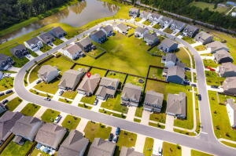


157 Hayworth Road
Nexton | Summerville, SC 29486 | MLS# 22024209 | $389,900
JUST LISTED!
Fall in love with this move-in ready one-story beauty, in the highly desirable Nexton Bradford Pointe neighborhood. Relax on the spacious covered front porch and say hi to your neighbors. Step inside to a light-filled space with soothing colors. The flex-room with French Doors is off of the foyer and is a perfect room for an office, playroom, den or library. Laundry room and garage access is conveniently located on the left side. Step into the main hub of the home where the beautifully appointed kitchen, with a spacious island overlooks the dining/living space. The Owner's Suite is situated at the rear of the home and offers a large walk-in closet, great wall space for furniture placement, dual vanities, and a large shower with a bench seat in the bathroom. Two additional bedrooms and a full bathroom with a tub/shower combination, complete the floor plan. Step outside to the backyard to a large covered back porch and extra patio space, perfect for grilling and outdoor dining. Lots of room to play in the spacious, fully fenced backyard. In the warmer months enjoy the wonderful neighborhood pool, just a quick walk or golf cart ride away. Enjoy all that Nexton and Summerville have to offer from award winning restaurants to concerts, movie nights, festivals plus so much more! Close to the interstate, shopping, schools, hospitals, downtown Charleston and local beaches.
Take a virtual tour: https://my.matterport.com/show/?m=iBdMW1M2t4v
Beth Mandell
M 803-463-7734 | O 843-871-2121
bmandell@century21properties.com
www.bestcarolinahomedeals.com
Century 21 Properties Plus of Summerville | 118 W Richardson Ave | Summerville, SC 29483

