Slide 1
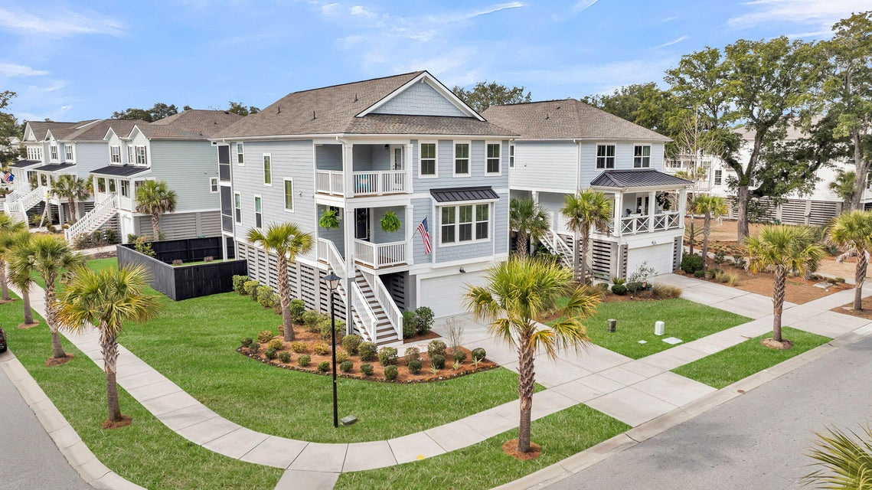
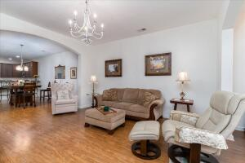
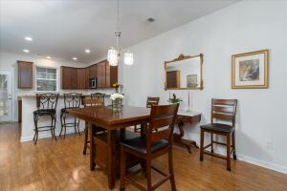
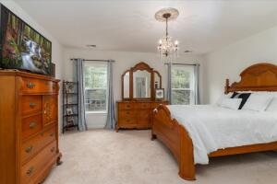
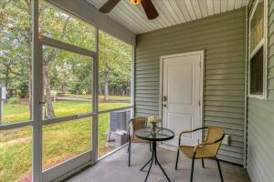
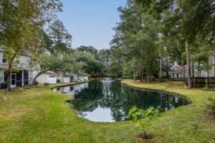
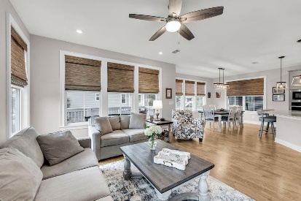
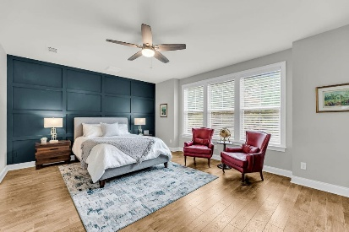
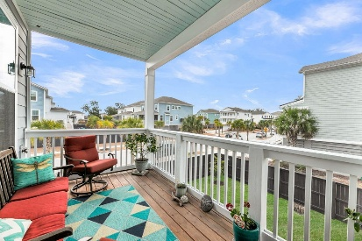
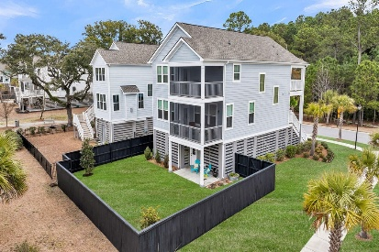


1581 CULTIVATION LANE MOUNT PLEASANT, SC 29466 | MLS# 26004798 | $1,225,000
Liberty Hill Farm - Quality Upgrades- Elevator To All Levels
Updated,Spacious 5 Bedroom On Cul-de -Sac!
Dual owner suites, elevator to all levels, garage for 3 cars with a workshop & custom upgrades throughout this very well maintained, gently lived-in home -is a must see! Situated on a coveted corner lot, with woods & trail in front & views of park in the back, enjoy coastal living in this elevated home with 4 porches near the beach, schools, new town park, shopping & dining in desirable Liberty Hill Farm. The open concept main living area offers an oversized island, gourmet kitchen & bright dining area that leads to a comfortable screened porch with view of community park. The main level also offers an owner's suite, with custom walk-in closet & oversize shower with seat. The attractive tiled risers lead you to the upstairs with 3 additional bedrooms to include another owner's suite.
Retreat to the screened porch off this generous sized suite that offers room for nursery or work area, has another custom closet, ensuite with large shower & bathroom storage (in some layouts this space is a great room/flex space). Upstairs laundry with cabinets/hang rod provides easy access from bedrooms, all 4 of which have walk-in closets. The elevator from the garage makes life easy & convenient - a beneficial upgrade valued at approx. $50k. Park 3 vehicles, golf cart & other toys in the garage & there's a workshop/storage area. Use the spacious garage for hobbies, workout area, activities & more & enjoy the fenced in yard. The operating elevator with custom interior, private fenced in yard, custom closets, double screened in porches, workshop with storage shelving, new light fixtures, kitchen & bath fixtures, add'l plantings to include a magnolia, tangelo & tulip tree are just a few of the quality features this home has to offer. Enjoy Liberty Hill Farm community amenities to include a resort-style pool, open-air pavilion, playground, community garden, and scenic walking trails. Only 1 mile to the Isle of Palm Connector & a short ride to historic downtown Charleston & all it has to offer!
Alma Certa
843-730-3356 alma@agentownedrealty.com
AgentOwned Realty Preferred Group | 824 Johnnie Dodds Blvd | Mt Pleasant, SC 29464

