Slide 1
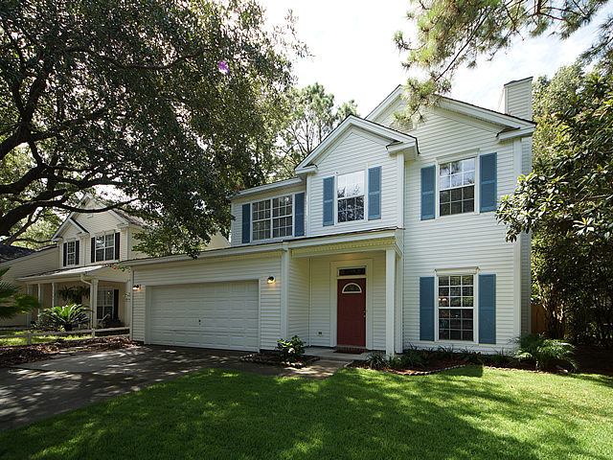

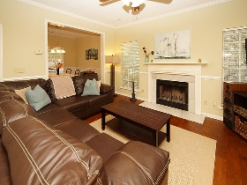
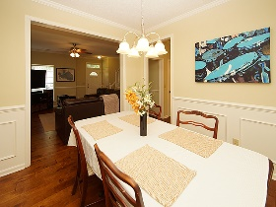
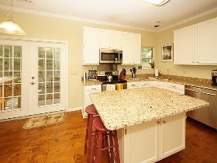
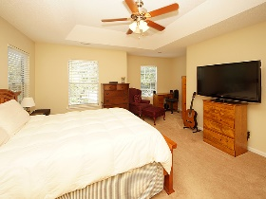
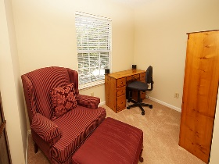
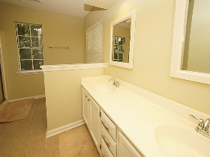
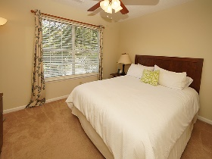
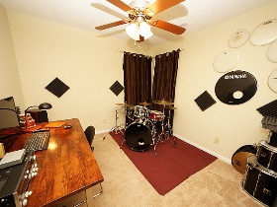
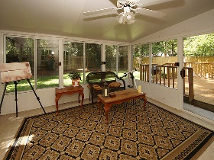
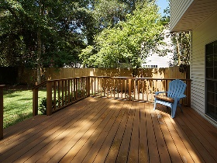
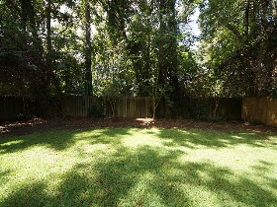
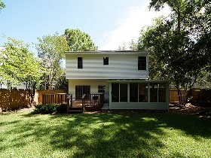



$5,000 Agent Bonus!!! James Island!! Renovated!
1582 Harborsun Drive
Wexford Sound Charleston, SC 29412
MLS# 17021317 | $345,000
3 Bedrooms :: 2½ Bath :: 1,618 sf
Move-in-ready, beautifully cared for home in Wexford Sound! This three bed, two and a half bath home was upfitted in 2014! New Architectural Shingle roof in 2014! New Stainless Steel Appliances added in 2014! New trim, wainscoting, and crown molding added in 2014! The eat-in kitchen has a massive island adorned with granite counter tops! The great room is a perfect space for the family, with a Marble Fireplace. The formal dining room could be used as a separate living space, or even an office. Off of the kitchen is a beautiful glass sun room that is not included in the square footage! Right off the sun room is a large, terrace back porch - overlooking the private, wooded back yard. The master bedroom has a large sitting area and a walk in closet with plenty of room for your clothes.
There is also a two car garage, so there is ample space for guests to park. Wexford Sound has a beautiful community pond called "Lazy Lake". Grab a fishing pole after work and head on down there! There is a community dock where you can easily launch your kayak for a morning / evening paddle trip. Right next to the pond is a shady picnic area where you can enjoy some R&R. **Sunroom could easily be converted to heated / cooled space to contribute to the square footage...TOTAL NEW SF WOULD BE 1800**. **Newly installed AT&T Fiber Optics in the subdivision for Very Fast Internet** Also, the subdivision is situated off of Secessionville Road, with an easy "back road" route to Folly Beach, and Downtown Charleston. Wexford Sound is James Island living at it's best. **MOST Furnishings are negotiable with an acceptable offer**
Eric Draper
(843) 442-7118
eric.draper@gmail.com
Jon Moore
(843) 732-3365
jon@charlestonrealestategroup.com
www.charlestonrealestategroup.com
Charleston Real Estate Group | 792 Folly Rd. C1 | Charleston, SC 29412

