Slide 1
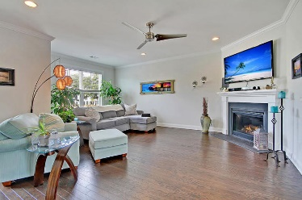
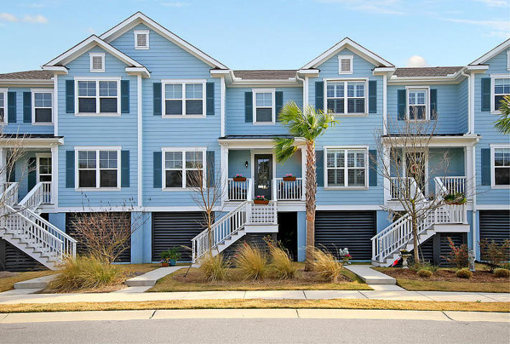
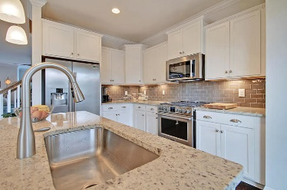
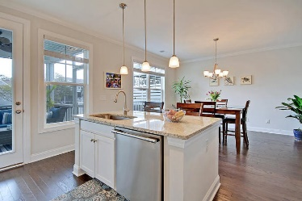
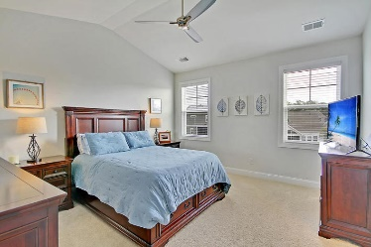
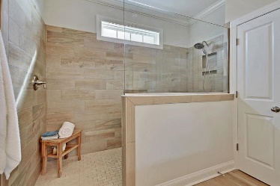
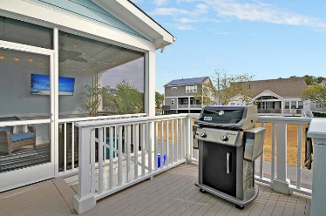
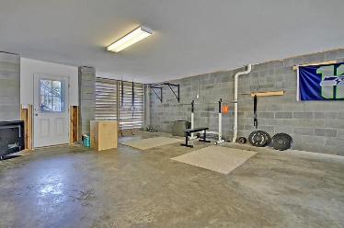
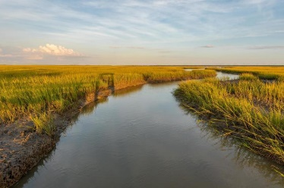

1582 Prince Edward Street Oyster Point · Mount Pleasant, SC 29466 MLS# 20004123 · $450,000
Just Listed Townhouse in Oyster Point
Gorgeous Listing
EXQUISITE 3 bedroom, 2.5 bath elevated townhouse with stunning curb appeal in Oyster Point! The charming front porch overlooks greenspace which provides a buffer for this home. Upon entering you are greeted with handsome hardwood floors, open floor plan, soaring ceilings, and an abundance of natural light. The large family room has a gas fireplace with mantle, wall of windows, room for a sectional couch and is open to the CHEF-INSPIRED GOURMET KITCHEN. The kitchen boasts granite countertops, stainless steel appliances, gas stove, eye-catching glass tiled backsplash, island with room for stools, pantry, and eat-in area. This kitchen is ideal for cooking while entertaining family and friends! Gorgeous wood tread stairs lead to the second floor with beautiful custom stairway light fixture and upgraded hardwood floor hallway. The expansive master bedroom retreat easily holds a king sized bed, has vaulted ceiling, an ENORMOUS walk-in closet and an ensuite master bath with luxurious tiled walk-in frameless glass spa shower with rain shower head, granite dual sink vanity, tiled floor and private water closet-this master bath is A MUST SEE! There are two additional generously sized bedrooms that share a full bath with granite vanity and beautiful tiled floor. There is a fantastic screen porch that was updated after closing with a sound barrier wall that is perfect for relaxing with a cool beverage and watching the egrets and herons fish in the two stocked ponds that provide serine views. Attached to the screen porch is a separate deck with stairs that lead to the backyard. The HUGE garage holds three cars, has room for all your toys: golf cart, kayaks, water boards, fishing gear, and much more. Oyster Point in Mount Pleasant is a wonderfully landscaped community with stately Live Oak Trees, play park, tennis courts, community pool, club house, dock facilities, exercise room and access to Fort Palmetto County Park! The neighborhood is close to local shopping and grocery stores and is a short drive to downtown Charleston with 5-star restaurants, world class shopping and iconic history as well as a short drive to the beaches, the airport, Boeing and Daniel Island. Come take a look because you will not find another townhouse that offers as much as this one: a chef's delight and nature's lovers dream! Call today to see!
Stan Huff
843-670-2835 stan.huff@agentowned.com
Jill Marcacci
843-297-5590 jill@agentowned.com
www.agentownedrealty.com
AgentOwned Realty Co. Preferred Group, Inc. | 824 Johnnie Dodds Blvd | Mt Pleasant, SC 29464

