Slide 1

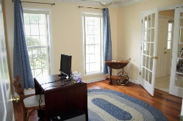
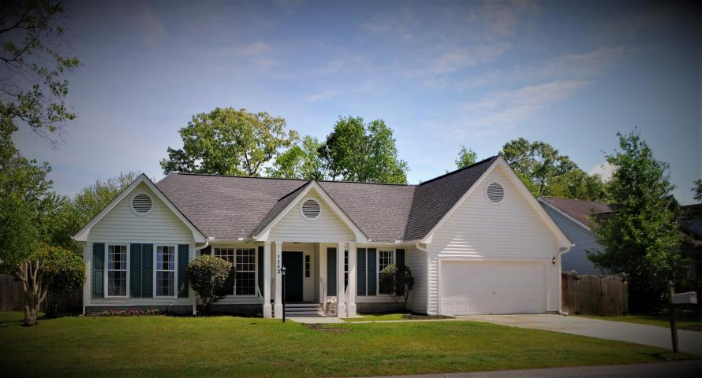
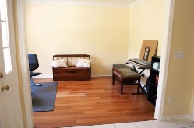
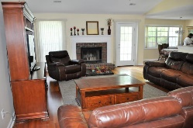
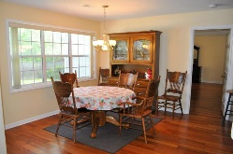
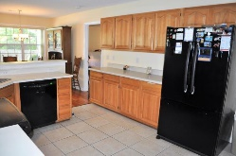
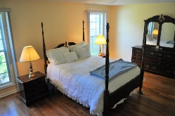
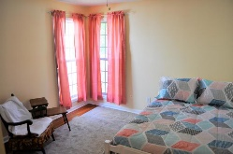
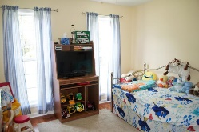
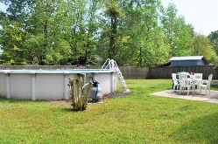
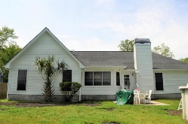


Your New Forever Home
1582 Wabeek Way
Forest Lakes Extension • Charleston, SC 29414
MLS# 19010444 • $314,900
This awesome 1 story home is open and airy, large bright rooms - Great Room w/vaulted ceilings and fireplace. Secondary bedrooms are nicely sized with ample closet space. Large hall/guest bathroom. Master is separate from other bedrooms. Nicely sized walk-in closet, bath has a garden tub and walk-in shower. Kitchen is open into a formal dining room and eating area, and pantry. Front room could be formal living room and/or office/playroom/great Flex space. 2 car garage. Backyard is fenced with above ground pool and gate. Pool can be easily taken down. Newer pump and ladder. Great neighborhood - close to West Ashley park with ball fields, trails, picnic areas, etc... Close to West Ashley HS and St. Francis/Roper hospital, shopping and easy access to I-526.
Lisa Stine, REALTOR
(843) 364-5359
lisastine61@gmail.com
Elaine Brabham and Associates, LLC • 1890 Sam Rittenberg Boulevard, Suite 217 • Charleston, SC 29407

