Slide 1
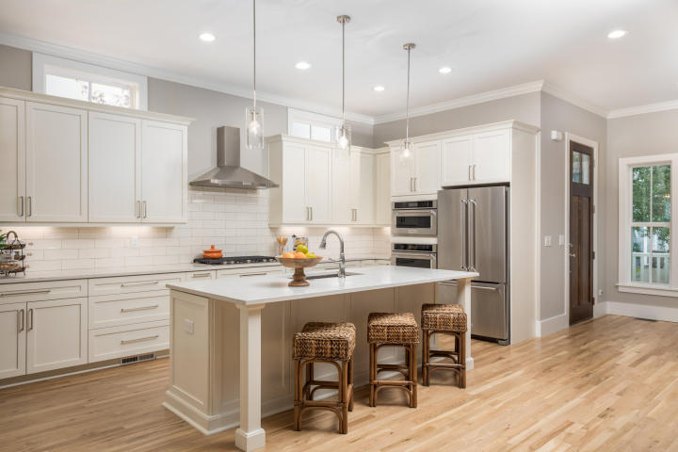
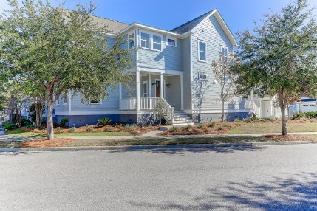
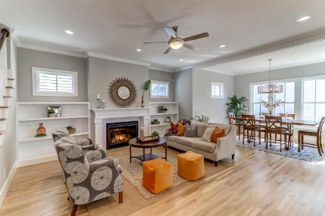
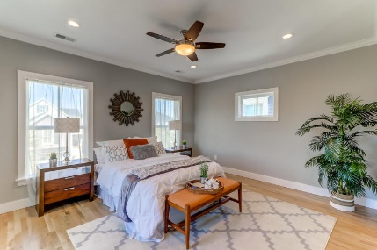
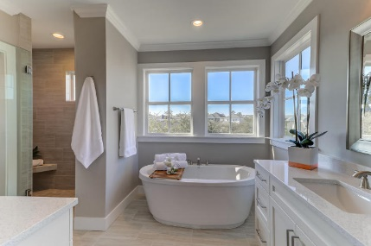


BROKER OPEN HOUSE Thursday January 18th 10am to 12pm Refreshments And Drawing For Prizes
Location! Location! Location!
5 miles to IOP and Sulllivans beaches 7 miles to historic downtown Charleston
1584 Paradise Lake Drive
Watermark Community
4 Bed 3.5 Bath | 2,910 Sq Ft | Built 2017 | Listed for $799,900 | MLS# 17030454
One of a kind custom home. Site finished white oak floors, 10' ceilings and 8" solid core doors, 9' ceiling up. Light filled open floor plan, modern kitchen with Stainless Kitchen Aid appliances, 5 burner gas stove, dishwasher, refrigerator, and wall oven and microwave. Gas fireplace with marble surround flanked by custom built-ins. Pantry and drop off/mud room with built-ins just off kitchen which leads to the back yard and detached 2 car garage. Office/study is located in the front of the home with a large closet and a full tiled bath just outside the room in the hall. Could easily be used as a guest bedroom. Upstairs you will find the master bedroom with large closet with nice built-ins, en suite features his and hers vanities, soaking tub and stunning fully tiled shower. 2 additional bedrooms, bathroom and generous sized laundry room.
The detached garage offers a fully finished living space with full bath and closet and dedicated HVAC system. The main house has 2 separate AC systems with programmable thermostats, pre-wired for surround sound and security system. Fully landscaped yard with irrigation. 1-2-10 Builder's warranty in place. Watermark boasts a 33 acre lake, winding rails along the water, play park and community pool.
Teresa Porter Realtor/Certified Negotiation Expert
(843) 300‐5822
Teresa.Porter@AgentOwnedRealty.com
www.AgentOwnedRealty.com
The AgentOwned Realty Co.
824 Johnnie Dodds Blvd.
Mt. Pleasant, SC 29464

