Slide 1
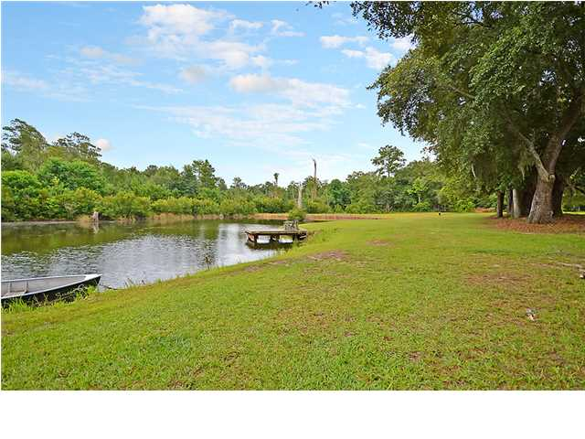
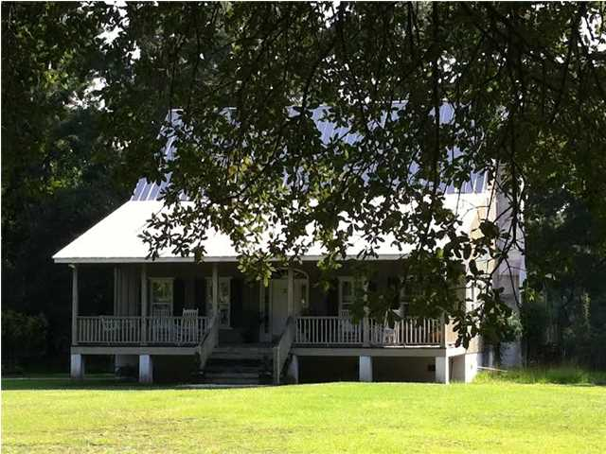
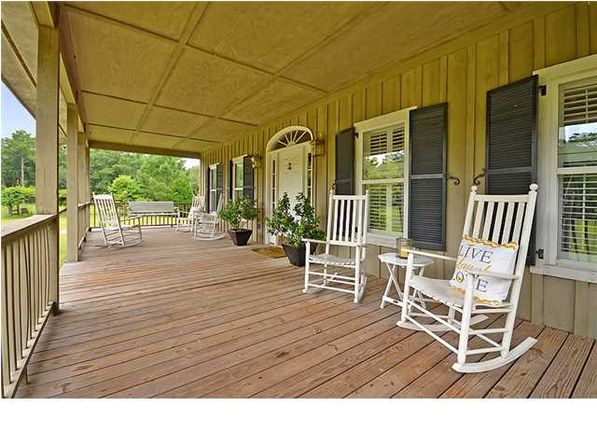
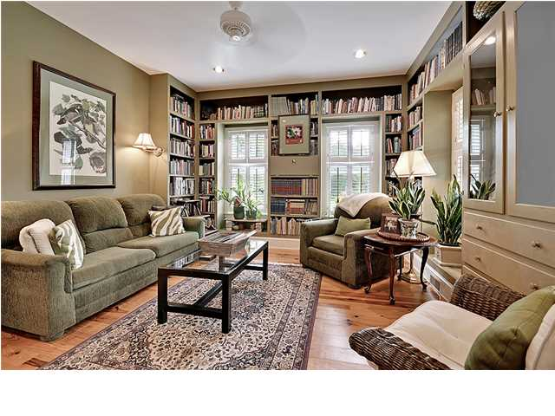
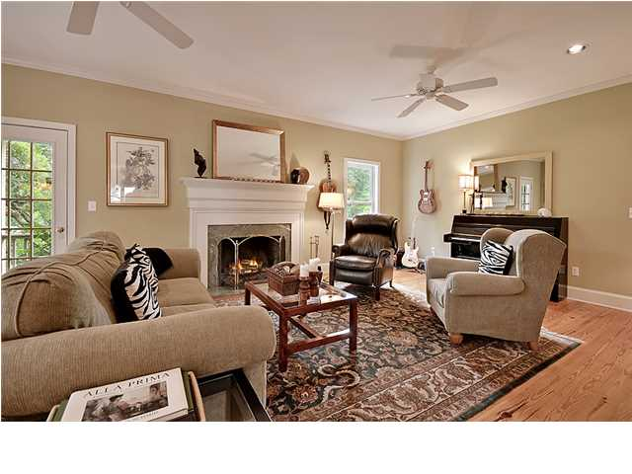
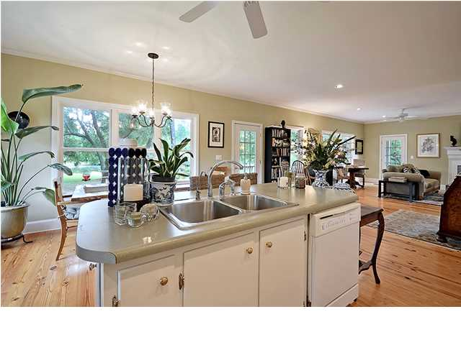
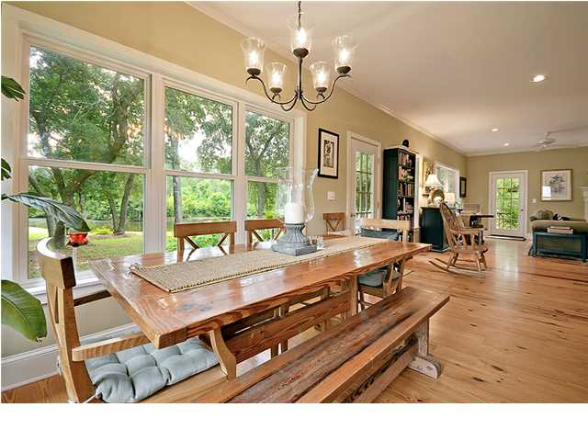
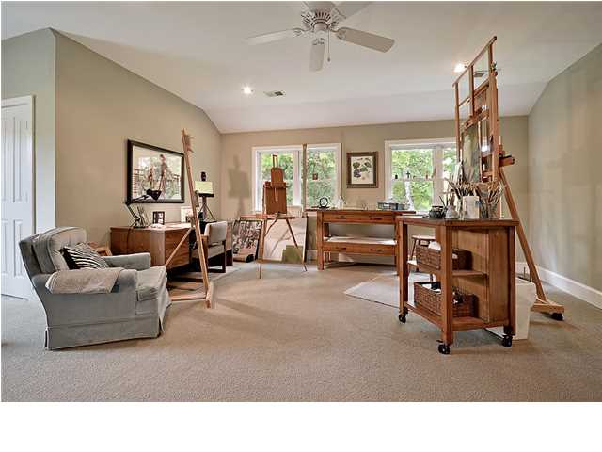
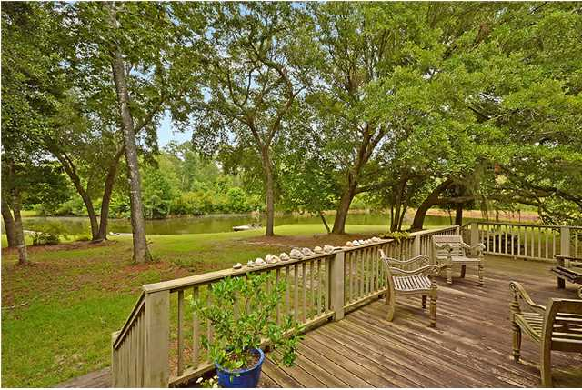
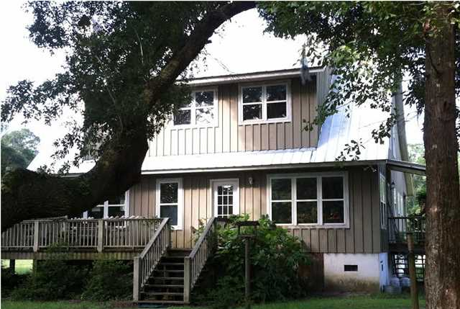

Quiet Country Retreat
Parkshore Marshfront
1586 Palmers Bridge Rd ~ McClellanville ~ MLS# 1421277 ~ $675,000
Tucked away in the Francis Marion National Forest of McClellanville, Cypress Bay presents this incredible three bedroom, two and a half home on 6.2 very private and gorgeous acres. With your very own dock on the spring fed pond, you can enjoy fishing right in your back yard. An oversized, relaxing front porch with a swing and room for many rocking chairs overlooks a fenced in pasture in the front yard that is shaded by beautiful live oaks. Built in 2005, this two story home offers 2,628 square feet of living space which includes an incredibly inviting great room with an adjacent cozy library and a warm, natural lit eat-in kitchen. Stunning hardwood floors, 9 foot high ceilings and tons of light are just a few highlights that make this open concept floor plan so appealing. The kitchen is accented by recessed lighting, has a great center island that can be used as a food prep area and the rear of the home is covered with a wall of windows to let the sun light pour in as well as provide great views of the water through lots of live oaks. The library, with its walls of built-in bookcases and plantation shutters, beckons the reader in all of us to curl up with a novel and relax. A dual master bedroom layout allows accommodations for guests or in-laws. The spacious deck in the rear of the home provides another fantastic option for outdoor living. Set up a table and chairs while you take in the tranquil views of the pond and the National Forest beyond. The detached workshop provides the perfect place to feed your passion, whether it's woodworking or other hobbies. In addition to all the great features you'll find in this gorgeous home, you'll also enjoy the energy efficient central geothermal heating and cooling system. Just minutes from historic McClellanville you'll enjoy the local shopping, dining and public boat landing. Getting to Mount Pleasant or Georgetown is no problem too. Also, there is a great new environmental Charter school (Cape Romain Environmental Education Charter School) in the area for children from preschool to eight grade. If you've been searching for a slower pace and quiet country feel while maintaining all the modern conveniences, found in a newly constructed home, this is the perfect combo for you.
Call or email for details: (843) 654-7777 or Ben@MattOneillTeam.com

