Slide 1
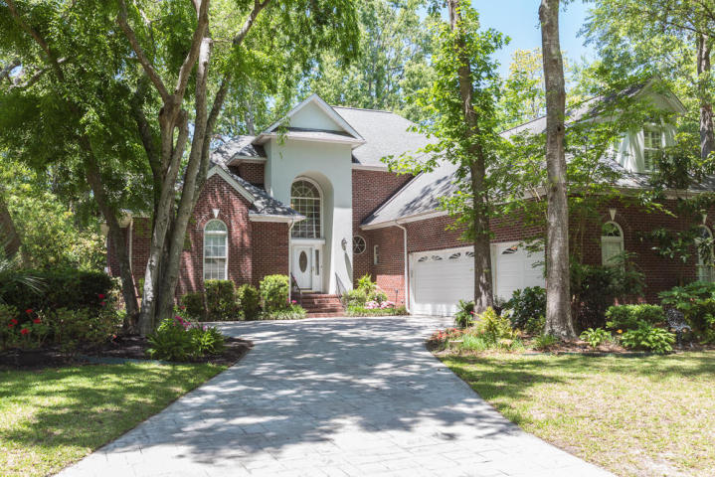
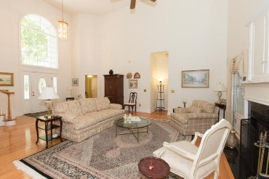
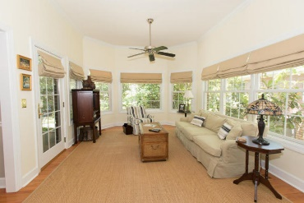
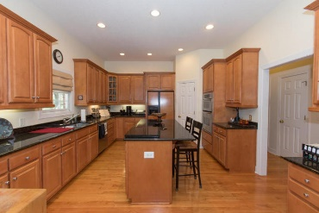
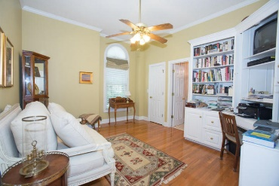
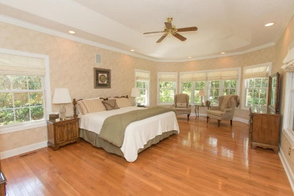
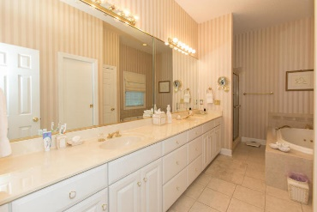
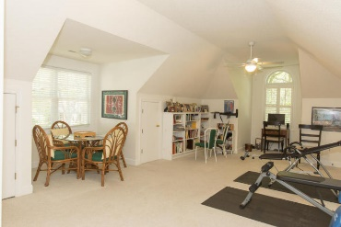
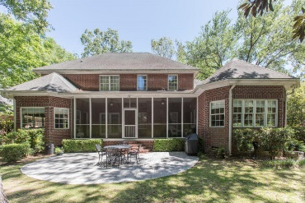
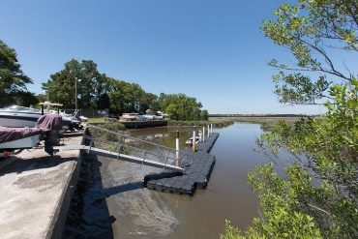


1588 Seawind Drive
Ashley Harbor
Charleston, SC 29407
MLS# 18012547
$745,000
Reduced to $698,888
Well maintained custom designed brick home located in the exclusive Ashley Harbor Gated Community. You will be entering 23'vaulted ceiling in living room and entry. 10' ceiling in remaining first floor. Hardwood floors throughout first floor. Large chef's kitchen with plenty of cabinets with sink boiling water dispenser and large pantry closet & granite counter tops. Eat in kitchen open to the den and to formal dining room. Large Master suite downstairs with custom closets, master bath with jacuzzi top. Gas fireplace in living room with built in space for TV. Music speakers throughout house. Another bedroom on first floor with full bath and closet. 3 car garage with four 220 V power outlets. Dehumidifier with thermostat in crawl space under house. Natural gas generator powers kitchen, master bedroom and all HVAC zones. You will be impressed with this beautiful custom home. This home is not in a flood zone.
Cathy Rosenblum
843-817-7869
crosenblum@comcast.net

