Slide 1
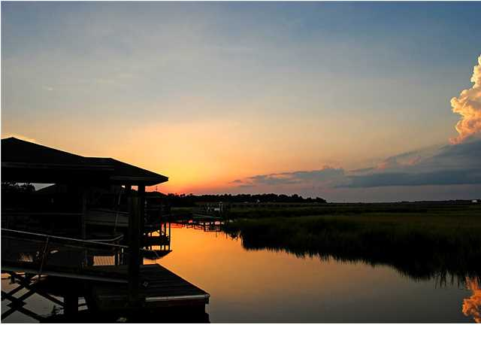
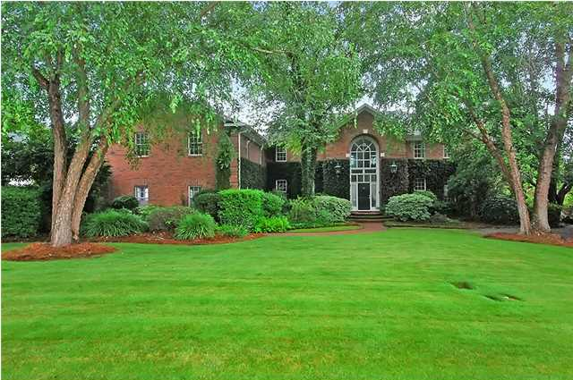
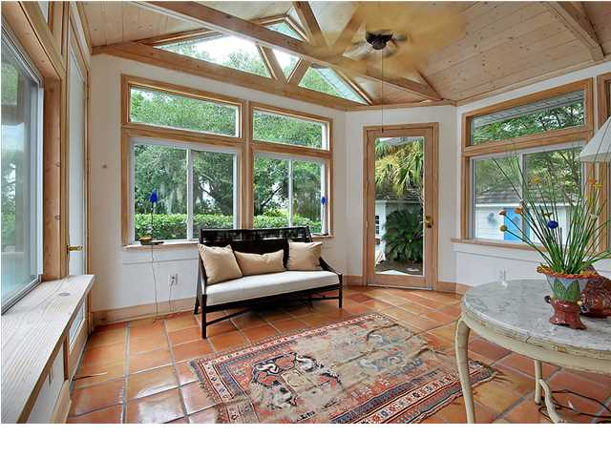
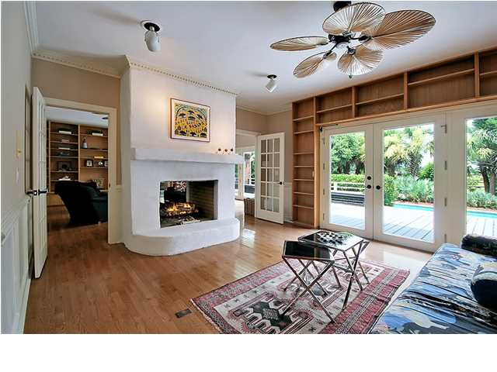
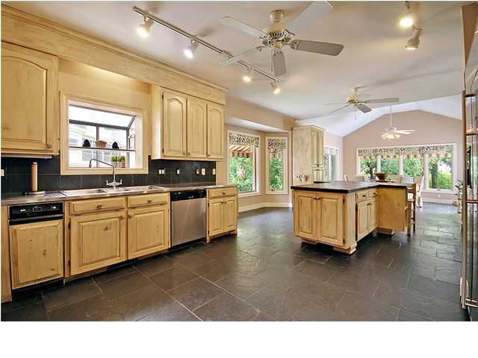
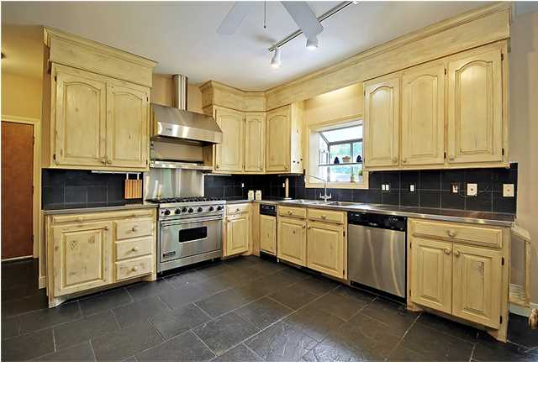
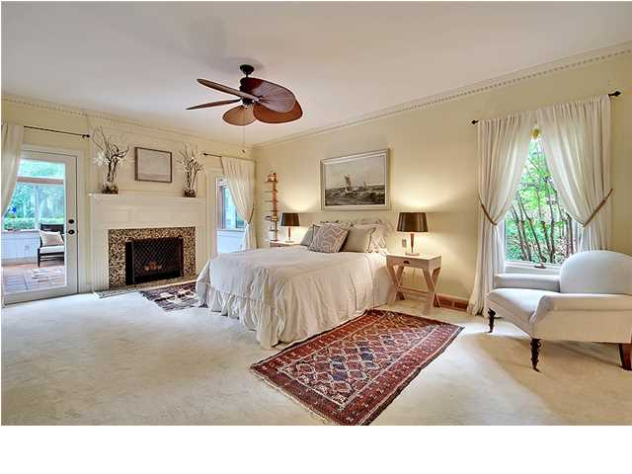
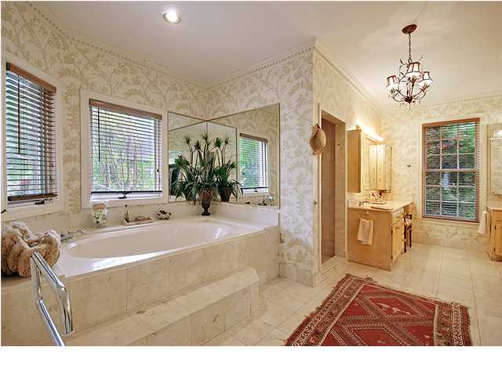
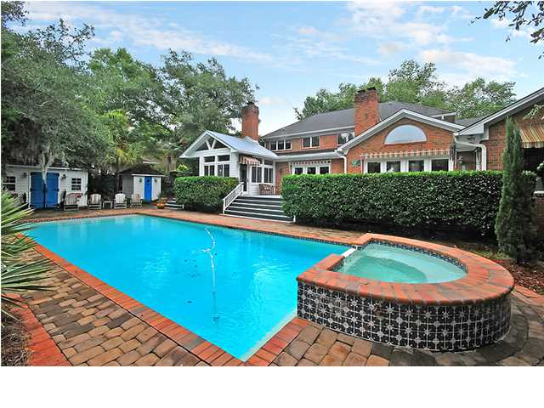
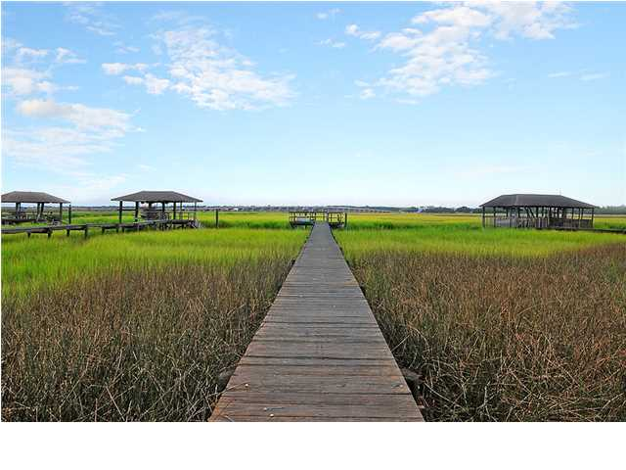

Price Reduced!
Own Your Slice of Lowcountry Paradise
1588 Spinnaker Ln ~ Charleston ~ MLS# 1420728 ~ $999,900
If you demand the best, then this six bedroom, four full bath, two half bath home in Ashley Harbor is right up your alley. The lush lawn that greets you to this .49 acre lot is adorned with pristine landscaping and mature trees and leads up to the beautiful, ivy covered brick front. An elegant two story foyer sets the stage for the 5,500 square feet of living area found in this open floor plan that has high ceilings, crown molding and intricate details throughout the home. The gourmet kitchen leaves nothing to the imagination with a six burner Viking stove and oven with matching hood, stainless steel appliances, a huge center island with a breakfast bar for food prep and taste testing, a bay window that lets the natural light pour in and a gracious eat-in area with a cathedral ceiling. The formal dining room is dressed up with wainscoting and chair rail molding and has lots of room to host your holiday meals. Gorgeous, white oak built-ins cover the wall of the family room while another wall is lined with floor to ceiling windows and a palladian window leaving the space very well lit. The family room runs into a library which is also full of built-in bookcases and it allows access to the giant deck. With retractable awnings, this outdoor living space looks over the jacuzzi that overflows into the Italian tile pool. The paver patio surrounding the pool is a great place to catch some rays and dry off after a swim. The pool house and cedar lined sauna makes for an enjoyable aquatic experience. The master suite on the first floor stays nice and cozy with a gas fireplace and gives you plenty of storage with four closets. The private sun room in the master has tile floors and views of the backyard. The master bath features two marble vanities, a relaxing garden tub and a walk-in shower. Upstairs you'll find five additional bedrooms and a spacious bonus room. Have you also been looking for a place to house your boat? With a private dock, you can rest your boat in your own backyard in between fishing adventures. As a part of Ashley Harbor you'll enjoy access to the community amenities which include tennis courts, a marina, boat ramp, and walking trails. The quality of construction in this home must be seen to be appreciated, be sure to come by today.
Call or email for details: (843) 654-7777 or Matt@MattOneillTeam.com

