Slide 1
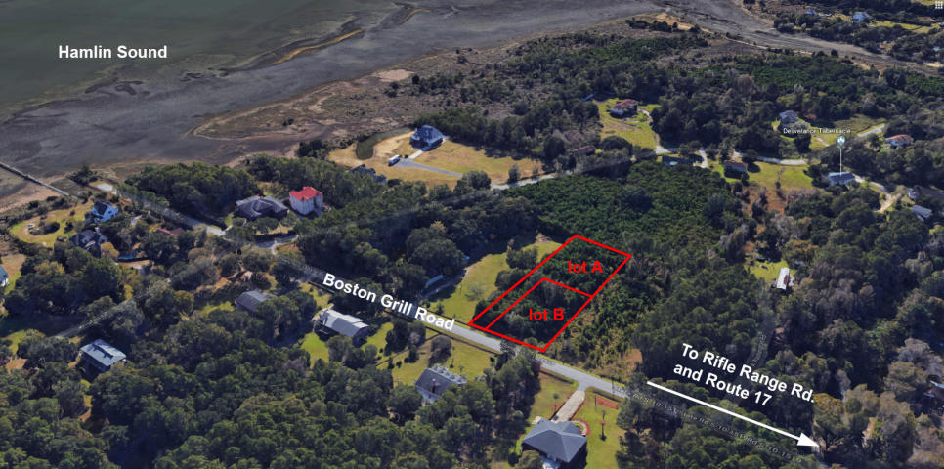
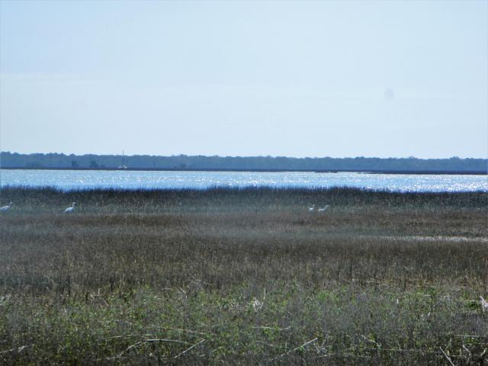
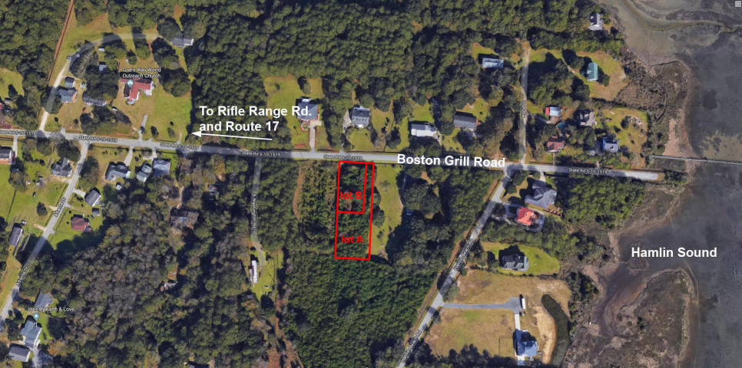
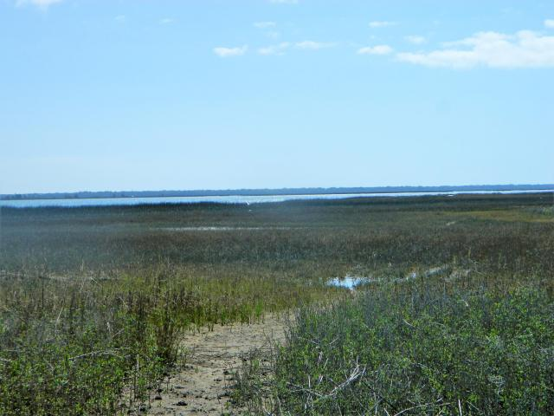


2 Lots for the Price of 1
1593 Boston Grill Rd
Mount Pleasant, SC 29466 ~ MLS# 18009543 ~ $189,000
HAVE TWO LOTS FOR THE PRICE OF ONE ($94,500 x 2). Unique opportunity to own a great parcel in quiet Mount Pleasant area near Hamlin Sound and build two elevated and nicely sized fee simple homes after pending subdivision. ''New Lot B'' is .506 acres (22,030 sq. ft) and ''New Lot A'' is .354 acres (15,427 sq. ft.) Lots are jurisdictionally in Charleston County so save on the substantial extra Town of Mount Pleasant fees, and no HOA. The home sites are mere steps from the Sound, a quick stroll for some R&R, and very close to the Isle of Palms beach, shopping and Downtown. See documents in MLS or ask me for details. SCDOT has approved curb cuts for the driveway. Project also includes substantial due diligence materials and quality surveys (including topo and tree) from top quality civil engineering group. These lots are an unbeatable value.
Wilcat Realty
PO Box 897
Mt Pleasant, SC 29465
Carrie Newbern
(843) 557-9001
carrienewbern@gmail.com

