Slide 1
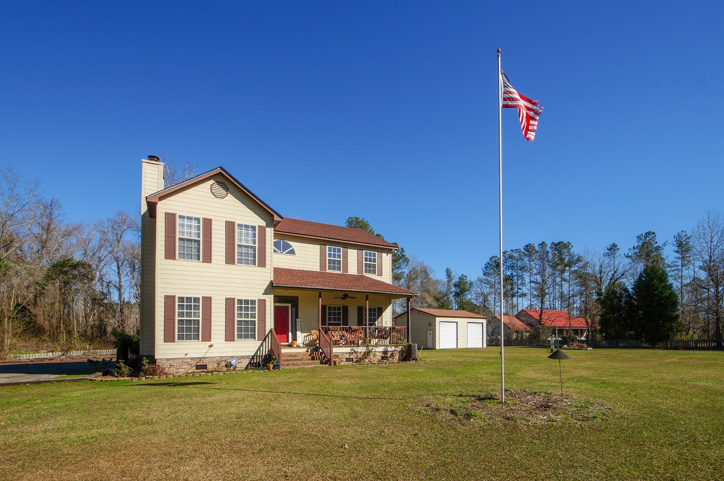
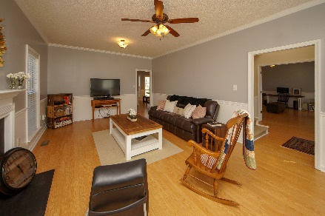
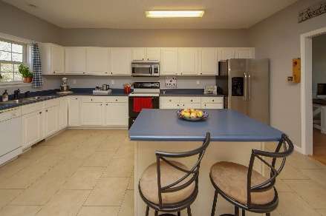
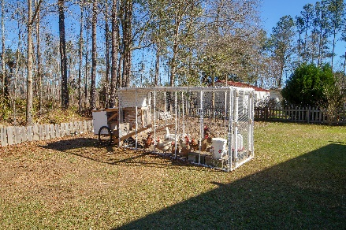


1594 E Church Street
Bonneau, SC 29431
MLS# 19000872 :: $278,000
3 Bed / 2½ Bath
Spacious Country Living
2.67 Acres!
Own a slice of country living with the farm house look and farm house feel! Spacious, open kitchen has plenty of cabinet/counter space with an over sized eating area. Family room has a wood burning fire place and separate dining room is large making this room an optional space for a second living room, office or play room. Laundry room is down stairs with side door access for perfect use as a mudroom. All bedrooms are up stairs and the master bath has an oversized soaking tub/shower. Every room is spacious with plenty of natural sun light and the seller has chosen perfect paint colors throughout. This home nestles on a cleared 1.29 acre lot with a 24x30 -2 bay garage/workshop with electric. Check out the chicken coop for the complete country experience. This is a must see! No HOA!
Connie White, Broker
843-532-3356
connie@chrepros.com · conniewhiterealestate.com
Charleston Homes · 597 Old Mt. Holly Road · Suite 301 · Goose Creek, SC 29445

