Slide 1
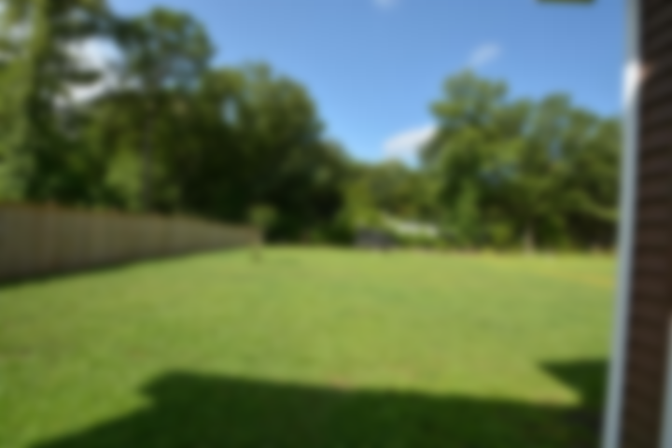
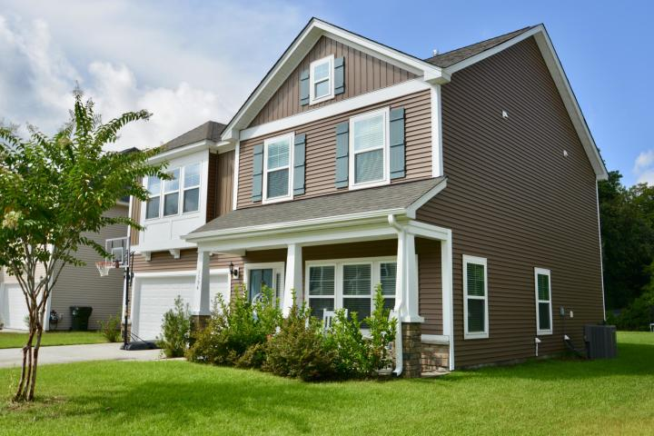
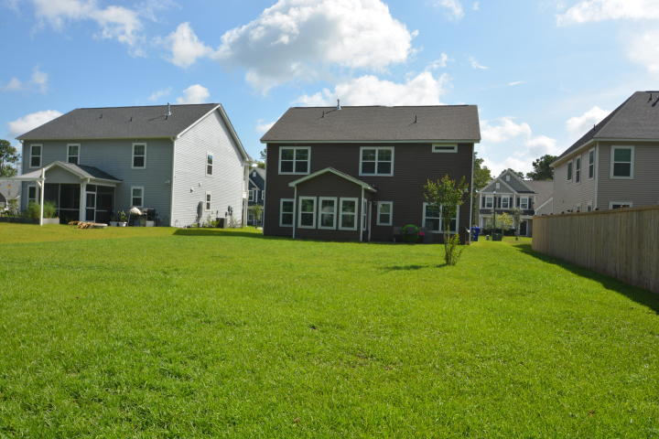
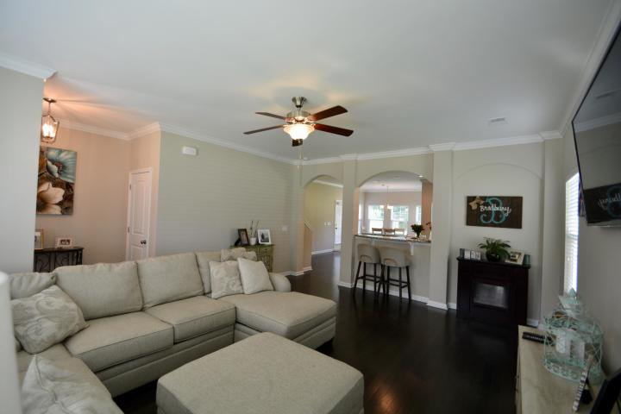
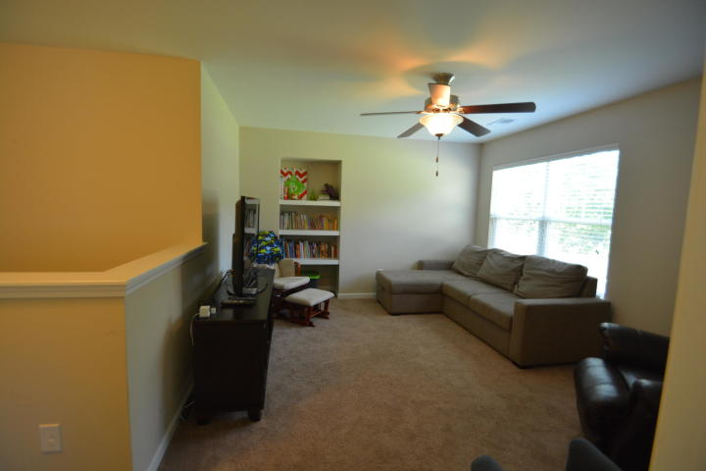
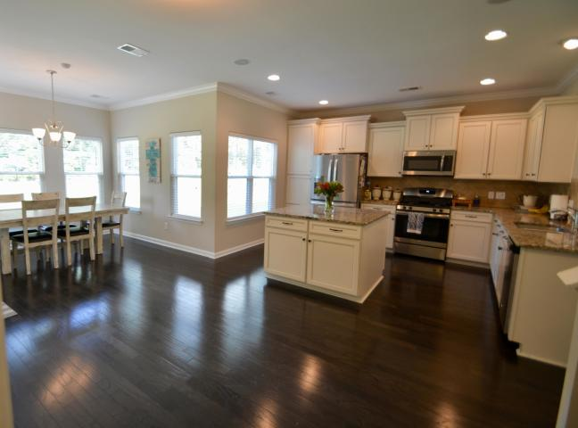
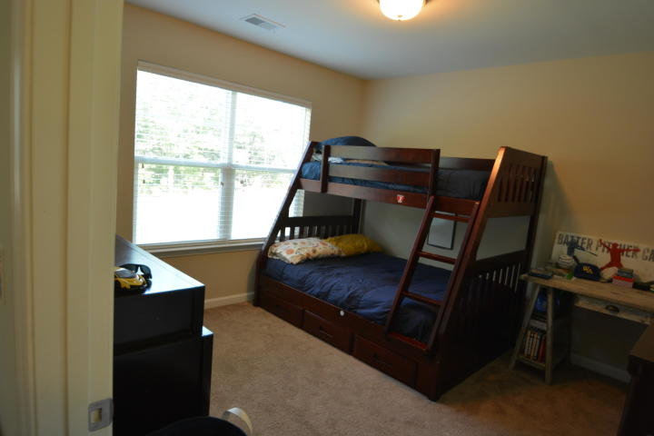
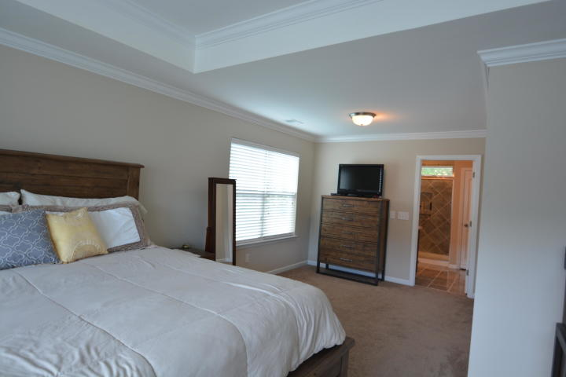
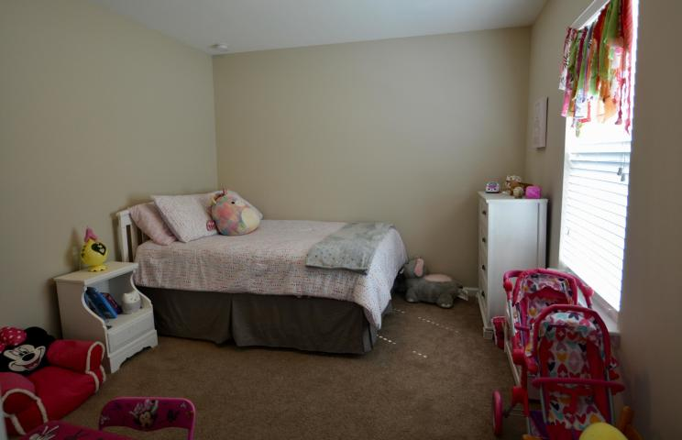
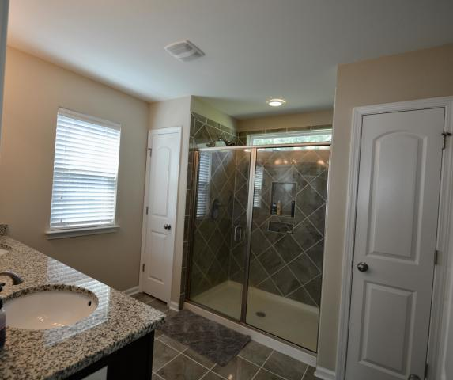
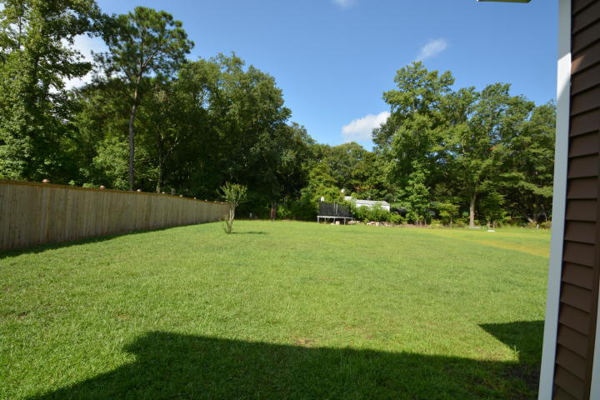
Just Listed in Fenwick Woods
1594 Fishbone Drive
Johns Island, SC 29455 ~ MLS# 19020358 ~ $354,900
Only 1.5 years old, this home truly is better than new! 4 bed 2.5 bath home. Beautiful upgrades throughout the home starting with laminate/wood flooring throughout the first floor, crown molding, upgraded kitchen cabinets, granite counters, tile backsplash, gas stove. Sunroom adds to the dining area! Security system & speakers built in. Blinds through out the house. The upgrades continue into the master bedroom with tray ceiling, crown molding, sitting area in the master, large walk- in closet, three linen closets in master bath, oversized shower, beautiful tile, and granite counters! Loft could be a great family area, play room, man cave or could convert to an additional bedroom. Large backyard! 2-10 builder's warranty with Mungo homes still in place and is transferable!
Patricia "Patti" Nickerson
(843) 312-7478
pattinickerson@hotmail.com
Brand Name Real Estate
4 Carriage Lane Suite #106
Charleston, SC 29407
Michael Albenesius
(843) 343-5870
m.albenesius@gmail.com

