Slide 1
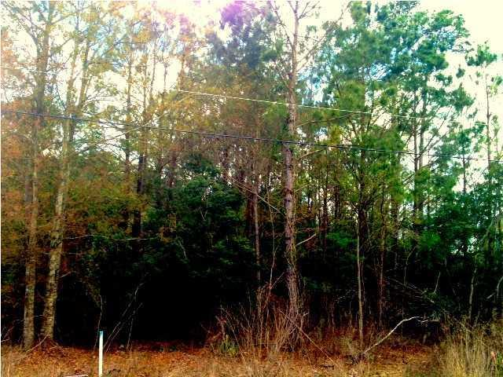
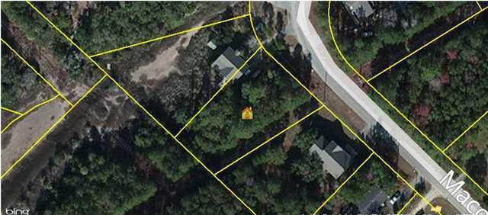


Drastically Reduced by Motivated Seller
1596 Macoma Dr
Mount Pleasant ~ Copahee View MLS# 1408964 ~ $49,500
Wants to see an offer!!! One of Mount Pleasants best kept secrets. Located just minutes to shopping, dining and the beaches, this is the perfect spot to build your dream home. Covenants and restrictions help protect the integrity of your property while still allowing you the relaxed environment that you need after a long day. There is also a neighborhood boat landing which allows for access to the Copahee Sound. Drive through the neighborhood and you will see the comfort of casual living combined with the ease and convenience of living in-town.
Katrina Johnson
843-452-2747
kjohnson@carolinaone.com

