Slide 1
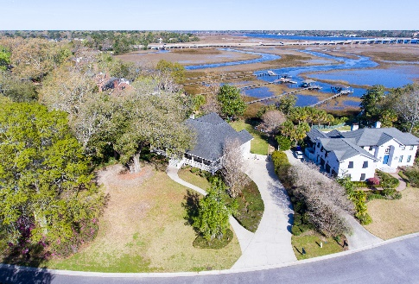
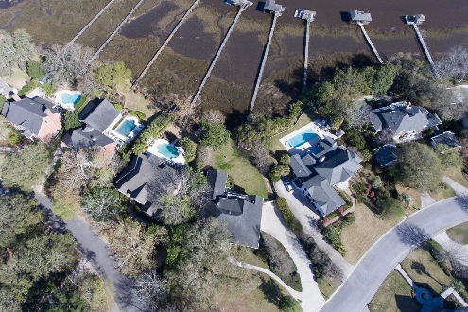
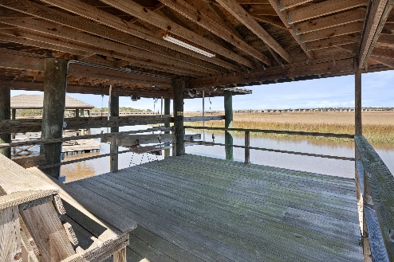
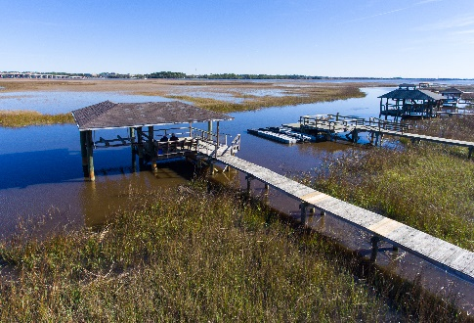
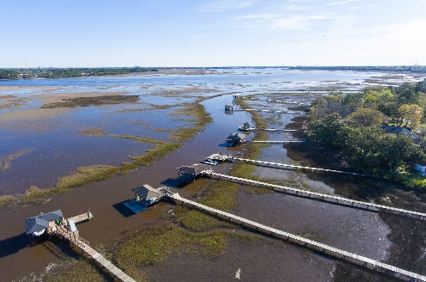


Beautiful Waterfront Property
REDUCED
1596 Spinnaker Lane
Charleston, SC 29407 · MLS# 24006480 · $2,490,000
Michael Dew
O 843-769-5100
M 843-870-7000
michaeledew@gmail.com
www.michaeldewrealestate.com
Custom home with private Deepwater Dock and Covered Boat Lift on Bull Creek off the Ashley River. This three story low country style home is situated on a large corner lot in the private gated neighborhood of Ashley Harbor. The gorgeous wrap around porch overlooks the expansive front yard centered around a 200 year old historic live oak. This one owner home is now being offered for sale for the first time. When entering the main level through the front door, ten foot ceilings and custom hardwood floors span the foyer, main living area, formal dining room, and traditional living room. The main living area overlooks the Ashley River with coffered ceilings, a masonry fireplace, a powder room, and French doors leading onto the large screened in porch. A separate wet bar room is accessible off the main living area. The spacious eat in kitchen is complete with breakfast bar, custom cabinetry, dual ovens, laundry room access, and butler's pantry. The secluded master bedroom has a water closet and separate his and her counters and sinks. From the grand entrance, a foyer stairway leads to the third level. Two bedrooms upstairs both have walk-in closets and a Jack and Jill bath. Both bedrooms have doors leading out to a third floor porch overlooking the Ashley River. The downstairs contains a guest suite with private bath. The large home office contains custom built-in cabinetry and bookshelves. A large workout/playroom is also found downstairs. Accessible through the downstairs hallway is the four car garage, a 25x15 workshop complete with a 12 foot work bench, and additional 20x12 ft. storage room. Hurricane shutters have been installed on back of the house. A walkway leads across the marsh to a covered party deck, covered 10,000 lb. boat lift, and floating dock. The floating dock has 6 ft of water at low tide. Required flood insurance is very minimal. This is one of Charleston's few true deepwater lots. Bull Creek is situated off the Ashley River and provides navigable accesss to the Atlantic Ocean. Ashley Harbor is a well established private neighborhood with a staffed guard gate. Neighborhood amenities include a marina center with boat launch ramp, 100 ft. guest dock, boat/RV storage, private community lake, tennis courts, playground, and fitness trail. 8 miles to Charleston International Airport. 7 miles to Downtown Charleston and MUSC.
AgentOwned Charleston Group
902 Savannah Hwy
Charleston, SC 29407
Real Estate ● Mortgage
Insurance ● Business Brokerage

