Slide 1
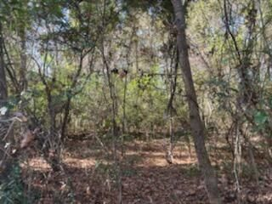
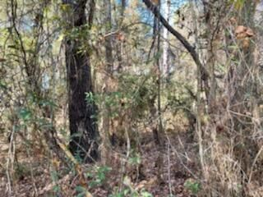
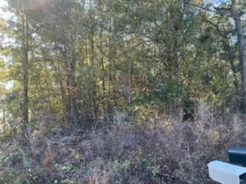
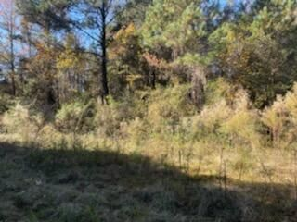
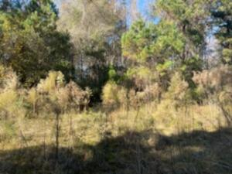


Vacant Land
Reduced!
159 Dogwood Trail
Harleyville, SC 29448
MLS# 22011172
$79,000
Michael Dew
O 843-769-5100
M 843-870-7000
michaeledew@gmail.com
www.michaeldewrealestate.com
2.39 acre wooded lot in Harleyville!
AgentOwned Charleston Group
902 Savannah Hwy
Charleston, SC 29407
Real Estate ● Mortgage Insurance ● Business Brokerage

