Slide 1
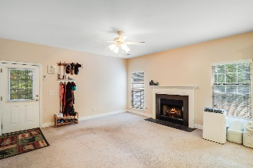
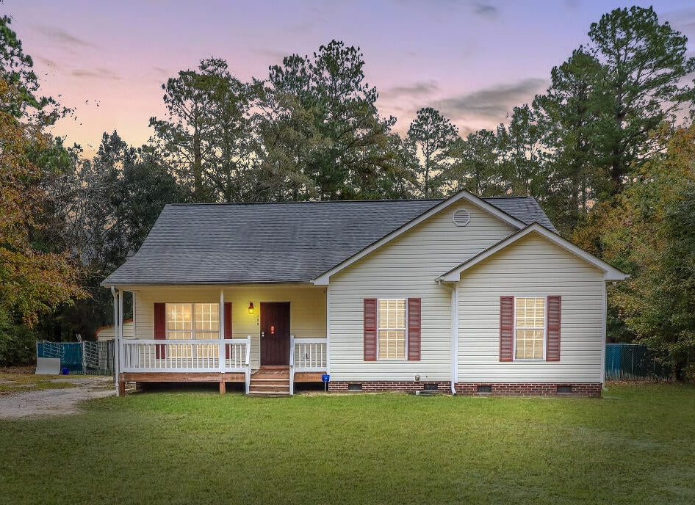
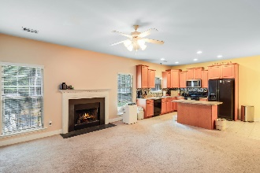
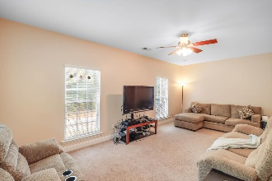
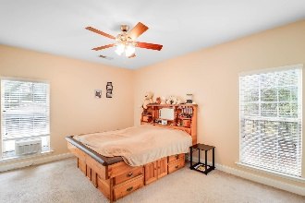
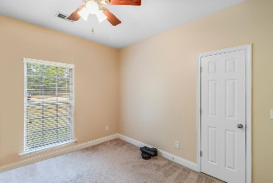
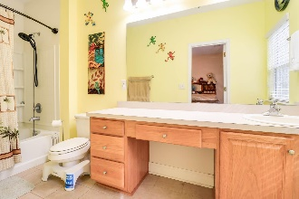
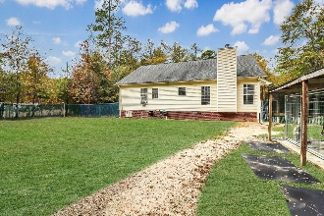
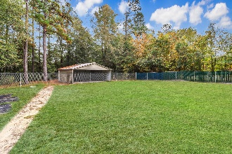
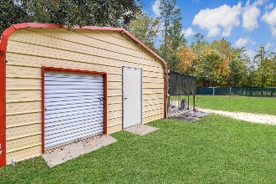


159 Live Oak Drive Orangeburg, SC 29118 MLS# 23026286 | $275,000
Spacious 4-Bedroom Ranch on 1 Acre
Open House
Wednesday, 7/20
3-5PM
Welcome to this charming 1-story ranch-style home nestled on a sprawling 1.06-acre lot, offering a tranquil country setting mere minutes away from the convenience of shopping and dining options in Orangeburg. This well-maintained residence, constructed in 2009, boasts a spacious layout featuring 4 bedrooms and 2 full baths, perfectly designed for comfortable living. As you step inside, you're greeted by an inviting open concept family room and kitchen area, highlighted by a cozy gas-burning fireplace—ideal for relaxing evenings or entertaining guests.
The kitchen area seamlessly integrates with the family room, fostering a warm atmosphere and fostering easy interaction among family members or guests. Additionally, there's an extra living room space that provides versatility for various activities or as a quiet retreat.
The primary bedroom, situated on the main floor, offers convenience and privacy. The layout is well-suited for those seeking a home with a primary bedroom on the ground level, ensuring ease of access and comfort.
Enhancing the property's appeal are the bonus features it offers: an 18 x 20 metal building equipped with power, which includes inside dog kennels. The kennel fencing is optional with an acceptable offer, providing flexibility for those considering this setup. Moreover, an additional 24 x 25 metal building with a concrete pad presents ample space for storage or potential for various uses, catering to your specific needs or hobbies.
Outside, the property showcases the beauty of a serene country landscape while still being conveniently close to urban amenitiesa perfect blend of peaceful living and modern convenience.
Experience the best of both worlds in this delightful ranch-style home, offering comfortable living spaces, a picturesque setting, and the convenience of nearby city amenities. Don't miss the opportunity to make this property your haven in Orangeburg.
Brandon Ray
(843) 499-1928
brandon.ray@carolinaone.com
www.therightrayhome.com
Carolina One Real Estate
900 N Main St
Summerville, SC 29483

