Slide 1
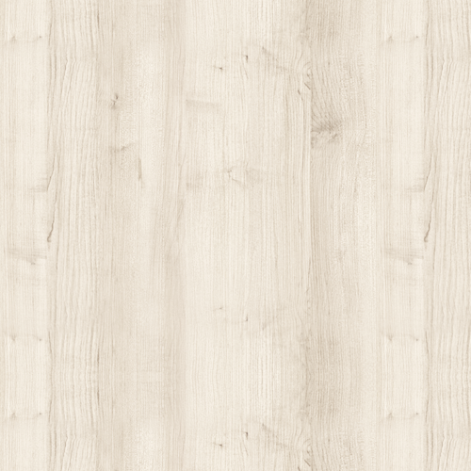
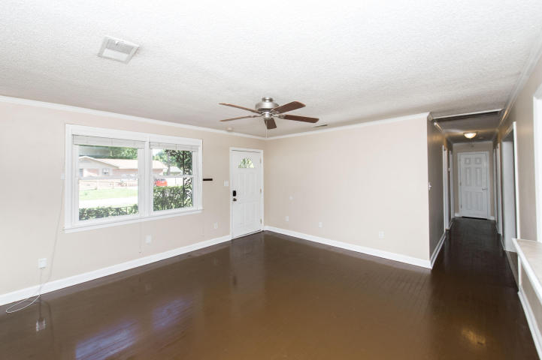
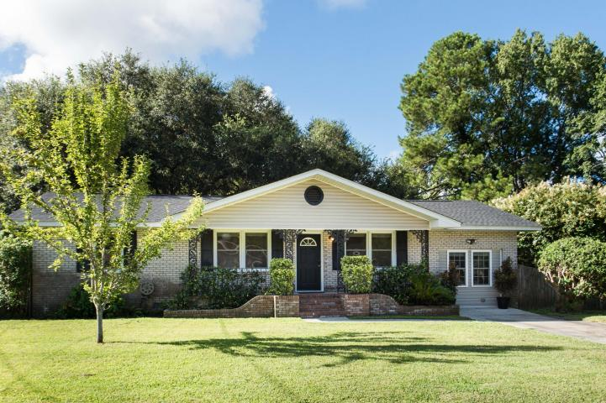
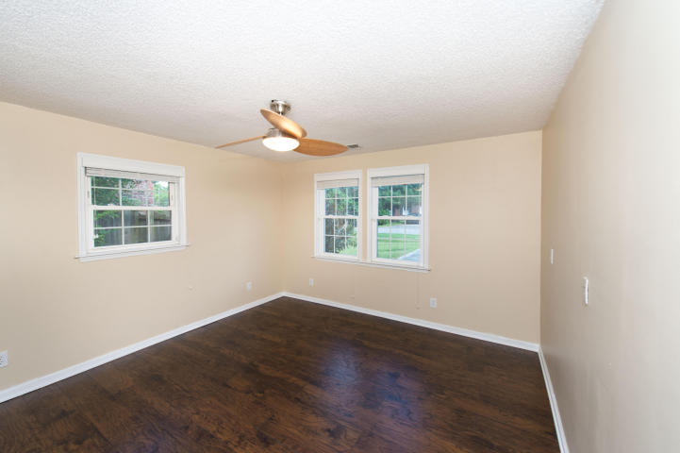
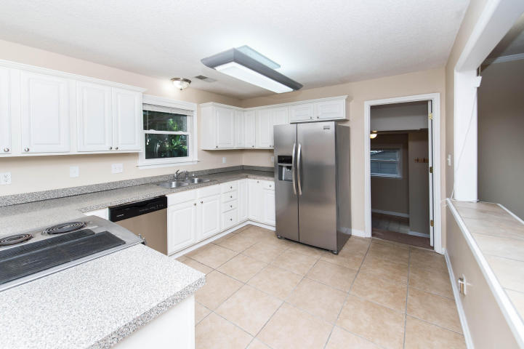
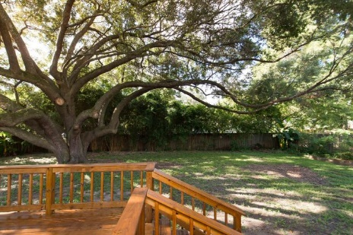


Renovated Home In West Oak Forest Neighborhood
15 Bossis Drive
Charleston, SC 29407 ~ MLS# 16021976 ~ $269,000
You'll love this lovely and spacious renovated home in West Ashley's West Oak Forest neighborhood! Conveniently located in the heart of West Ashley, this renovated home features an open floor plan and a large kitchen to enjoy. The spacious kitchen and both full bathrooms have been updated with tile flooring and tile shower surround in both bathrooms. Home sits on a large/wide lot with abundant space to enjoy in the front and fenced in back yard. Amazing grand Oak Tree in the private backyard provides a lovely and shaded setting that is truly special. Brand New Architectural Shingle Roof recently installed in 2016.
Don't miss out on this one, book your showing today!
Bradley Thompson
M 843-323-7600 | O 843-885-6199
bradley@charlestonhomebuying.com
Colony & Craft LLC
76-A Spring St
Charleston, SC 29403

