Slide 1
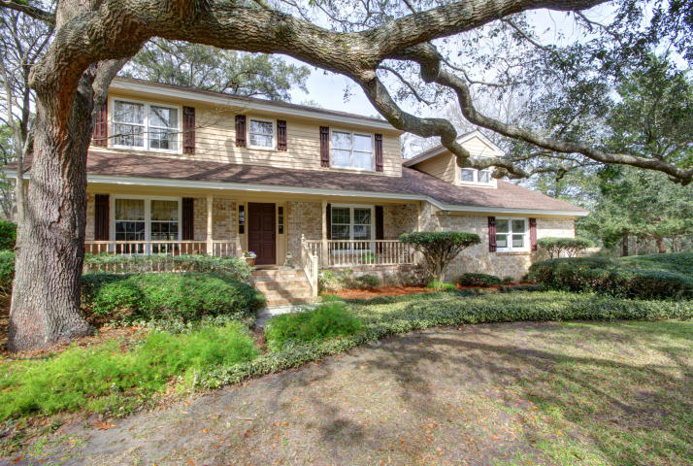
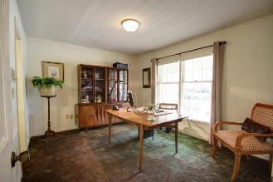
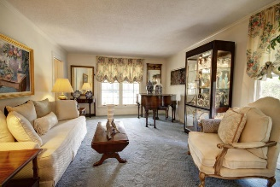
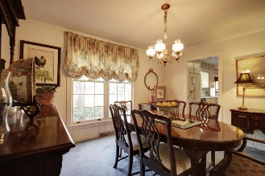
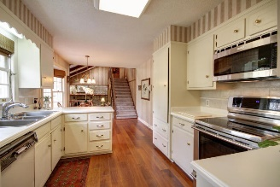
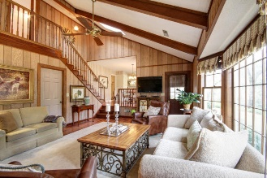
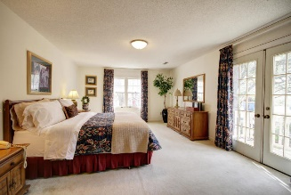
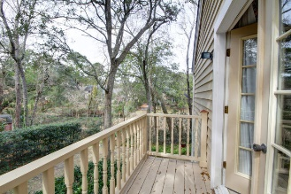
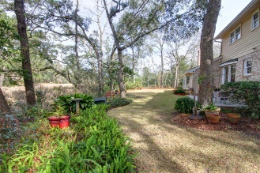
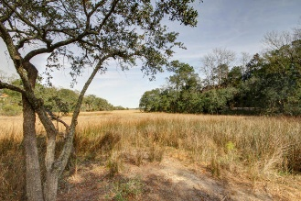
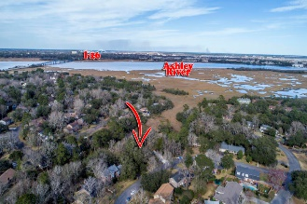


15 Brigadier Drive
Parkshore :: Charleston, SC 29407
MLS# 19004570 :: $495,000
MARSH FRONT IN PARKSHORE
First Time On The Market!
Classic Parkshore home first time ever on the market. This home is situated on almost an acre of beautiful manicured yard with mature trees surrounded by the ever-changing marsh area. The home has been well loved for over forty years by same owner and is in good condition. There is a formal living and dining area, a guest bedroom, full bath, eat in kitchen and sunken den area with large fireplace on the main level. Upstairs is master bedroom with a balcony perfect for morning coffee and nature watching. There are 2 additional bedrooms each with their own bath and a large FROG (could easily be bedroom) with access from den area and or bedroom level. Laundry/utility room to large two car garage and a driveway that will accommodate multiple vehicles. Backyard patio overlooking marsh.
Clay Cunningham
O (843) 886-8110
M (843) 345-4647
clay@carolinaone.com
www.claysre.com
Carolina One Real Estate
1503 Palm Blvd Ste
Isle of Palms, SC 29451

