Slide 1
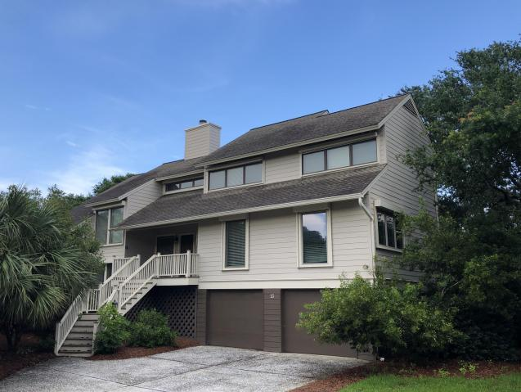
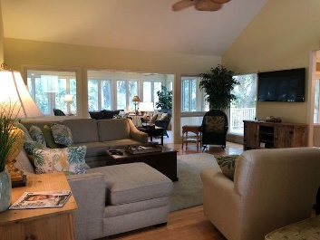
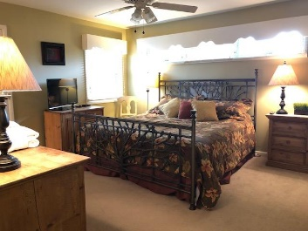
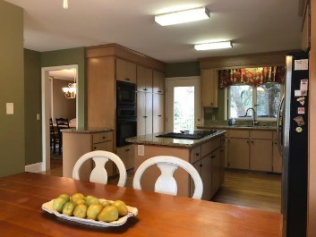
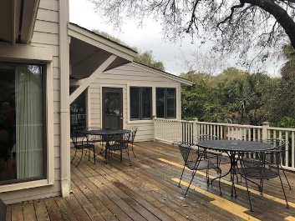
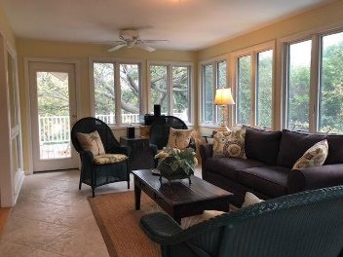
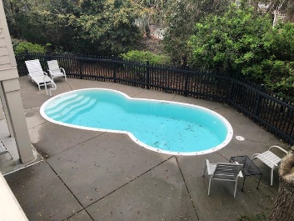


15 Dunecrest Lane Wild Dunes Isle of Palms, SC 29451 MLS# 18009117 $99,000
$1.3M+ Home At "Fraction Of Cost”
And It’s Just Steps To Beach!
Elevator to all levels
Lot Elevation is AE 13
Viwinco Hurricane rated windows
Raised seam metal roof
Water faucets on front, rear, and screened porches!
(No reason for dead flowers!)
Paver Patio
Garage is up fitted with additional electrical for golf cart charge or workshop
Custom heavy duty garage door, Custom Mahogany finished
Exterior door from inside garage to rear living area and paver patio
Hot/Cold Outdoor Shower
Spray foam insulation in attic ceiling
Multi zoned HVAC
10'Ceilings
Custom Rosewood Cabinetry in kitchen with 2 Corner lazy Suzanne's to maximize use of space, soft close drawers, pull outs
GE Profile Kitchen Appliances that include:
-Microwave/Convection Oven
-Wall oven
-Refrigerator
-Trash Compactor
-Dishwasher
Deep Sinks
Garbage Disposal
Custom Built closets throughout all bedrooms, linen and laundry
Granite in kitchen and all baths
Custom tile in all bathrooms and entry and oak wood floors throughout
Master bath elegant oval soaking tub with wand for body rinse
Oversized shower with wide glassed door entrance
Dual vanity with cosmetic seating area
Additional cabinetry
Separate commode area
Main level Bedroom/Office with window seat with storage
and attached bath.
Pocket doors maximize wall space.
Front entry door is custom Mahogany
Boat slips are available for lease and purchase Morgan's Creek Marina
$10,000 Bonus!
RARE OPPORTUNITY to own and enjoy this 1/13th ‘Share 1’, 4 weeks yearly rotating ‘Fractional’. The distance to the beach - unbelievable! Enjoy the Village and other Wild Dunes amenities spontaneously! Inside, 15 Dunecrest is all about character and has abundant storage, volume ceilings, an has an open floor plan and niches for quiet times. The oversized eat in kitchen, easily accommodates multiple cooks and has direct access to the wrap upper deck for dining and entertaining! Below, there is ample room for parking, beach toys, golf cart and pool use. Bonus feature - you CAN bring the family pet! And, rent out any time that you can't use! See, measure, enjoy! $1000 Quarter Regime Fee covers all but housekeeping. Make your memories here at a ‘Fraction’ of the cost!
Listed by
Bill Donovan 843-991-0146 donovans@carolinaone.com
Renee Meyer Mobile - (843) 991-0007
renee@carolinaoneplus.com
www.CharlestonHomesHotline.com
Carolina One Real Estate
1503 Palm Blvd
Isle of Palms, SC 29451

