Slide 1
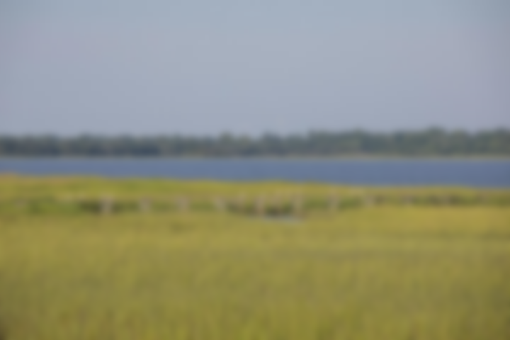
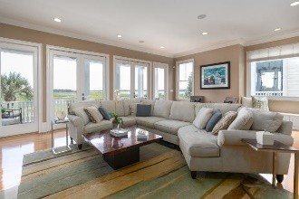
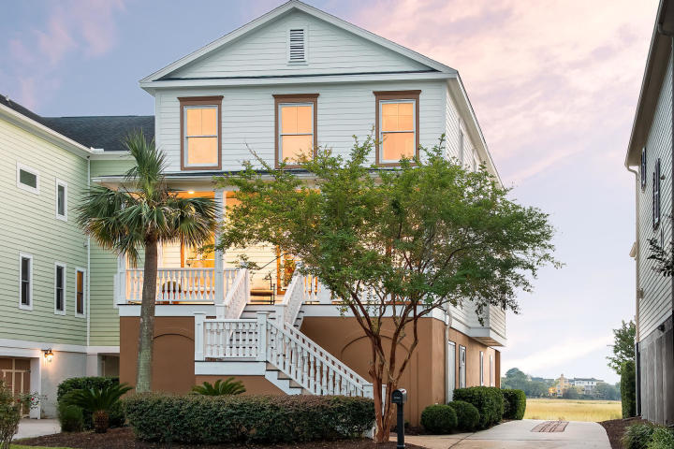
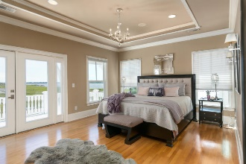
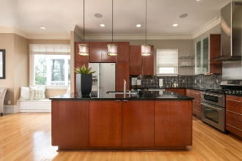
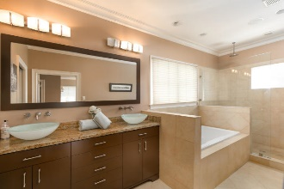
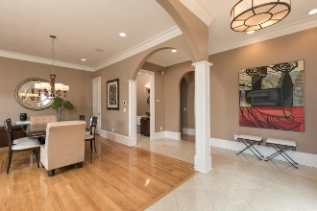
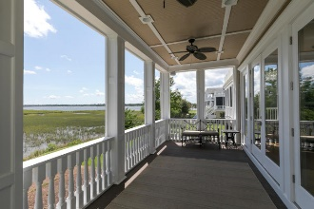
Lowndes Pointe Open House Saturday 1-3 & Sunday 2-4
Lite snacks and beverages will be served!
15 Lowndes Pointe Drive
Charleston, SC 29403 | MLS# 19017918 | $1,259,000
Price Correction - Motivated Sellers!
Imagine living in one of the most coveted neighborhoods on the peninsula. Walk to your private deep water dockslip then take the boat out to watch the sunset over the Ashley like an evening stroll after dinner. Entertain friends and family in your cozy but spacious open concept floor plan with custom kitchen equipped with granite countertops, stainless steel appliances and wet bar. Lose yourself in the views of the marsh and of the Ashley River from your family room, screened in porch and master bedroom. This custom built home has over 3,000 square feet of living and entertaining space. Marble floors greets you at the entrance and lead you to a formal dining area defined by soaring columns.
Melanie Bias
(843) 990-2631 | mel@southerncharmadvisors.com
Brand Name Real Estate | 4 Carriage Lane, Suite 106 | Charleston, SC 29407

