Slide 1
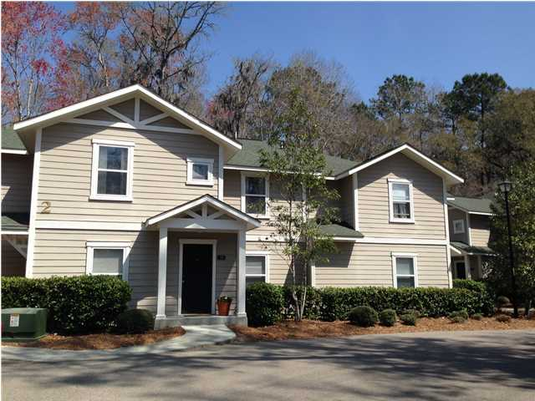
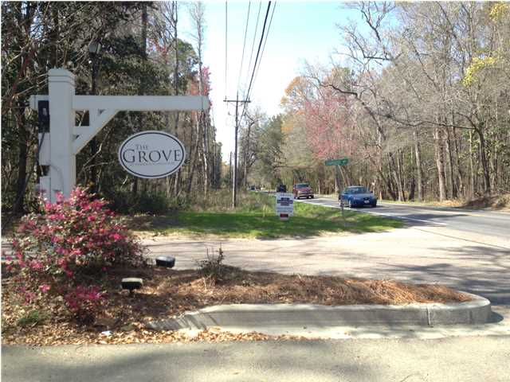
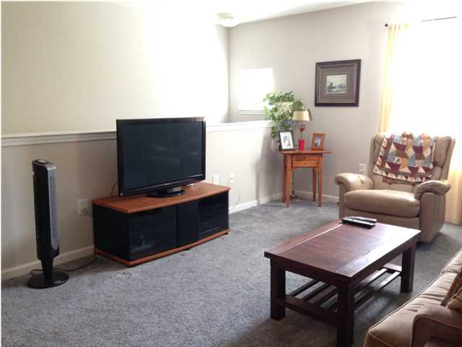
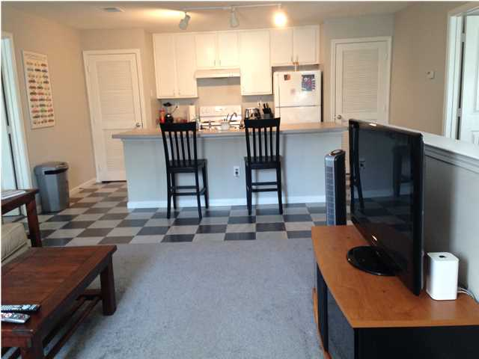
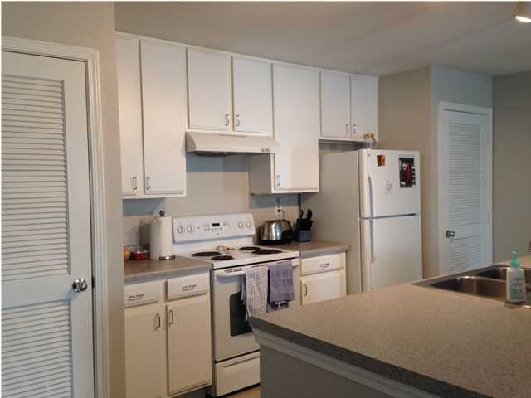
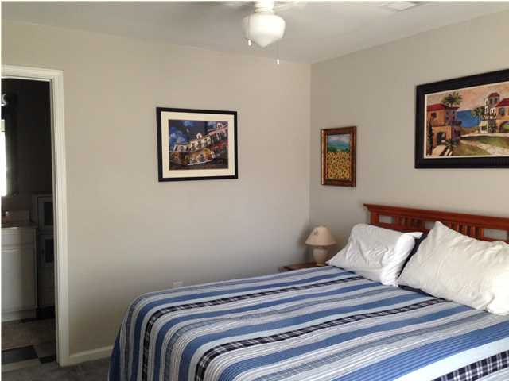
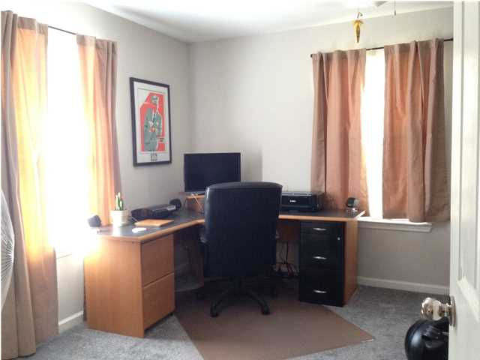


Minutes from Downtown for under $110k!
15-2B Stardust Way
The Grove at Fenwick Plantation
MLS# 1407818 ~ $107,000
The Grove at Fenwick Plantation is a beautifully wooded community conveniently located just minutes from Downtown Charleston, Citadel Mall, and Kiawah/Seabrook.
Enjoy amenities such as a neighborhood pool and playground!
Low monthly HOA fee covers water, sewer, pest control, hazard insurance for the exterior and grounds maintenance.
Morisa Herrick
O: 843-884-7300
M: 843-868-1288
morisa.herrick@agentownedrealty.com
www.agentownedrealty.com
The AgentOwned Realty Company
824 Johnnie Dodds Blvd
Mt. Pleasant, SC 29464

