Slide 1
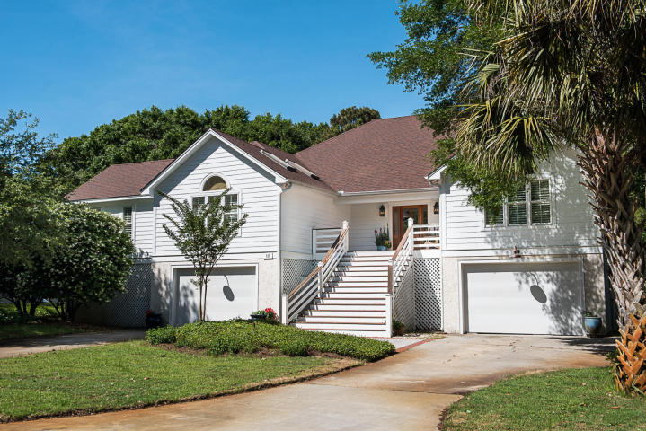
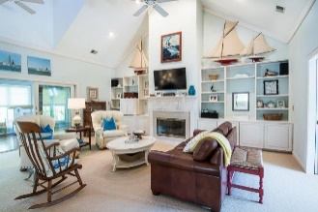
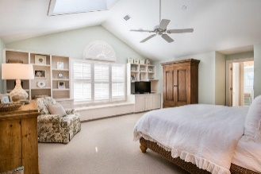
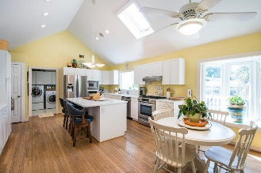
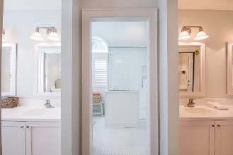
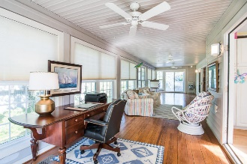
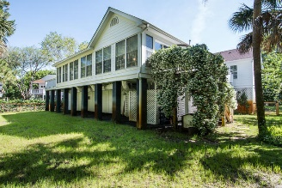
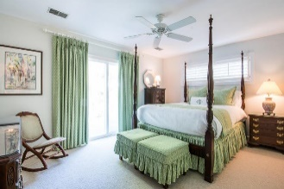
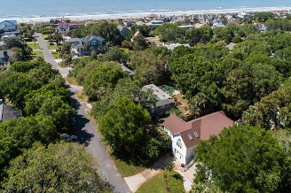


15 44th Avenue
Isle of Palms, SC 29451 ~ MLS# 18014158 ~ $1,095,000
Price Reduced
in the Old Village!
Just a block
from the beach!
The short walk to the beach, very functional floor plan and curb appeal are just a few of the many great features of this expansive and well kept home! A two-bay garage is under the house and has flex space now used for an office/workshop and fishing tackle storage area that anyone would enjoy! A large and welcoming front porch invites guests to an entrance way and huge, sun-filled living/dining room combination with a fireplace and vaulted ceiling. Built in book cases flank either side of the fireplace and make for an impressive focal point in the room. A spacious kitchen with a pass-through window, ample cabinet space, a center Island and room for a breakfast table and chairs make for easy entertaining. There is a large laundry room off of the kitchen with an ice maker and utility sink. The sun room is accessible from the kitchen or great room and provides easy access to all living spaces. The flow is especially nice when entertaining large crowds! The master bedroom has a wall of windows with plantation shutters and skylights and is large enough to accommodate a king bed with plenty of room to spare. The en-suite bath has separate his and hers vanities and walk-in closets. Two guest rooms with large closets are on the other side of the house, so guests have privacy when visiting. With the path to the beach being visible from the curb of this home, you'll want to show it to your beach loving clients!
Mac Jenkinson
M (843) 224-0210
mac@carolinaone.com
Beth Moore
M (843) 532-4892
bmoore@carolinaone.com
www.jenkinsonandmoore.com
Jenkinson & Moore, LLC | Carolina One Real Estate | 1503 Palm Blvd | Isle of Palms, SC 29451-2280

