Slide 1
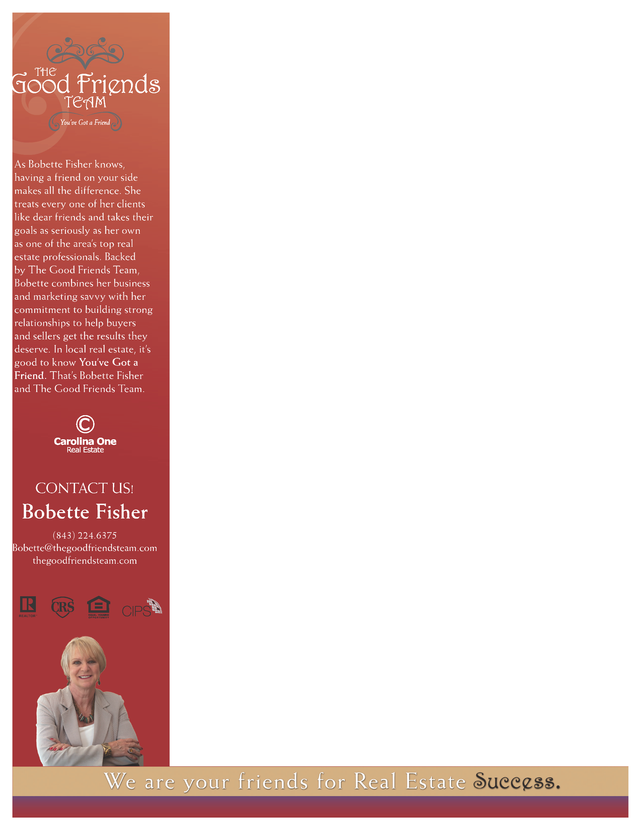
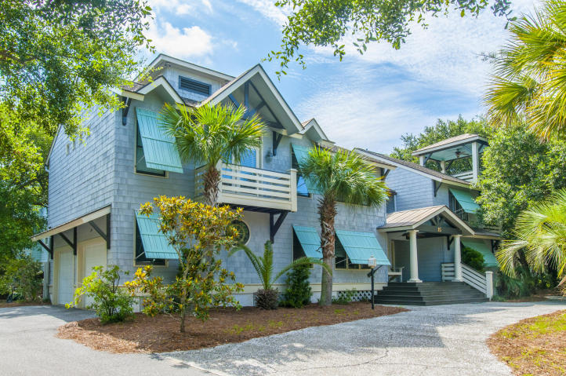
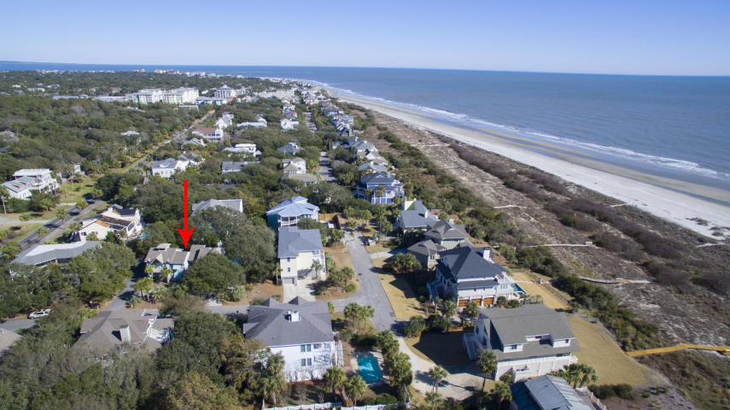

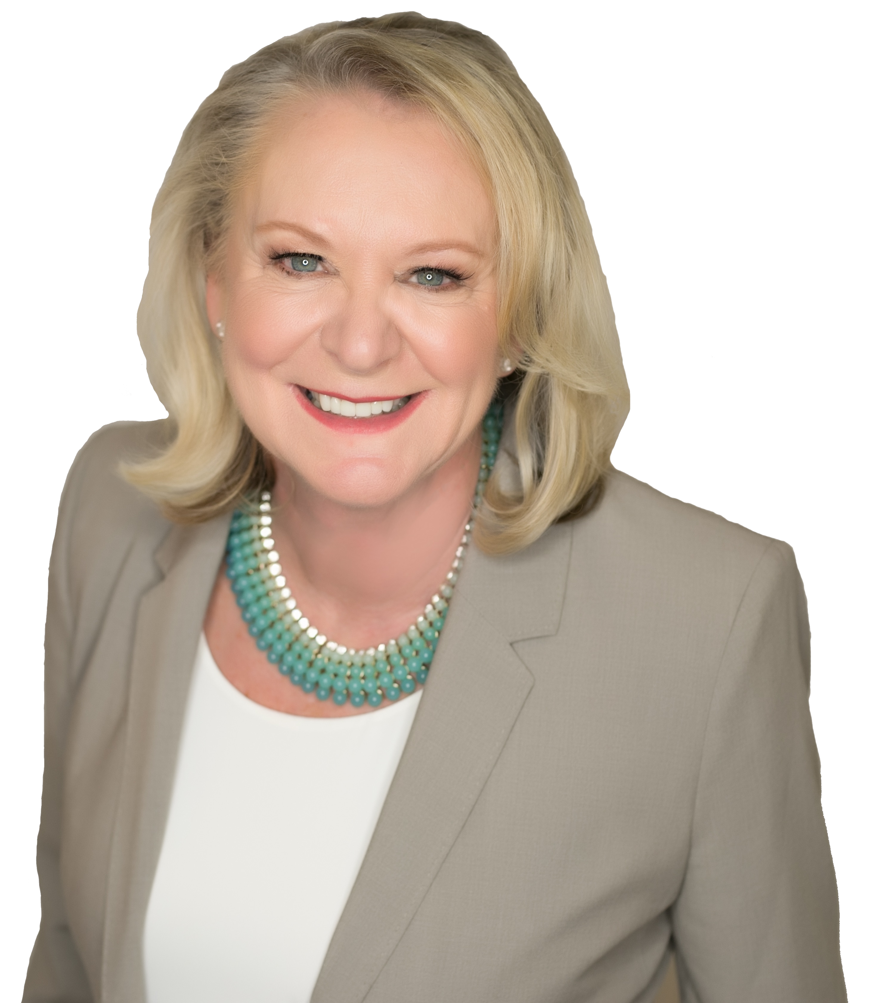

Open House Thursday 9/27
15 54th Avenue
Isle of Palms, SC 29451 ~ MLS# 18005628 ~ $1,950,000
Attention ALL Beach Buyer Agents
Bring your business card! FIVE $50 gift cards to the "Obstinate Daughter" will be drawn in exchange for giving us your help.
Our cozy listing at 15 54th Avenue has been passed up too many times and we're trying to figure out why. Please stop by between 11am-1pm tomorrow to see this 5bed/5.5 bath beautiful beach home while having a little bubbly!

