Slide 1
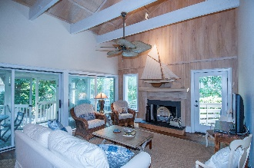
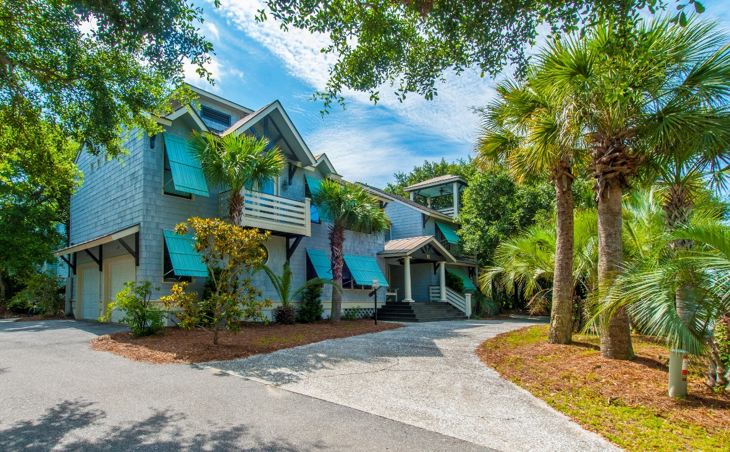
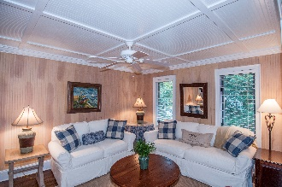
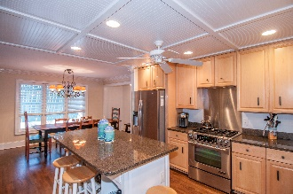
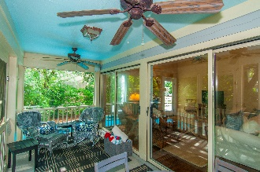

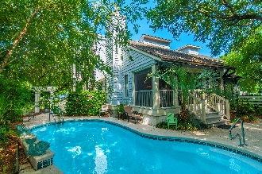


15 54th Avenue
Isle of Palms :: $2,200,000 :: 3,116 sf :: 5 Bed/5½ bath
Not in MLS – Viewings by Private Appointment Only
Newly renovated! This lovely pool home is furnished & ready for your clothes to be placed in the closet. Only ½ block to the beach with easy access to sand and surf, this home can easily serve as a primary, second or income producing property. Hardwood floors throughout main living areas. Large “Chef's eat-in Kitchen” is the perfect gathering space; new stainless appliances, granite island and countertops plus cabinets galore flows easily to den/sitting area. Great room has vaulted ceiling and exposed beams with a cozy fireplace; wall of windows leads to screen porch and onward to garden backyard and pool. Guest Bedroom down with bath en-suite; Master up plus two additional en-suite bedrooms with access to private decks plus an additional bedroom/office. Hear the ocean and feel the cool breezes from the rooftop deck with beautiful view of the ocean and pool below accessed by spiral staircase.
Bobette Fisher
GRI, CRS, REALTOR
(843) 224-6375 | bobette@bobette.net
www.bobette.net
Carolina One Real Estate | 2713 Highway 17 North | Mt. Pleasant, SC 29466

