Slide 1
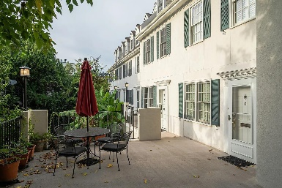
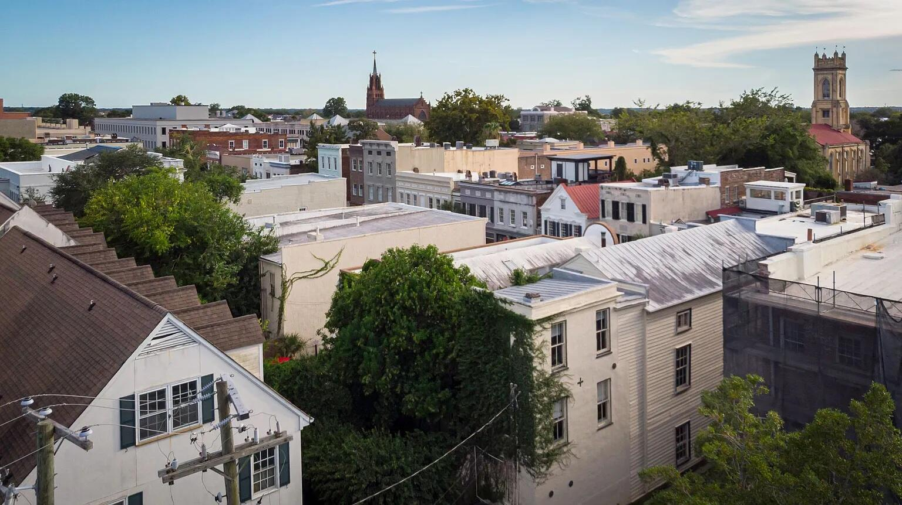
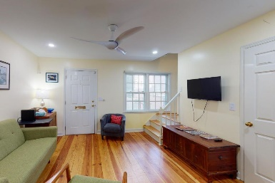
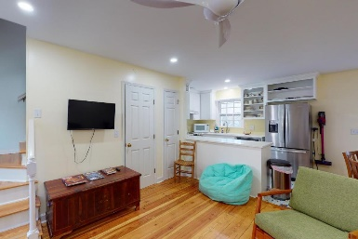
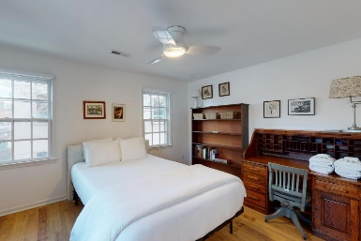
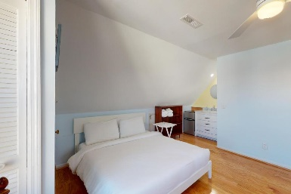
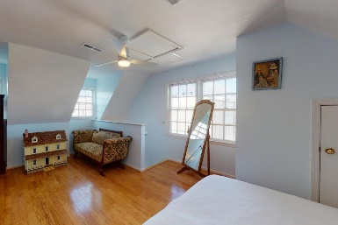
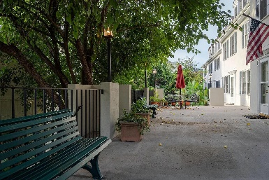


15 Horlbeck Alley C-1
Harleston Village · Charleston, SC 29401
MLS# 23022785 · $750,000
Dramatic Price Reduction
This condo is located in the heart of downtown Charleston. It is in one of the best locations in all of the city. The condo is within walking distance to the College of Charleston, the Market, the Four Corners of Law, multiple restaurants and to all of the shopping that King Street has to offer. This condo boasts 3 bedrooms and two bathrooms. Through the front door you enter into the family room which leads towards the back of the unit to the kitchen. The kitchen has beautiful cabinetry with an island and has a nice open feel and tons of natural light. It boasts beautiful countertops and stainless steel appliances. There is a laundry closet situated on the first floor as well as another closet that can be used as a pantry.
On the second floor there are two bedrooms and a full bath in the middle of them that has been recently updated with gorgeous tile. On the third floor is a spacious master bedroom with room for a sitting area or an office space. It also has its own master bathroom as well that has been updated with gorgeous tilework. This condo complex also boasts a community outdoor area for all of the residents to enjoy and underneath the building is a parking garage and this unit comes with two parking spaces.
Carey Nikonchuk
(843) 276-1701 M
cnikonchuk@gmail.com
www.palmettoproperty.net

