Slide 1
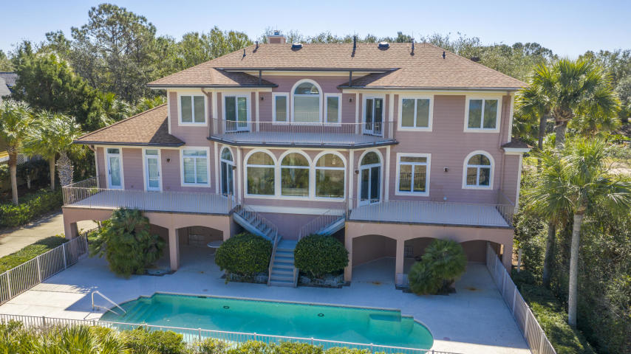
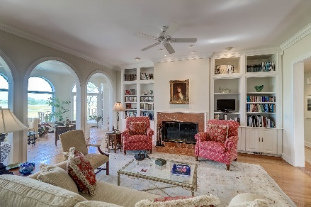
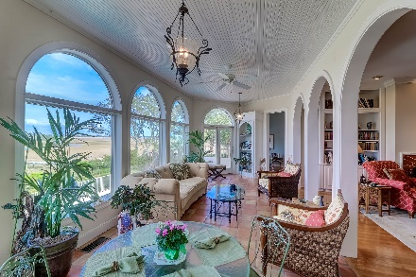
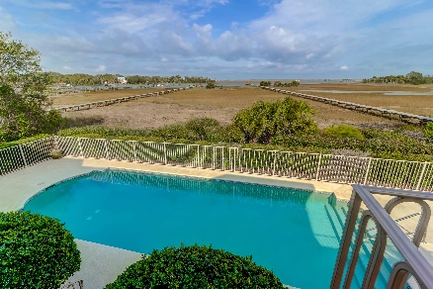
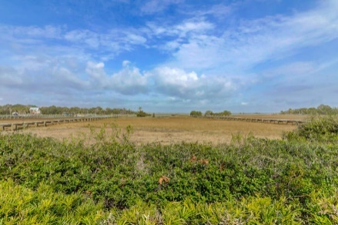


15 Waterway Island Drive Wild Dunes | Isle of Palms, SC 29451 | MLS# 20005631 | $1,900,000
MOTIVATED SELLER!! REDUCED 150K!
Outstanding Water Views & Luxurious Pool
Highly Sought-After Section of Wild Dunes
15 Waterway is positioned on a large beautifully landscaped lot in one of the most beautiful sections of Wild Dunes. Spectacular views of the Intracoastal Waterway are seen from most every room of the home. Enjoy these picturesque views from the multiple decks and porches as well as the lovely pool area. With the master down, an elevator to all floors and no shortage of storage, you won't ever want to move. The Sun room will be your perfect spot for morning coffee or nap by the fire in the Great room. This home is a "must see"!
Darlene Smith Office - (843) 886-8110
Mobile - (843) 696-7824
darlenesmith@carolinaone.com
DarleneSmithTeam.com
Carolina One Real Estate
1503 Palm Blvd Ste
Isle of Palms, SC 29451

