Slide 1
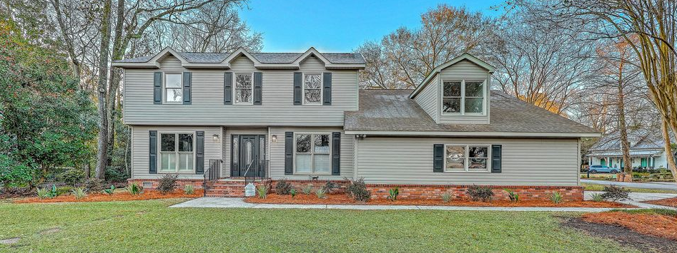
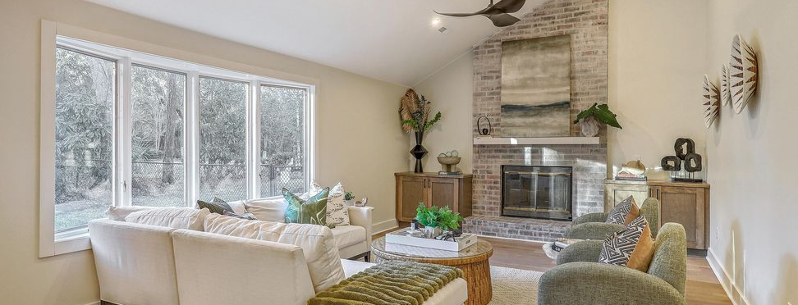
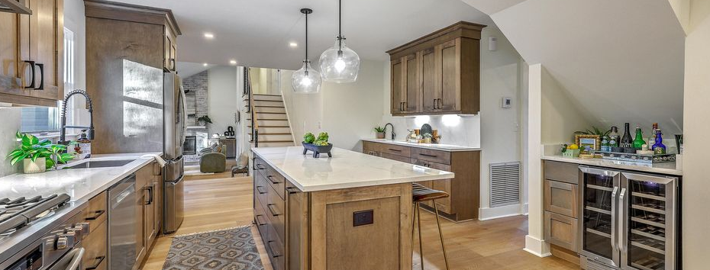
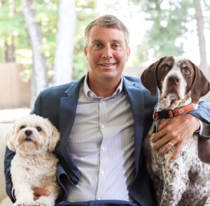
Recent $30k Price Drop
JUS
9714 ROSEBERRY STREE
MOTIVATED SELLER!
/
7
1/
ii
Fully renovated and thoughtfully reimagined, this Parkshore III home offers 4 bedrooms PLUS a large FROG bonus room, 3.5 bathrooms, and dual primary suites (one upstairs and one downstairs) on a corner lot with no HOA and room to park a boat in one of West Ashley's most established neighborhoods.
15 Windsor Drive
Parkshore III | Charleston, SC 29407 | MLS# 26002064 | $1,095,000
�
$1,095,000
4 BED
3.5 BATH
3,000 SQ FT
0.24 ACRES
Nearly 3,000 square feet of redesigned living space blends custom craftsmanship, modern upgrades, and a flexible layout ideal for both everyday living and entertaining. Inside, the open floor plan centers around a dramatic vaulted family room with a striking brick fireplace and flows into a beautifully renovated kitchen featuring extensive custom cabinetry, stainless steel appliances, gas range, prep sink, wine fridge, solid-surface backsplash, under-cabinet lighting, and a large island overlooking the main living space. A spacious formal dining room provides the perfect setting for gatherings.
Dual primary suites offer exceptional flexibility, including an upstairs retreat with dual walk-in closets and a spa-inspired bath with double vanities and an oversized curbless steam shower. A main-level bedroom with private bath provides ideal guest accommodations, while the large FROG offers additional options for a media room, office, or flex space.
Major improvements include updated electrical and plumbing, redesigned and open kitchen, upstairs laundry room, downstairs powder room, smooth ceilings, recessed lighting, new fixtures throughout, fresh interior paint, premium LVP flooring, and an encapsulated crawlspace, providing long-term peace of mind. The fenced backyard offers ample space for outdoor entertaining, recreation, or future pool plans.
Parkshore is a well-established West Ashley neighborhood known for quiet streets and convenient access throughout the Charleston area. Residents enjoy a neighborhood park and easy walks to the waterfront at Northbridge Park for sunset views and fishing along the Ashley River. The home is located within the preferred lottery zone for Orange Grove Charter School and offers exceptional access across the region, less than 10 minutes to downtown Charleston, Charleston International Airport, and Park Circle's vibrant restaurants, breweries, and nightlife.
Professionally renovated by a respected local contractor who stands behind his work and is available to discuss additional updates or modifications to help tailor the home to a buyer's vision. Come see it today and tell us how we can make it just right for you.
Scott Baskin
THE SCOTT BASKIN TEAM
843-324-4139
scott@explorecharlestonrealestate.com
SCOTT BASKIN TEAM

