Slide 1
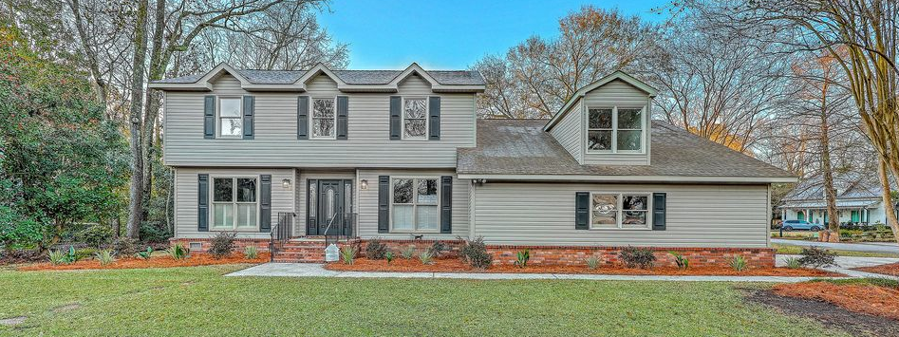
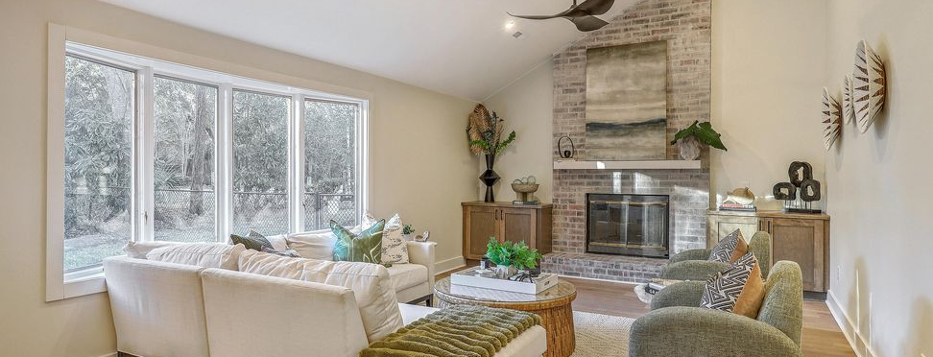
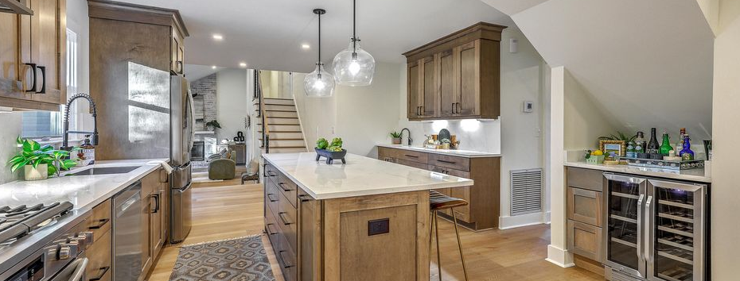

New Listing & Open House Friday from 4-6
JUS
9714 ROSEBERRY STREE
MOTIVATED SELLER!
/
7
1/
ii
Fully renovated and truly turnkey, 15 Windsor Drive is a rare offering in the highly sought-after Parkshore III neighborhood of Charleston, where homes rarely come to market.
15 Windsor Drive
Parkshore III | Charleston, SC 29407 | MLS# 26002064 | $1,200,000
�
$1,200,000
4 BED
3.5 BATH
3,000 SQ FT
0.24 ACRES
Positioned on a corner lot within a quiet cul-de-sac, this expansive ~3,000 SF home has been thoughtfully redesigned with modern finishes and a layout ideal for large families or multi-generational living. The heart of the home is the open, show-stopping kitchen featuring extensive custom cabinetry, stainless steel appliances, a 36'' gas range, prep sink, wine fridge, solid-surface backsplash, under-mount lighting, and a large island with seating, all overlooking the sunken family den. The den offers soaring vaulted ceilings, a focal-point brick fireplace, and easy access to a newly added powder room, creating an ideal space for everyday living and entertaining.
This home offers 4 bedrooms plus a spacious FROG with multiple closets, 3 full baths, and 1 half bath, including dual master suites, one upstairs and one downstairs. The downstairs ensuite doubles perfectly as a home office or guest suite. The upstairs master suite spans over 250 SF and features dual walk-in closets and a spa-like bath with dual vanities, water closet, and an oversized curb-less steam shower. Two additional upstairs bedrooms, a hall bath, convenient laundry room, and the flexible FROG, ideal for a media room, game room, or additional office, round out the second level.
Additional highlights include premium LVP flooring, abundant storage, a two-car garage, and a large rear deck perfect for entertaining. Ideally located just off I-26 with quick access to the airport, Park Circle, downtown Charleston, and more. Preferred lottery zoning for Orange Grove Charter School. A rare, fully updated home in a high-demand neighborhood - this one checks every box.
Scott Baskin
THE SCOTT BASKIN TEAM
843-324-4139
scott@explorecharlestonrealestate.com
SCOTT BASKIN TEAM

