Slide 1
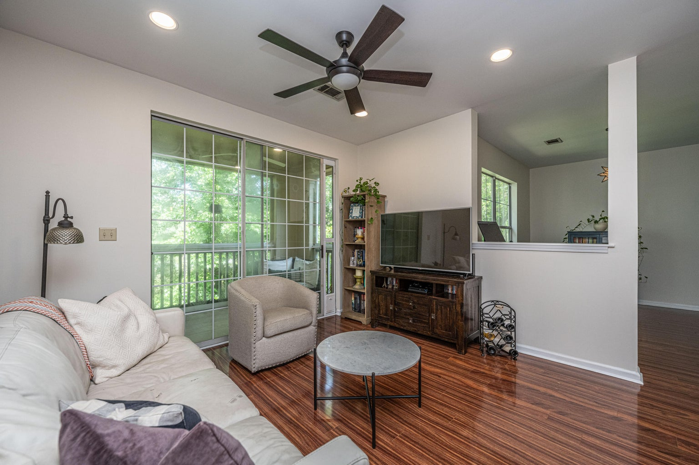
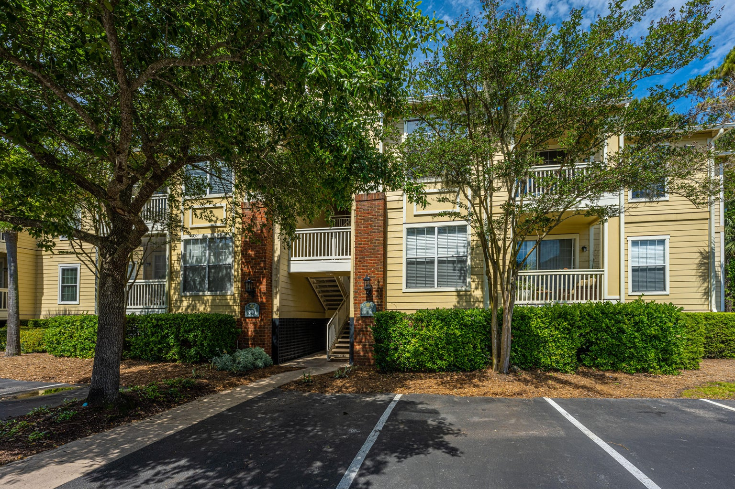
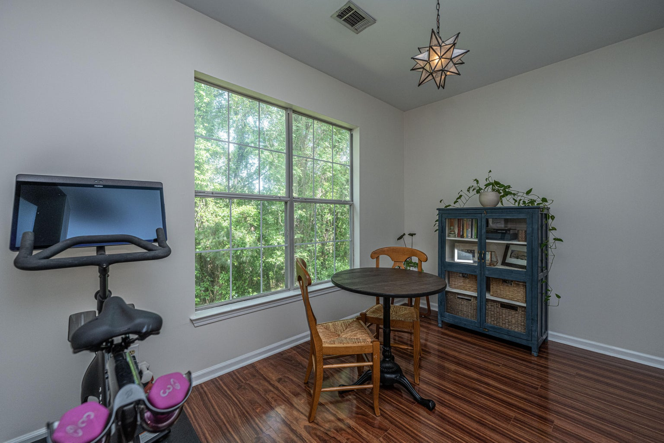
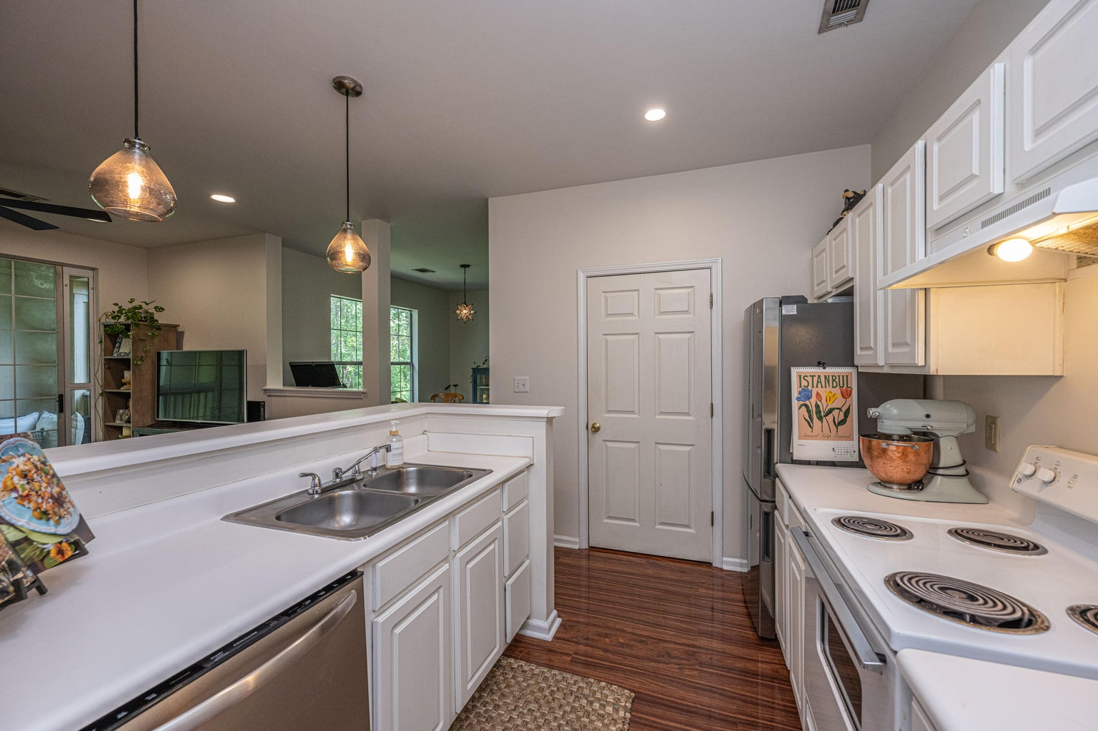
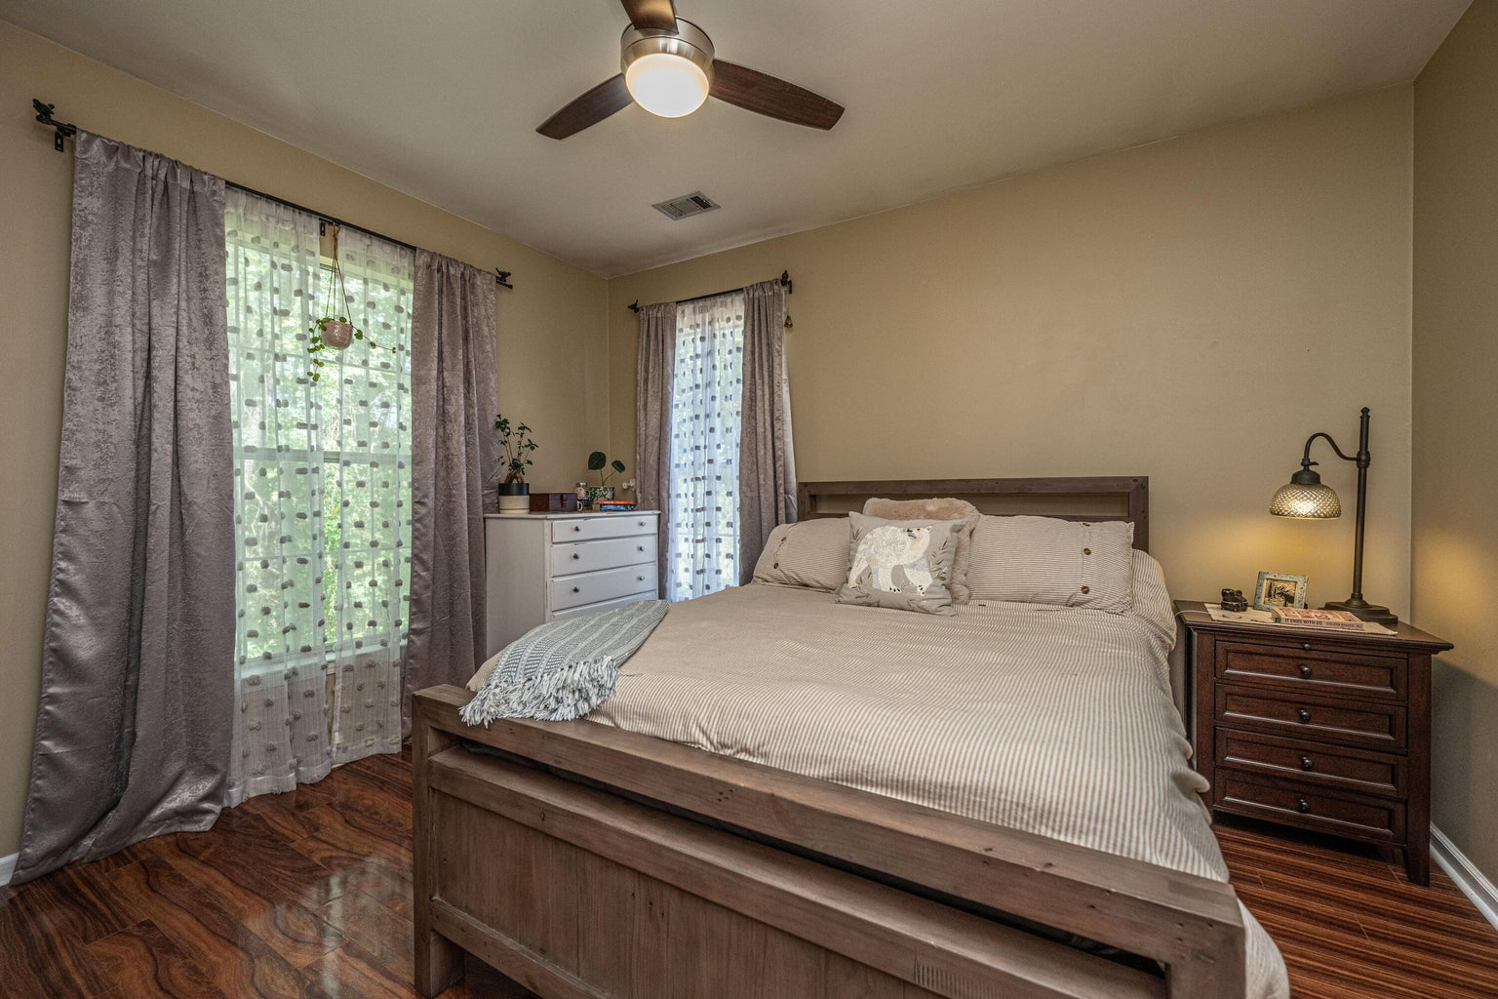



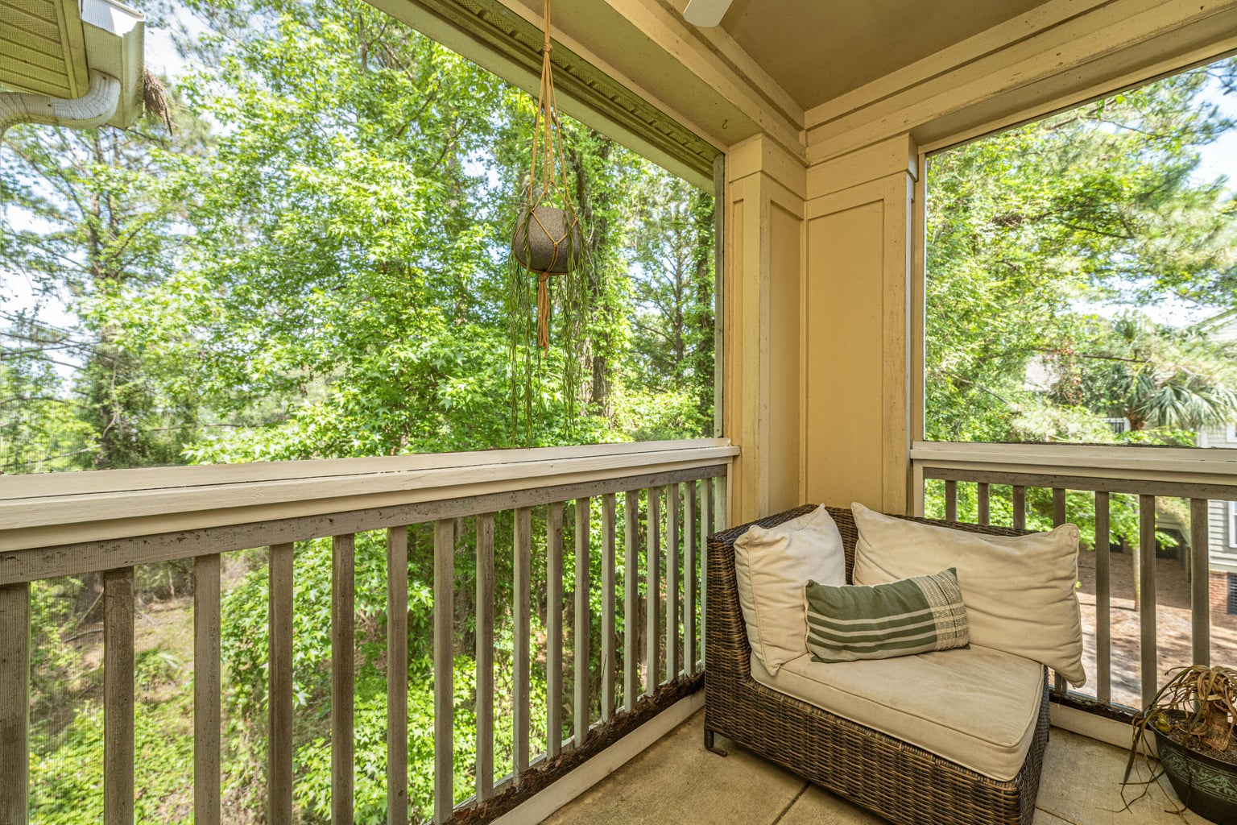
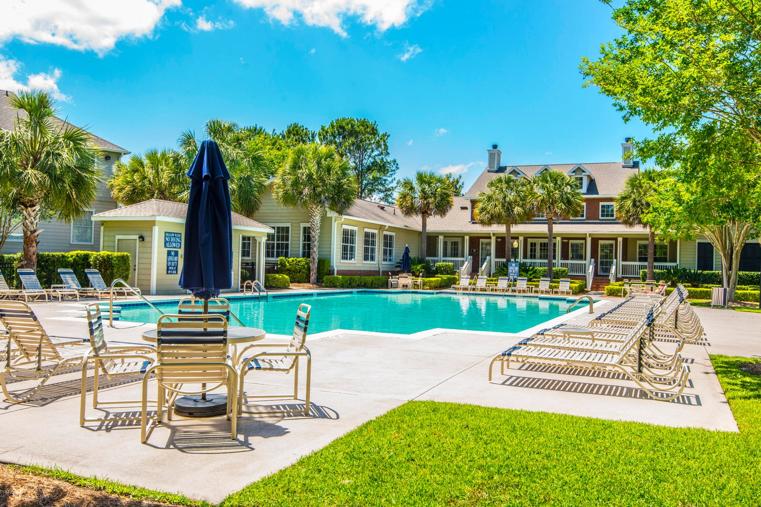


Perfect First-Time Buyer or Investment Opportunity
1600 Long Grove Drive #828
Long Grove | Mount Pleasant, SC 29464 | MLS# 23009068 | $315,000
Just Minutes to the Beach…and Steps to Dinner or Shopping.
Long Grove is the perfect spot for your buyer! This darling 1BR/1BA second floor condo has a private screen porch with a wooded view and extra storage. Inside is picture perfect with fresh paint, stunning laminate floors throughout, new tile in bathroom and newer appliances. Pretty yes but a great practical buy as well - NEW HVAC in 2022 and NEW WATER HEATER in 2021. Super cute and well maintained - feels and looks like new construction, but…
IT'S READY TODAY!
4
3
1,844
Geri Lipps
843-810-8398
glipps@carolinaone.com

