Slide 1
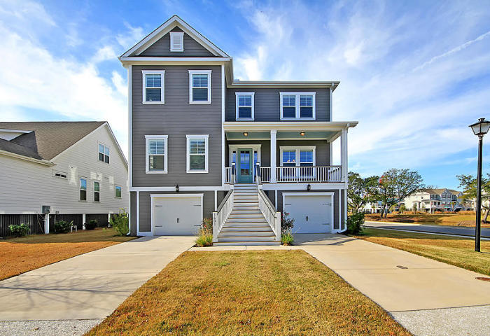
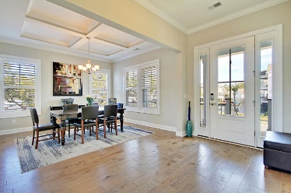
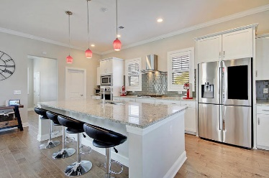
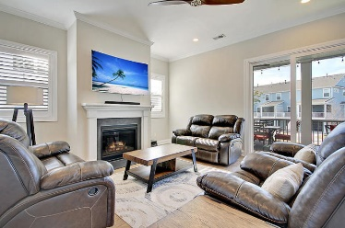
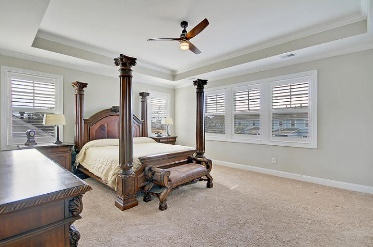
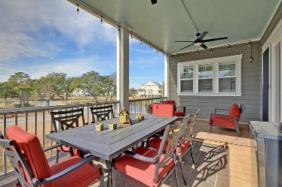
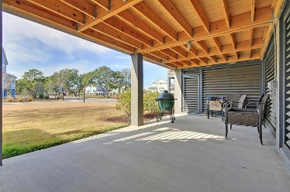
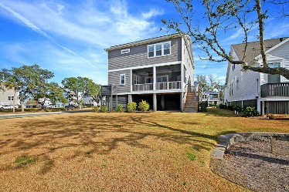
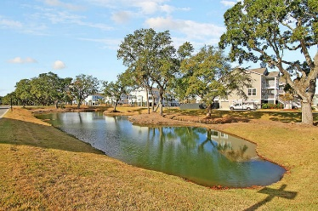

1601 Fort Palmetto Circle Oyster Point · Mount Pleasant, SC 29466 MLS# 19033655 · $770,000
Gorgeous Listing
Power $40 Month
POWER BILLS ARE About $40 a month on this STUNNING Elevated 5 bedroom, 3 full bath home that has wonderful views of beautiful ponds from front porch and dining room. The views are relaxing and ever changing, no matter the season. This spectacular home is better than new with plantation shutters throughout, handsome hardwood floors, heavy molding, coffered ceiling, natural light and a chef inspired gourmet kitchen that has an ENORMOUS granite island, glass subway tile backsplash, custom white cabinets, gas cooktop, custom hood, walk-in pantry, and stainless steel appliances! Additional features, oversized screened porch, fireplace in family room, huge expansive loft for second living area, office/flex area that could be 5th bedroom on main level with full bath. The large master suite retreat has a wall of windows, and spa-like bath with separate vanities, tiled shower, and large master closet. This home really has it all and is PERFECT for entertaining or relaxing on the screen porch with a beverage or a good book. Solar panels provide ridiculously low power bills for a 5 bedroom home. The garage has parking for three cars plus a golf cart, tons of storage, a gardening shed area under the front stairs, and a 1/2 bath that is very convenient when working outside or in the garage. Oyster Point in Mount Pleasant is a wonderfully landscaped community with a play park, tennis courts, community pool, club house, dock facilities, exercise room and with access to Fort Palmetto County Park! The neighborhood is close to local shopping and grocery stores and is a short drive to downtown Charleston with 5-star restaurants, world class shopping and iconic history as well as a short drive to the beaches, the airport, Boeing and Daniel Island. Come take a look because you will not find another home that offers as much as this one: a chef's delight and entertainer's dream! Call today to see!
Stan Huff
843-670-2835 stan.huff@agentowned.com
Jill Marcacci
843-297-5590 jill@agentowned.com
www.agentownedrealty.com
AgentOwned Realty Co. Preferred Group, Inc. | 824 Johnnie Dodds Blvd | Mt Pleasant, SC 29464

