Slide 1
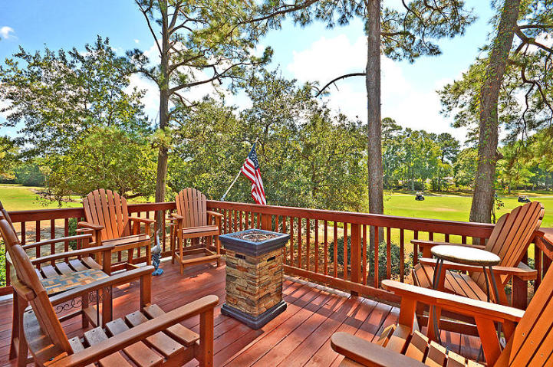
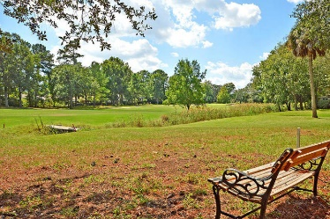
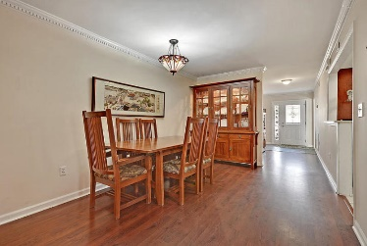
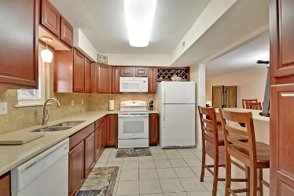
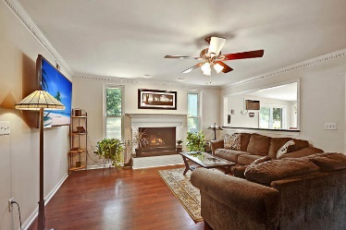
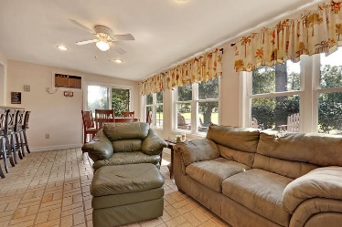
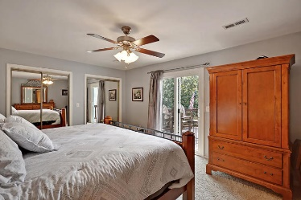
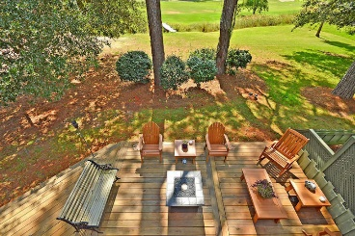
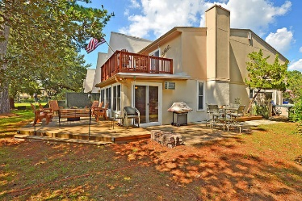

1601 Ventura Place
Snee Farm · Mount Pleasant · MLS# 18025934 · $315,000
CALLING ALL GOLFERS!!!
CALLING ALL GOLFERS!!!
Snee Farm Ventura Place End Unit Condo on GOLF COURSE with FANTASTIC PANORAMIC VIEWS and DOUBLE DECKS on the back! 3 bedroom 2.5 bath home that FEATURES GORGEOUS HIGH-END UPDATES and 2 yr. old HVAC! The gourmet kitchen has beautiful quartz countertops, custom cabinets to take advantage of all available space, breakfast bar, and leads to the laundry area with pantry and extra storage. The main level has a dining area, family room with fireplace, and bright and airy sunroom that overlooks the golf course. The deck off the sunroom is full sized and is perfect for entertaining friends and family by sitting around the fire-pit or playing cornhole. Upstairs the master bedroom suite has a huge deck that overlooks the golf course with sweeping scenic views and is perfect for a morning cup of coffee while watching golfers and listening to the birds. The ensuite bath has been updated and is IMPRESSIVE with STRIKING TILED shower, floors, and a new beautiful vanity. There are two additional large bedrooms upstairs that share a bath that has been completely renovated and is STUNNING! The tiled oversized shower is a must see. Snee Farm in Mount Pleasant is a wonderfully landscaped community with golf club membership available, clubhouse, community pool, and tennis courts! The neighborhood's location is ideal and is close to local shopping and grocery stores and is a short drive to downtown Charleston with 5-star restaurants, world class shopping and iconic history as well as a short drive to the beaches, the airport, Boeing, Volvo, and Daniel Island. Come take a look because you will not find another condo that offers as much as this one: a private backyard oasis on the golf course, and an entertainer's dream! Sqft includes converted sunroom.
Stan Huff
843-670-2835
stan.huff@agentowned.com
Jill Marcacci
843-297-5590
jill@agentowned.com
www.agentownedrealty.com
AgentOwned Realty Co. Preferred Group, Inc. | 824 Johnnie Dodds Blvd | Mt Pleasant, SC 29464

