Slide 1
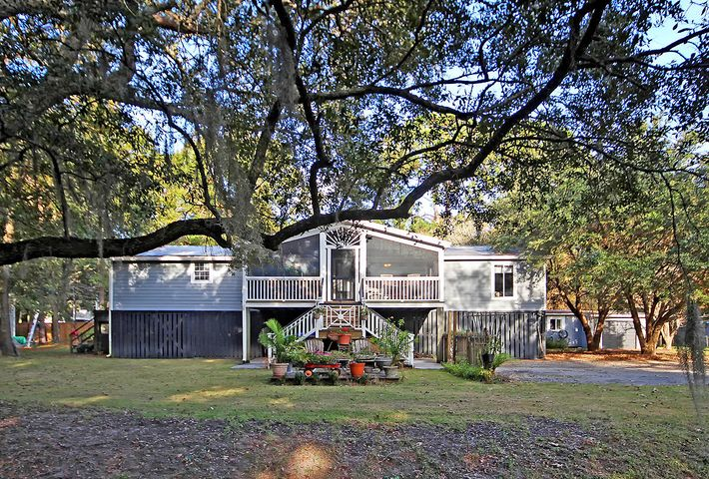
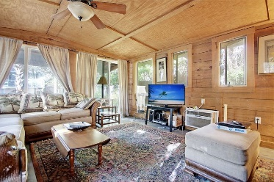
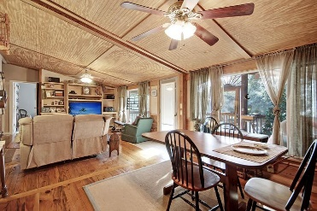
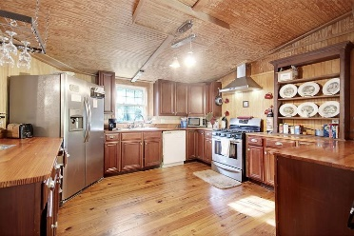
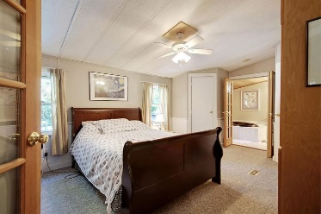
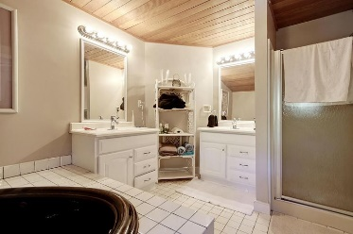
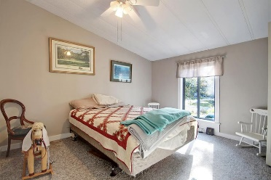
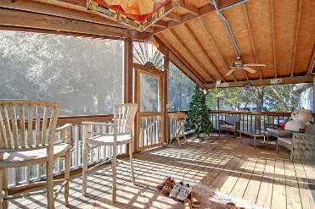
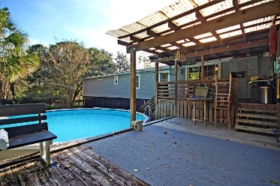

1601 Periwinkle Drive
Copahee View · Mount Pleasant, SC 29466
MLS# 20031836 · $290,000
Gorgeous Listing
Great Cash Flow
Investors Opportunity CASH or Owner MAY Finance For a Qualified Buyer WIth 50% down payment. Terms TBD. The property has the following: 1600 square foot mobile home that is in good condition, a small Accessory Dwelling unit that is currently rented for $1000 a month guaranteed until February 2022. The ADU was not permitted as far a the current owner knows. He did not build the structure.
The property is in good condition, but the seller is selling as is where is. The HVAC System was installed in the MH on 10/2019. The Flood Zone is going to improve when the new FEMA map is adopted. The current owner self insures but thinks he may have an elevation certificate.
Take a video tour: https://vimeo.com/483881833
Stan Huff
843-670-2835
stan.huff@agentowned.com
Jill Marcacci
843-297-5590
jill@agentowned.com
www.agentownedrealty.com
AgentOwned Realty Co. Preferred Group, Inc. | 824 Johnnie Dodds Blvd | Mt Pleasant, SC 29464

