Slide 1
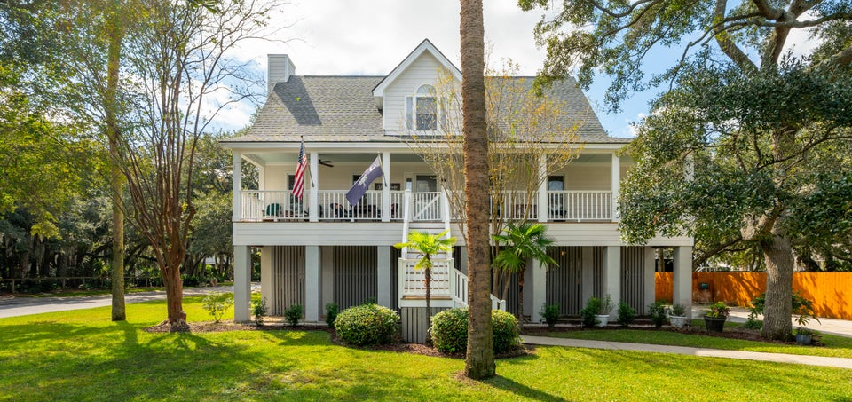
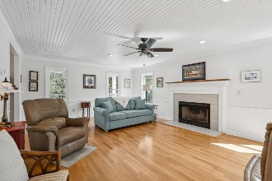
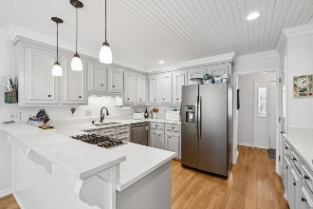
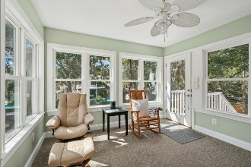
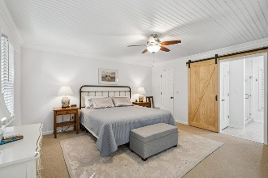
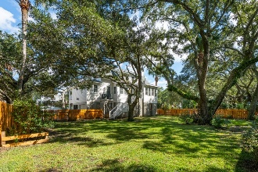
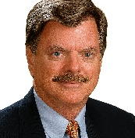

Just Listed
1602 Charlotte Circle
Home Farm | Mount Pleasant, SC 29464 | MLS# 25028650 | $1,395,000
SELLER IS OFFERING 3% BUYER AGENT COMMISSION
Presenting an opportunity to acquire a corner interior lot in the highly sought-after Home Farm neighborhood, known for its convenient location just off Ben Sawyer Blvd. NEW ROOF, NEW HVAC & DUCTWORK 1st level, NEW PEX PLUMBING. This charming ''Southern Living Lowcountry Cottage'' features a welcoming full front porch and includes primary bedroom w/updated bath on the 1st level, w/walk-in shower, double vanity & closet. The 1st level has bead board ceilings throughout w/complementary crown molding. The kitchen boasts gas cooktop, granite countertops w/similar finishes in the primary & 1/2 baths The dining area offers counter seating, while the sunroom, provides picturesque views of the oak and palmetto trees in the newly re-fenced backyard.
The living room has a fireplace plumbed for propane gas. The second level comprises two additional bedrooms, a shared bath with tub/shower combo, home office/study space, linen closet, an extra clothing closet, 4 storage areas, with additional opportunities for customization.
Seller is a licensed SC real estate agent.
Randy Espeseth
843-743-1025
randy@randyehomes.com
www.randyehomes.com
Carolina Elite Real Estate | 706 N Cedar St | Summerville, SC 29483

