Slide 1
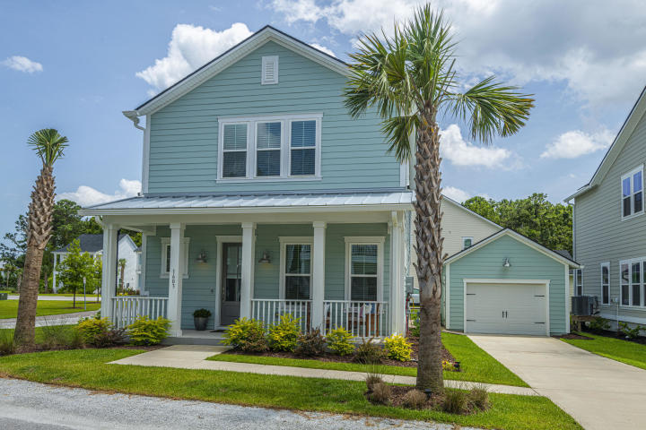
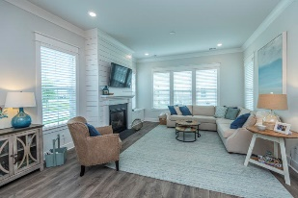
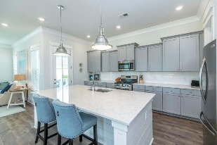
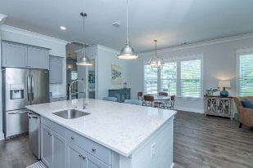
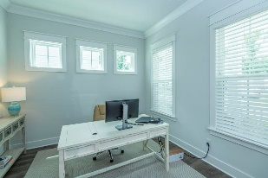
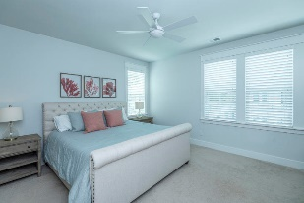
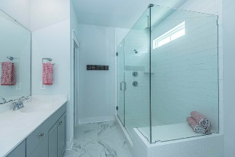
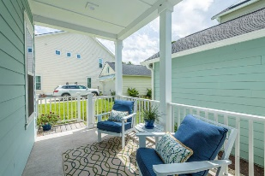
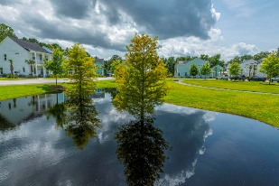


1603 Bombora Alley Sea Aire :: Charleston, SC 29412 :: MLS# 20017679 :: $448,000
James Island Almost New
Rare opportunity in award winning solar community of 24 homes. Just 4 miles to Folly Beach and 5 miles to downtown Charleston. Sea Aire's standout environmental features include preserved grand oak trees and native plantings among community gardens, compost bins, storm water filtration systems, and pervious grass pavers. Corner lot, light-filled home overlooks the picturesque green space & nautical themed playground. Open floor plan with separate office/playroom on 1st floor. Gray cabinets with white quartz & subway tile complete the kitchen. Mst bath has frameless shower with upgraded rainhead shower. Outdoor living space extends into the finished garage perfect for Ping Pong and paddleboard storage. Owner added numerous upgrades including finished interior garage, gutters and landscaping built in cabinets & shelves. Home features Amazon integration with Alexa voice controls to make the most out of Wi-Fi CERTIFIED" smart features. A $2200 Lender Credit is available and will be applied towards the buyer's closing costs and pre-paids if the buyer chooses to use the seller's preferred lender. This credit is in addition to any negotiated seller concessions.
Jeanne Jamme
(843) 343-1934 M
jjamme@carolinaone.com www. carolinaone.com

