Slide 1
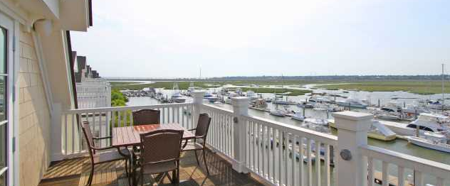
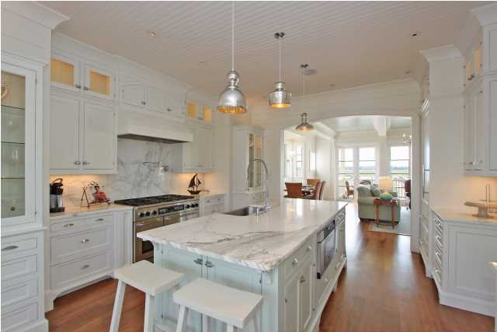
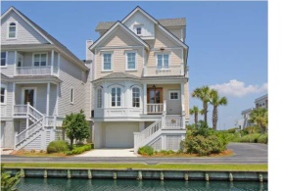
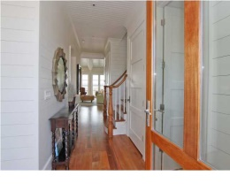
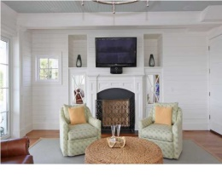
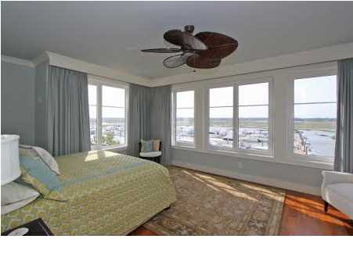
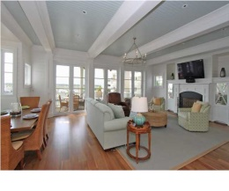
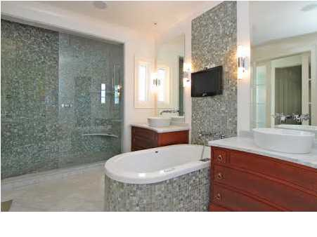
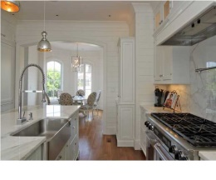
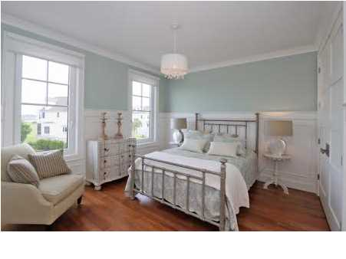
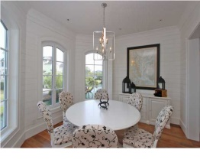
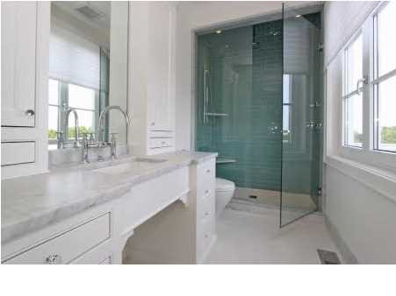
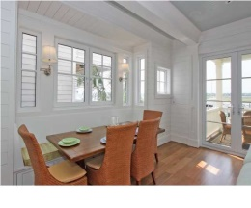
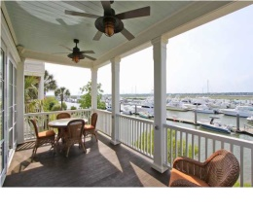


Back on the Market!!
1603 Marsh Harbor Ln
Marsh Harbor - Mt Pleasant
MLS# 1415462 - $1,598,000
The newest available & arguably the most upscale home in Marsh Harbor-featured in design magazine-built by Kirk Wood with exquisite attention to detail & design -even maintained annually for owner by the builder himself*Elevator from garage to top floor*Top of the line kitchen-Calcutta gold marble countertops, beautiful custom white cabinets, shiplap white board walls and bead board ceilings painted in subtle beach tones*Dacor gas stove w/potfiller, Fisher-Paykel 2 drawer dishwasher, Grohe fixture*Hardware & lighting package is stunning*No expense has been spared on the baths which include glass tiles in the master curved shower and an air bath tub. Private Master suite with 180 degree views*Windows are every where in this home with a different view in every direction. Wood & marble floors throughout*Spacious secondary bedrooms have private baths*Media room on top floor with wet bar, bath & sundeck-plus private bedroom*Steps from boats in Tolers Cove Marina*Plenty of garage room for cars, "toys" & BBQ-walls that open to take advantage of views & breezes*Deeded boat slip available for purchase separately*You must see this home to appreciate its upscale design & detail.
Sheila Romanosky
(843) 224-0242
sromanosky@carolinaone.com

