Slide 1
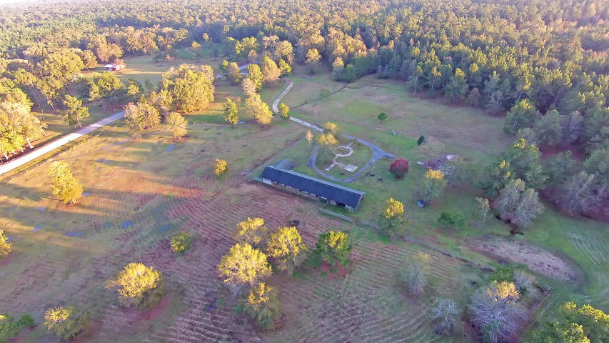
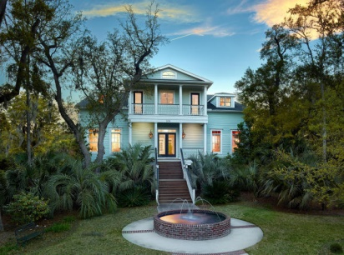
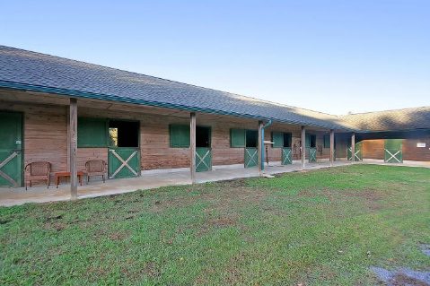
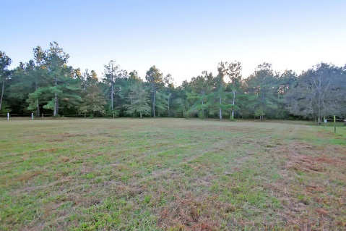
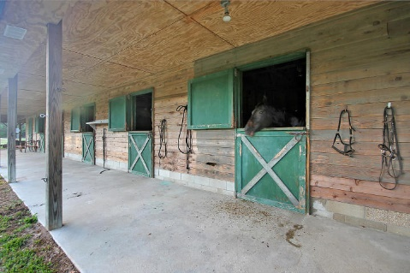
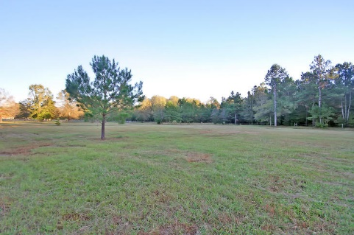
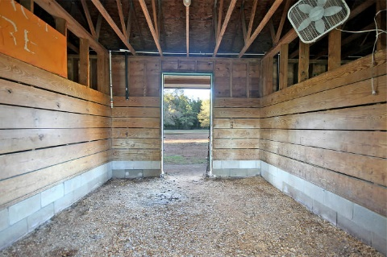
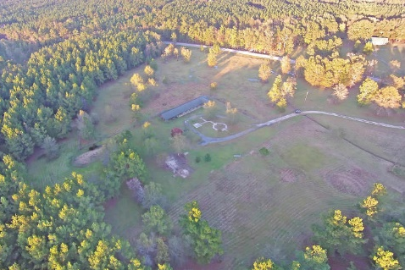
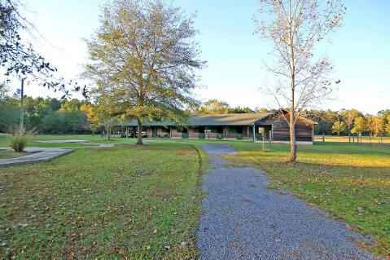
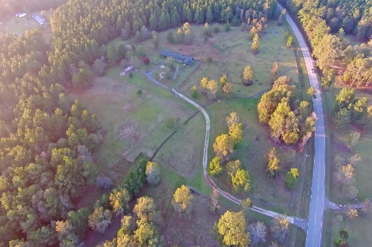
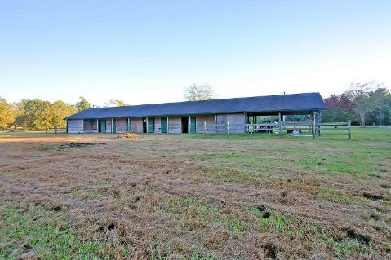
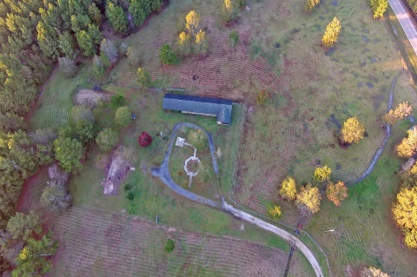

Equestrian Acreage
1603 Santee River Road
Saint Stephen, SC 29479 ~ MLS# 15027908 ~ $265,000
Have you been waiting for the ideal property to make your equestrian dreams a reality? This 30+ acre property comes with around 20 acres of fenced paddocks and over 10 acres of riding trails through the towering trees.
A long winding driveway leads to the circular drive revealing a beautiful six stall barn complete with tack rooms and open tractor bays. The ideal accommodations for your four legged friends.
The land has been cleared, perced and has utilities ready for your custom home to be built. Located in the Francis Marion National Forest, you’re just 15 minutes to Moncks Corner and have access to endless riding/hiking trails that will lead you to the peaceful Santee River.
When it comes to having a private retreat for you and your horses, it doesn’t get much better than this.
Nate Gainey nate@mattoneillteam.com 843-513-2038

