Slide 1
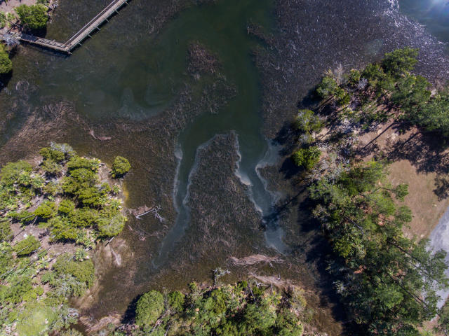
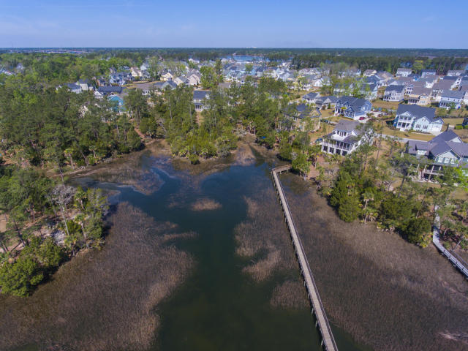
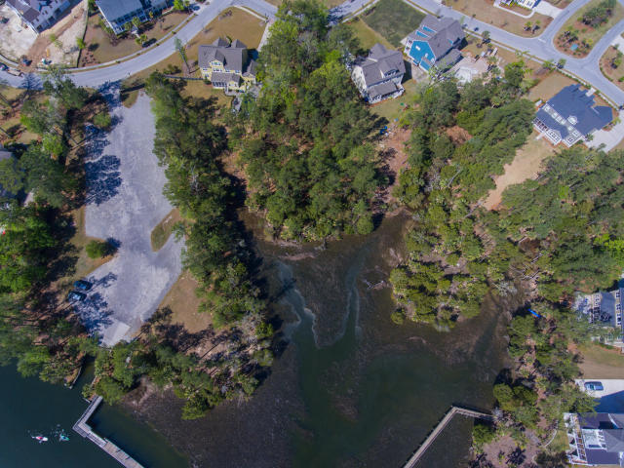
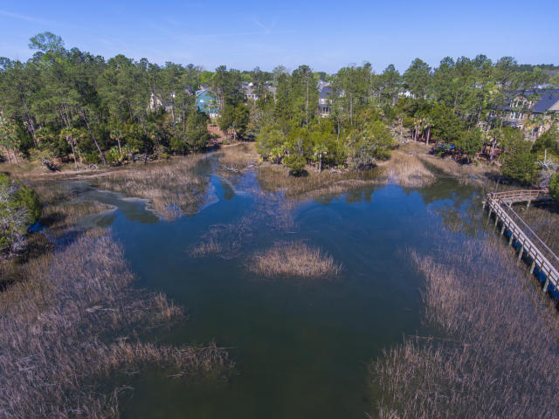

1604 Catamaran Court
Dunes West | Mount Pleasant, SC 29466
MLS# 17006217 | $479,000
Price Reduction
in Park West
$775,000
Beautiful Waterfront Lot in Dunes West
One of the largest marsh and water front lots in gated community of Dunes West. (.88 of an acre) Located on Wagner Creek tucked away from traffic but very close to boat ramp. Enjoy the beautiful trees and nature on this tidal creek. Just a few minutes from Country Club, Award winning Golf Course, multiple pools, tennis club, work out facility, and walking trails.
Stan Huff
843-670-2835
stan.huff@agentowned.com
Margaret Wannamaker
843-364-5851
wannamom66@gmail.com
www.agentownedrealty.com
AgentOwned Realty Co. Preferred Group, Inc. | 824 Johnnie Dodds Blvd | Mt Pleasant, SC 29464

